Slide 1
Chapter 5:
Protein Dynamics

Slide 2
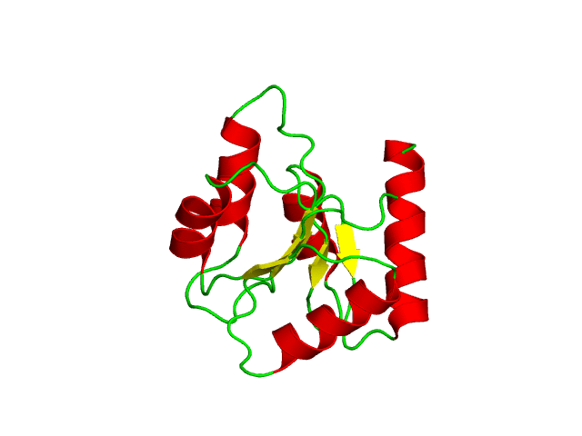
Overview
Proteins dynamics is functionally important
Dynamics results from motions around single bonds
Dynamics is diverse:
Time: 10⁻¹⁵-10⁴ sec
Amplitude: 0.01-100 Å
Backbone dynamics of chemotaxis Y protein (46 NMR structures)
Notes:
Figure 5.5. Backbone dynamics of folded proteins. The conformational dynamics of chemotaxis Y protein is illustrated by superimposing 46 allowed conformations of the single protein, solved by NMR (PDB entry 1cey). The structures are colored according to secondary structure (helices are red, sheets are yellow, and loops are green).

Slide 3
Overview
Dynamics is driven by the thermal energy in the surroundings
Dynamics can be affected by external factors:
Environmental conditions (pH, temperature)
Ligand binding
PTMs
Backbone dynamics of chemotaxis Y protein (46 NMR structures)

Slide 4
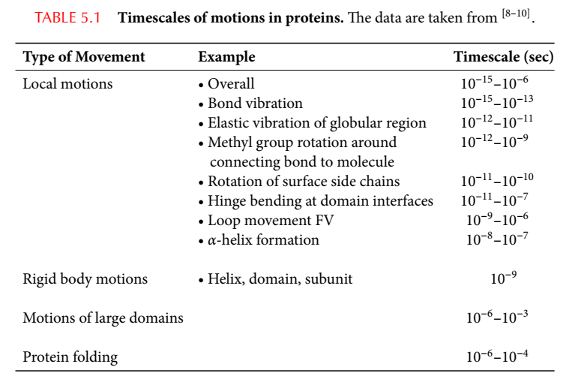
Types of motions in proteins
4
Notes:
Table 5-1. Timescales of motions in proteins. The data is taken from:
1. Zhong, D. (2007) Ultrafast catalytic processes in enzymes. Curr Opin Chem Biol. 11: 174-81.
2. Benkovic, S.J. and Hammes-Schiffer, S. (2003) A perspective on enzyme catalysis. Science. 301: 1196-202.
3. Akke, M. (2002) NMR methods for characterizing microsecond to millisecond dynamics in recognition and catalysis. Curr Opin Struct Biol. 12: 642-7.

Slide 5
Correspondence to biological processes
Fast vibrations/motions in enzymatic catalysis
Making/breaking of covalent bonds (10⁻¹⁴-10⁻¹⁰ sec)
Formation of hydrogen bonds (10⁻¹²-10⁻¹⁰ sec)
Electrons/protons/hydride ions transfer (10⁻¹² sec)
Electron tunneling (10⁻⁹-10⁻⁴ sec)
Water molecules reorganization (10⁻⁸ sec)
Notes:
The simplest proof that dynamics is crucial for protein activity is that cooling the protein diminishes activity. In addition, discrete motions of residues and larger protein parts are deeded for specific events in protein activity, such as opening/closing of binding/active sites, reorientations of sidechains for catalysis, etc.

Slide 6
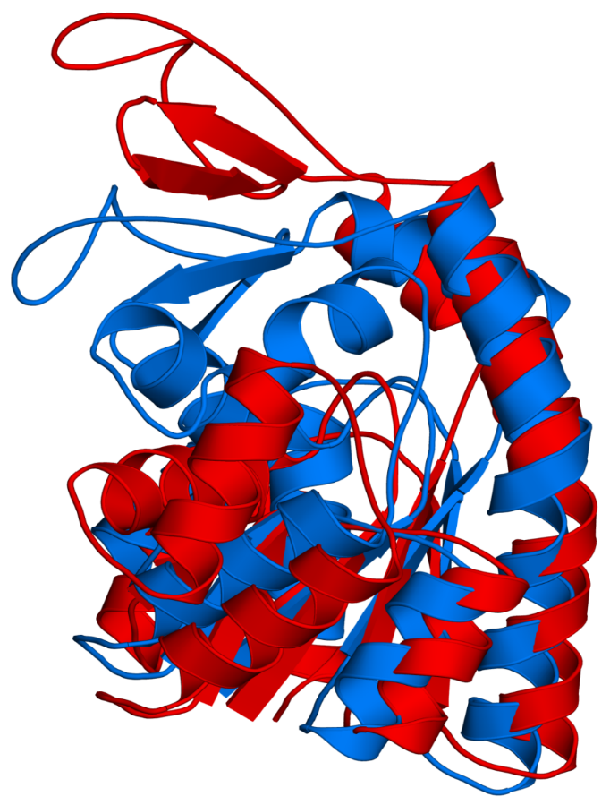
Correspondence to biological processes
Motions of side-chains, 2nd elements, and domains
Proton transport (10⁻⁹-10⁻⁴ sec)
Ligand binding (10⁻⁸-10¹ sec)
Single residues: positioning of residues around ligand
Segments: opening/closing of gating loops (e.g. hinge motion)
Local denaturation (10⁻⁵-10¹ sec)
Allostery (10⁻⁵-10⁰ sec) – often by changing the availability of the active site (e.g. by hinge motion)
Hinge motion
(molmovdb database: http://www.molmovdb.org)
Notes:
The simplest proof that dynamics is crucial for protein activity is that cooling the protein diminishes activity. In addition, discrete motions of residues and larger protein parts are deeded for specific events in protein activity, such as opening/closing of binding/active sites, reorientations of sidechains for catalysis, etc.
Figure 5.1. Hinge motion in adenylate kinase. The motion of the loop in the upper-left region is illustrated by superimposition of the two conformations of the proteins (PDB entries 2eck, 4ake). The hinge region is circled.

Slide 7
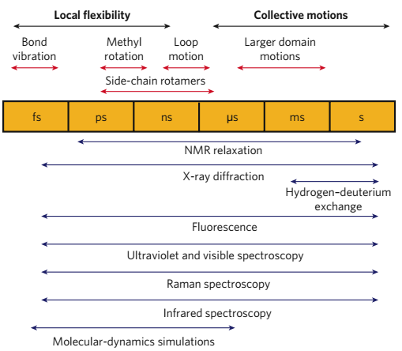
Different motions require different methods
Nature (2007) 450: 964-972

Slide 8
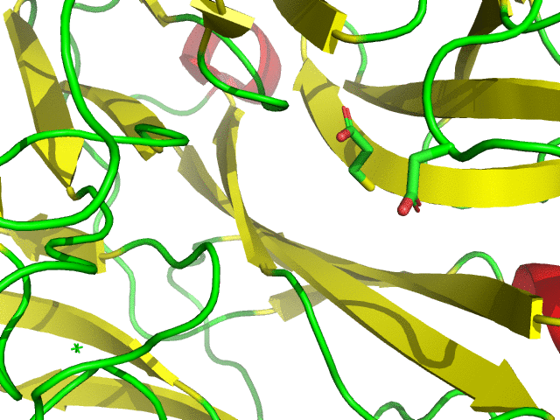
Theories on protein dynamics
Induced fit theory (Koshland 1959)
Proteins can adapt their structure to bound ligand
Small-scale induced fit of neuraminidase following Tamiflu binding
Notes:
The notion that proteins are inherently dynamic was not always recognized; At first it was thought that conformational changes in proteins are induced by ligand binding.
Conformational change in N1 neuraminidase following the binding of Tamiflu, a sialic-acid analogue (structures: 2hty, 2hu4).

Slide 9
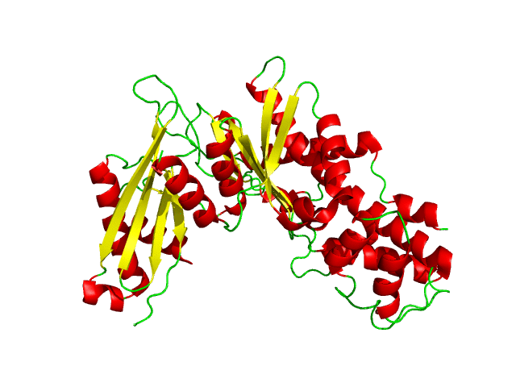
Theories on protein dynamics
Induced fit theory (Koshland 1959)
Proteins can adapt their structure to bound ligand
Large-scale induced fit of glucokinase following glucose binding
Notes:
Conformational change in glucokinase following the binding of glucose (structures: 1v4t, 1v4s).

Slide 10
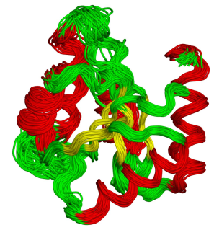
Theories on protein dynamics
Pre-existing equilibrium (MWC) theory (Monod et al., 1965)
Ligand-free proteins can exist in two different equilibrium conformations
Conformational selection theory
Proteins are in equilibrium between many different conformations/substates (ensemble)
Notes:
Actually, Linus Pauling preceded Monod in suggesting a pre-existing equilibrium; In 1940 he proposed that antibodies might acquire different configurations with identical energies. This implied that proteins could undergo conformational changes in the absence of bound ligand or substrate. Unfortunately, Pauling did not turn his idea into a detailed model.
Figure 5.5. Backbone dynamics of folded proteins. The conformational dynamics of chemotaxis Y protein is illustrated by superimposing 46 allowed conformations of the single protein, solved by NMR (PDB entry 1cey). The structures are colored according to secondary structure (helices are red, sheets are yellow, and loops are green).

Slide 11
Theories on protein dynamics
Currently accepted theory
The transition between the substates is driven by the surroundings’ thermal energy (k_{B}T), converted to kinetic energy (K) and then to atomic motions and bond vibrations:
K ∝ k_{B}T = ½mv²
Average kinetic energy
velocity
mass
* The energy available for 1 mol of proteins is RT = 0.6 kcal/mol (25 °C). k_{B}T is the energy available for one molecule (k_{B}T = RT/N_{A})
Notes:
More accurately, in monatomic ideal gases: K=3/2k_{B}T. This is because there are three independent directions a molecule can move, for each the average energy is ½ k_{B}T.
The Boltzmann constant (k_{B}) is 3.3∙10^{–24} cal·K⁻¹. The corresponding constant for one mol (R) is 1.989 cal·mol⁻¹·K⁻¹. It is, in fact, k_{B} multiplied by Avogadro’s number (6.022×10²³ mol⁻¹).

Slide 12
Theories on protein dynamics
Currently accepted theory
The probability (P) to acquire each conformation depends on its energy (ΔG):
The native conformation has the lowest energy → most populated
Other conformations are also sampled frequently, as long as they are within the RT range (energy ≤ 0.6 kcal higher than that of the native structure)
Ligand binding may stabilize higher-energy conformations
P ∝ e ^{(-ΔG/RT)}
Notes:
ΔG is the energy difference between the current conformation and the energy of a reference conformation (e.g. the previous one). Thus, it represents the probability of the transition process from the previous to the current conformation.
The assumption that the native state has the lowest energy relies on the fact that different methods and conditions produce the same structure for any specific protein.

Slide 13
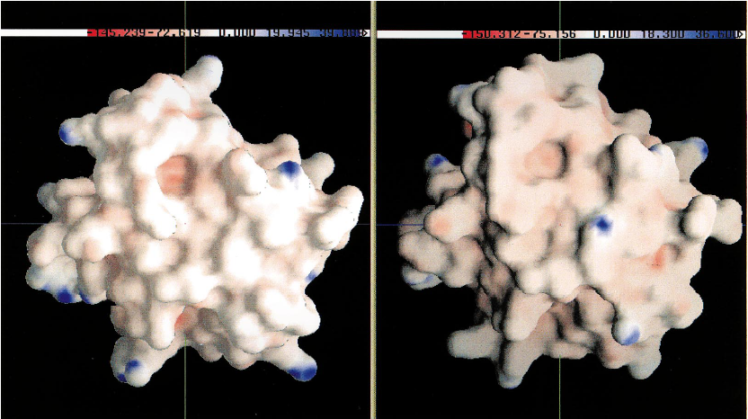
The biological significance of thermally-induced conformational changes
Changing active site properties
Conformational change → change in ε → change in Φ
Cytochrome c
J. Phys. Chem. (1998) 100: 10793
Notes:
Thermally induced motions are often small (compared to those induced by ligand binding or PTM), but they can still affect biological properties of the proteins.
Figure 5-6. Electrostatic differences between two similar microstates. The figure shows the electrostatic potential of two microstates of cytochrome c, generated using molecular dynamics simulations. Although highly similar in conformation, the potential of certain regions may differ significantly (e.g. see circled region).

Slide 14
The biological significance of thermally-induced conformational changes
Facilitating substrate diffusion into buried active site
ps-ns ‘breathing’ → transient voids from surface to core
Amplifying short thermal fluctuations
Cooperative ps-ns motions → larger, μs-ms motions (e.g. active site opening)

Slide 15
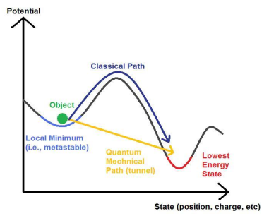
The biological significance of thermally-induced conformational changes
Optimization of quantum tunneling events
H⁺/H⁻/H∙ may transfer between protein/ligand groups despite large energy barriers, by QM tunneling
Cranberry (2008) Wikimedia (URL)
Notes:
Figure 5-7. Quantum tunneling. (a) Quantum tunneling vs. classical movement of a hydrogen atom between a hypothetical protein donor (X) and an acceptor (Y), depicted as the crossing of an energy barrier.

Slide 16
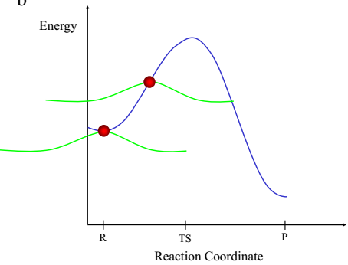
The biological significance of thermally-induced conformational changes
Optimization of quantum tunneling events
Mechanism: H only has to gain sufficient energy to reach the point when its wavelength exceeds the barrier’s width
X-H-Y
X-H Y
X H-Y
Notes:
(b) Explanation of quantum tunneling based on the wave properties of the reactant (i.e., the transferred hydrogen). The potential energy of a hydrogen reaction is depicted along the reaction coordinate (R - reactants, TS - transition state, P - products). The mean, most probable location of the hydrogen particle along the reaction coordinate is specified by the red sphere, and its probability distribution is represented by the green curve. As the plot shows, even when the hydrogen particle has only enough energy for 'climbing' halfway to the top of the energy barrier, it has a finite probability to appear at the other side of the barrier and complete the transfer.

Slide 17
The biological significance of thermally-induced conformational changes
Optimization of quantum tunneling events
Coupled vibrations (fs-ps) increase tunneling probability by optimizing geometric-electrostatic factors
X-H-Y
X-H Y
X H-Y
Notes:
(b) Explanation of quantum tunneling based on the wave properties of the reactant (i.e., the transferred hydrogen). The potential energy of a hydrogen reaction is depicted along the reaction coordinate (R - reactants, TS - transition state, P - products). The mean, most probable location of the hydrogen particle along the reaction coordinate is specified by the red sphere, and its probability distribution is represented by the green curve. As the plot shows, even when the hydrogen particle has only enough energy for 'climbing' halfway to the top of the energy barrier, it has a finite probability to appear at the other side of the barrier and complete the transfer.

Slide 18
External factors may affect dynamics
Which factors?
Ligand binding (allostery)
Post-translational modifications
Environmental factors (pH, temperature, etc.)
Mutations

Slide 19
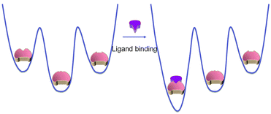
External factors may affect dynamics
Mechanism: biasing the conformational equilibrium towards certain conformations by changing the energy landscape of the protein
most stable
most stable
Phys Chem Chem Phys. (2014) 16:6332-41

Slide 20
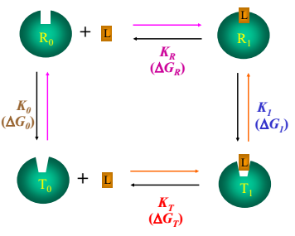
The ligand effect and allostery
The ligand effect
The ligand binds preferably to a protein conformation and stabilizes it via noncovalent interactions
The binding biases the natural equilibrium towards the this conformation
Notes:
The selective binding of the ligand to a certain conformation results from the fact that this conformation has a lower energy when ligand-bound, whereas others have lower energy when unbound.
Figure 5-9. Schematic illustration of the mechanism of allosteric ligands. (b) A thermodynamic cycle describing the path from the free low-affinity conformation (T₀) to the ligand-bound, high-affinity conformation (R₁) (orange path). T and R are the low-affinity and high-affinity conformations, respectively. L is the ligand. 0 and 1 note the ligand-free and ligand-bound states, respectively. The path may proceed via the ligand-bound low-affinity conformation (T₁) (orange path) or the free high-affinity conformation (R₁) (magenta path). The equilibrium constants (K) and related free energy changes (ΔG) associated with each step of the cycle are noted in different colors.

Slide 21
The ligand effect and allostery
Allostery
Definition: activity at the primary site is affected by ligand binding to a different site (allosteric site)
Exists in enzymes, receptors, channels, transporters, etc.
Used by cells to regulate biological processes (e.g. product inhibition, signaling-induced)
Notes:
Figure 8.1. (b) Allosteric regulators. The figure shows the protein fructose-1,6-bisphosphatase with 2,5-anhydro-D-glucitol-1,6-bisphosphate (AHG, an analogue of its substrate), and AMP (an allosteric inhibitor) (PDB entry 1fpd). As can be clearly seen, the allosteric ligand occupies a distinct binding site, which is quite distant from the catalytic site.

Slide 22
The ligand effect and allostery
Allostery
How it works: allosteric activators stabilize the active conformation(s); inhibitors stabilize the inactive one(s) - conformational selection model
inhibitor
activator
c
inactive
active
substrate
Allosteric regulation by changing active site fit to substrate
Notes:
Figure 5-9. Schematic illustration of the mechanism of allosteric ligands. (c) The effect of positive and negative allosteric ligands. Both types of ligands act as in (a), but they bind to different conformations, the first is inactive due to a substrate-incompatible binding site, and the second is active due to a substrate-compatible binding site, respectively.

Slide 23
The ligand effect and allostery
Allosteric regulators may stabilize multiple conformations of the ensemble

Slide 24
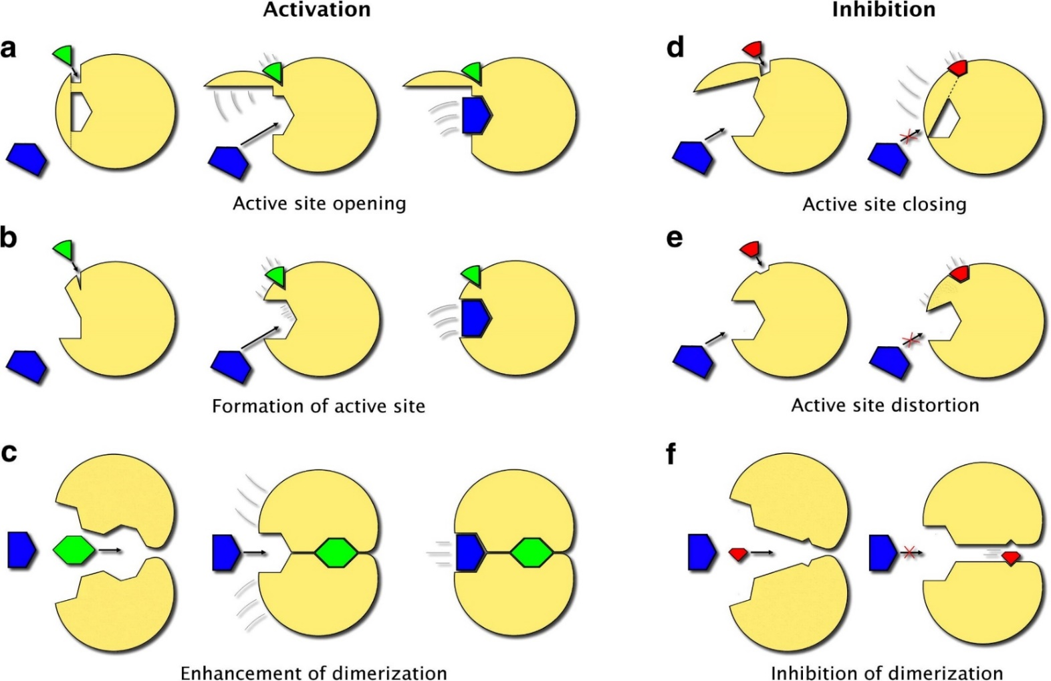
The ligand effect and allostery
Allosteric regulation may act on different levels (active site, oligomerization)
d
I
IV
II
V
III
VI
FEBS Lett. (2009) 583: 1692-8
Notes:
Figure 5-9. Schematic illustration of the mechanism of allosteric ligands. (d) Specific mechanisms of allosteric activators and inhibitors, affecting active site accessibility, active site shape, and oligomerization capability.

Slide 25
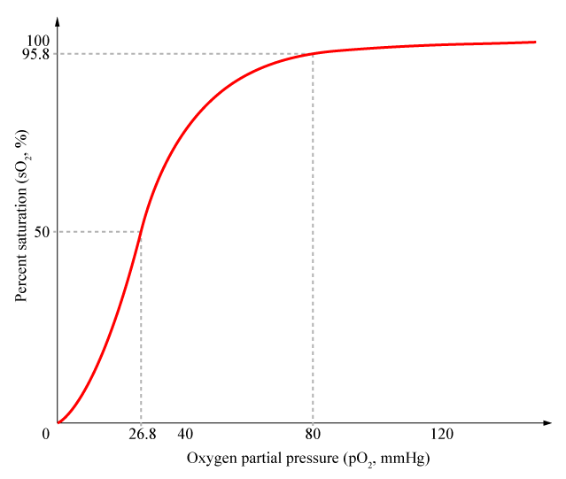
Allostery in hemoglobin
Hemoglobin displays cooperative binding of oxygen
Lungs
Tissues
Notes:
Box 5-3 Figure 2. Hemoglobin-oxygen binding curve. The curve describes the dependence of the binding (represented by the % saturation) on the oxygen's concentration (represented by its partial pressure). In the lungs, high oxygen concentration leads to strong binding, whereas in peripheral tissues the binding is weak due to low oxygen concentrations. Furthermore, the sigmoid shape of the curve indicates positive cooperativity in oxygen binding.

Slide 26
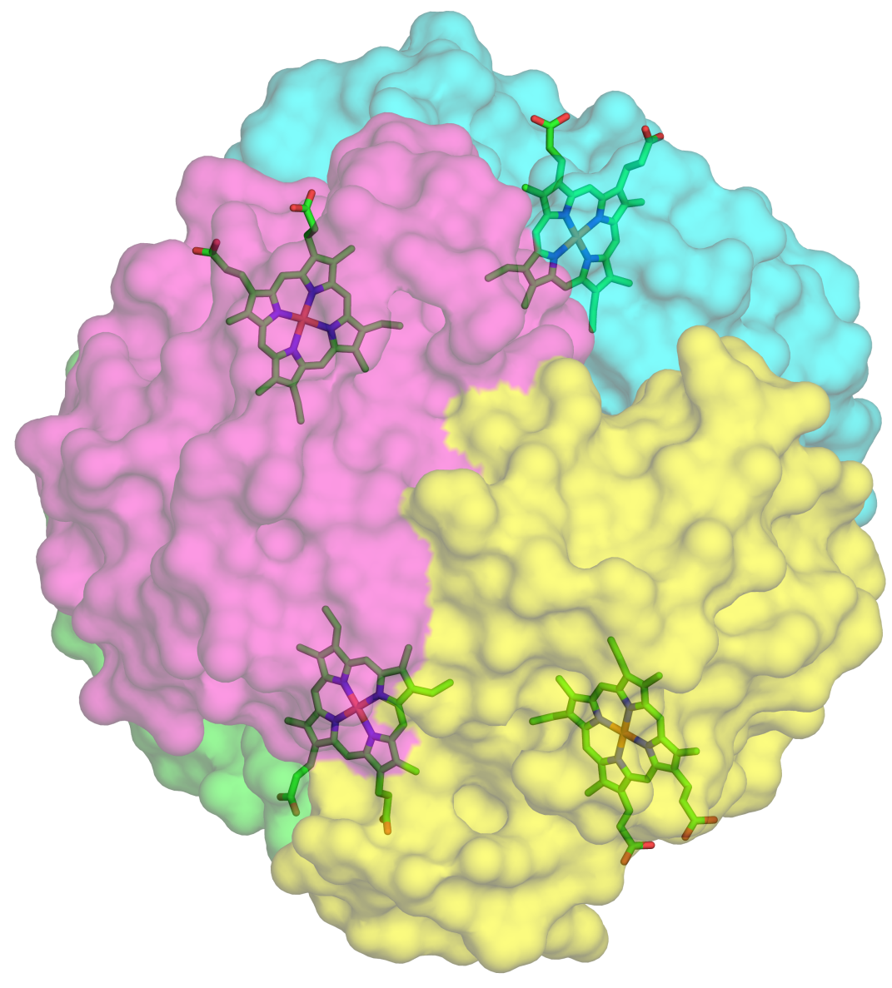
Allostery in hemoglobin
Hemoglobin has 4 subunits and binds oxygen using prosthetic groups
a
Notes:
Box 5-3 Figure 3. Hemoglobin structure. (a) The four subunits are marked with different colors and the heme groups are shown in bond-sticks models. (PDB, entry 1sfx).

Slide 27
Allostery in hemoglobin
The heme group includes a porphyrin, which contains the oxygen-binding iron
Oxygen
b
Pyrrole ring
Notes:
(b) Structure of the heme group (PDB entry 1hho). Atoms are colored by type, with the Fe²⁺ ion colored in gray. The location of the bound oxygen molecule is marked.

Slide 28
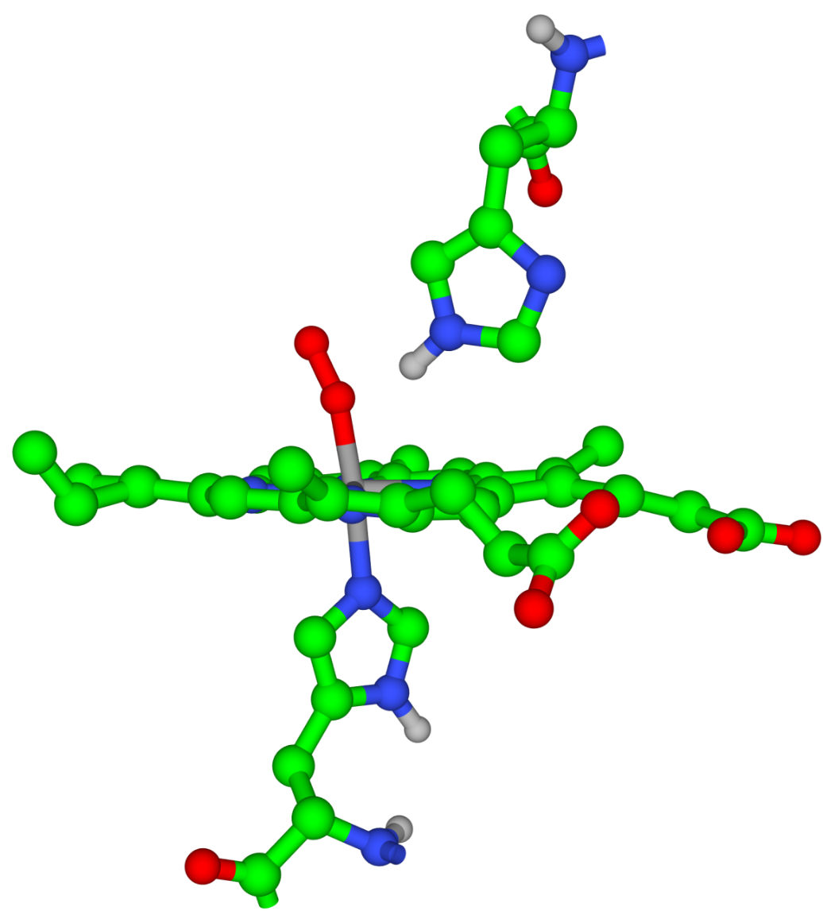
Allostery in hemoglobin
The distal His lowers the risk of carbon monoxide poisoning
c
Distal His
Proximal His
Notes:
(c) Proximal and distal histidine residues in hemoglobin.

Slide 29
Allostery in hemoglobin
Hemoglobin exists in two different states:
Deoxy – has low oxygen affinity
Oxy – has high oxygen affinity
Each state has a different quaternary structure
Max Perutz
Notes:
Box 5-3 Figure 4. Max Ferdinand Perutz (1914-2002), Nobel Prize laureate in Chemistry, 1962. Perutz, who determined the structure of hemoglobin by using X-ray diffraction, found that the oxy and deoxy states of hemoglobin have different quaternary structures

Slide 30
Allostery in hemoglobin
Deoxy hemoglobin is stabilized by salt bridges between subunits α₁α₂, α₁β₂, and α₂β.
The bridges break upon shifting to the oxy conformation
Notes:
Box 5-3 Figure 5. Salt bridges that stabilize the T state of hemoglobin.

Slide 31
Allostery in hemoglobin
Perutz's 'stereochemical model'
The oxy and deoxy states have different conformations (like the R and T states in the MWC model)
Oxygen, the substrate, also acts as an allosteric activator, inducing the deoxy→oxy (T→R) change
This creates positive cooperativity in oxygen binding
It also explains the different affinity to oxygen in the lungs (high oxygen pressure) compared to peripheral tissues (low oxygen pressure)
What are the structural changes occurring during the T→R change?

Slide 32
Allostery in hemoglobin
Fe moves into heme plane
Proximal His is pulled up
Notes:
Box 5-3 Figure 6. Hemoglobin dynamics. The figure shows the effect of oxygen binding to hemoglobin on various regions of the molecule. The induced motions are demonstrated by superimposition of the oxy (red) and deoxy (blue) states. The dashed green arrow marks the direction of the motions. (a) Motion of the iron atom (green) from below- into the middle of the heme plane, and of the proximal histidine in the same direction.

Slide 33
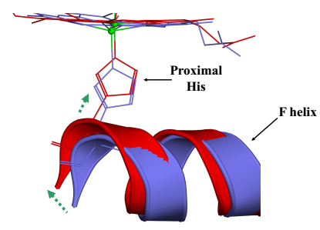
Allostery in hemoglobin
F-helix undergoes translation, changing tertiary structure of entire subunit
Notes:
Box 5-3 Figure 6. Hemoglobin dynamics. (b) The motion of the F helix.

Slide 34
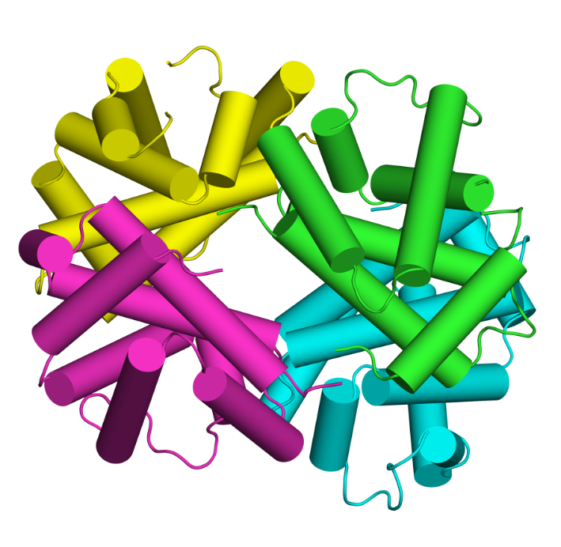
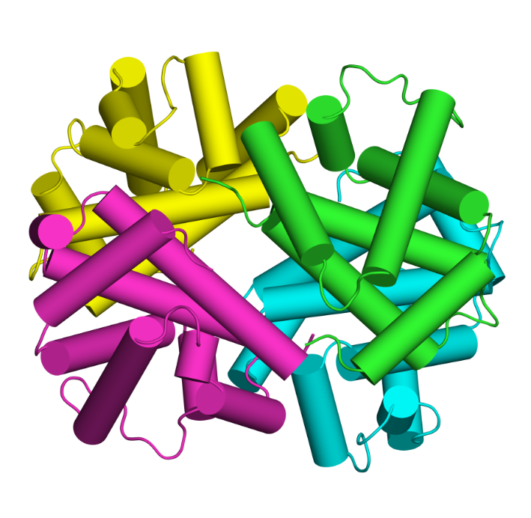
Allostery in hemoglobin
Change in a single subunit spreads to entire protein
The α₁β₁ dimer slides and rotates 15˚ with respect to the α₂β₂ dimer
The pocket between the beta subunits becomes narrower
Deoxy (T)
Oxy (R)
Notes:
Box 5-3 Figure 6. Hemoglobin dynamics. (c) Motions at the level of the entire molecule. Here the motions are complex, so we present the two structures and refer the reader to the global change in conformation. For example, notice the change in the size of the central cavity between the two structures.

Slide 35
Allostery in hemoglobin
Most of the hemoglobin is in the oxy state
Lungs
Most of the hemoglobin is in the deoxy state
Tissues

Slide 36
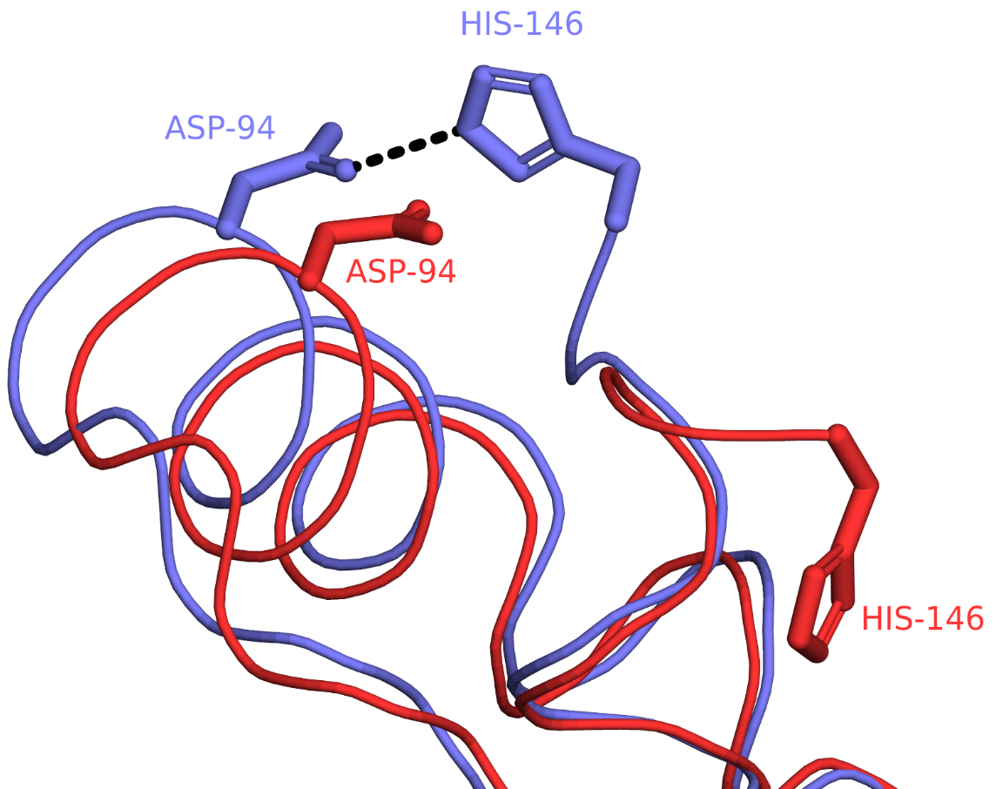
The Bohr (pH-induced) effect
Low pH stabilizes the deoxy conformation via salt bridges
Explains low oxygen affinity in peripheral tissues (pH=7.2) compared to lungs (pH=7.6)
-
+
-
Notes:
Whereas the Glu/Asp side-chains are almost always charged under physiological pH, those of His are only charged part of the time, because their pKa is close to the neutral pH. In peripheral tissues His-146 is protonated (positively charged) and forms a salt bridge with Asp-94, that stabilizes the T conformation. In the lung the bond breaks.
Thus, the R→T change happens due to a drop in both oxygen concentration and the pH when hemoglobin transports from the lungs to peripheral tissues.
Box 5-3 Figure 7. The salt bridge between His-146 and Asp -94, which makes the largest contribution to the Bohr effect ^{[279]}. The salt bridge is present in the deoxy state (PDB entry 2dn2, colored in blue) and absent in the oxy state (PDB entry 2dn3, colored in red).

Slide 37
Protein Folding

Slide 38
Levinthal’s paradox (1968)
For a 100-residue protein, assuming that:
Each residue has 3 possible conformations
The conformation of each residue is independent of that of the other residues
Then: the entire polypeptide chain has 3¹⁰⁰ conformations!
Assuming that each conformational transition takes 1 ps, the folding time is 5×10³⁵ seconds = 1.6×10²⁸ years - longer than the age of the universe!!!
Still, protein folding takes only 10⁻⁶-10⁴ seconds

Slide 39
Levinthal’s paradox (1968)
Conclusions:
Proteins do not sample the entire available conformational space
Folding involves residue-residue interactions that limit the number of possible conformations in the next step
This is demonstrated by the hypothetical energy landscape of protein folding
Notes:
Figure 5.2. The folding energy landscape in three dimensions.

Slide 40
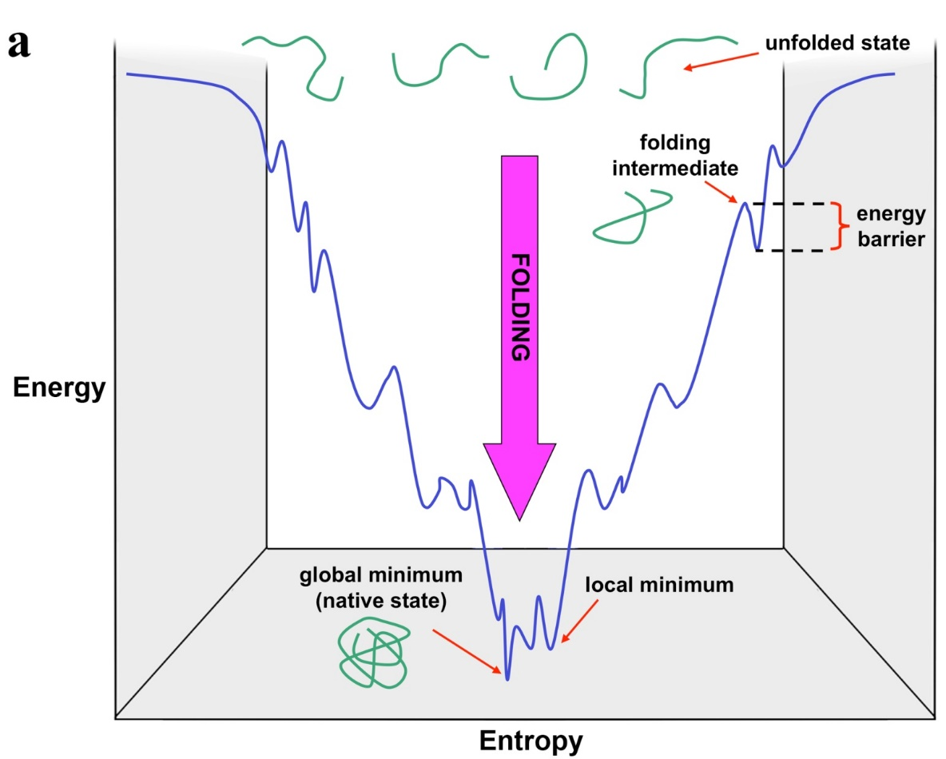
Folding energetics
Folding involves decrease in both entropy & energy (which overcompensates for the former)
Bottom well - the global energy minimum - represents the native state Other wells - local minima (contain non-native yet favorable local interactions)
Notes:
Figure 5-2. The folding energy landscape in two (a) and three (b) dimensions. The green shapes in (a) represent the polypeptide chain of the folding protein. The funnel shape of the curve reflects the simultaneous decrease in energy and entropy of the protein during its folding.
The shape of the global minimum determines the flexibility of the folded protein; if the shape is flatter, the protein is more flexible.

Slide 41
Folding energetics
3D:
Biochem Soc Trans. (2008) 36: 1404-8
Notes:
Figure 5-2. The folding energy landscape in two (a) and three (b) dimensions. The green shapes in (a) represent the polypeptide chain of the folding protein. The funnel shape of the curve reflects the simultaneous decrease in energy and entropy of the protein during its folding.

Slide 42
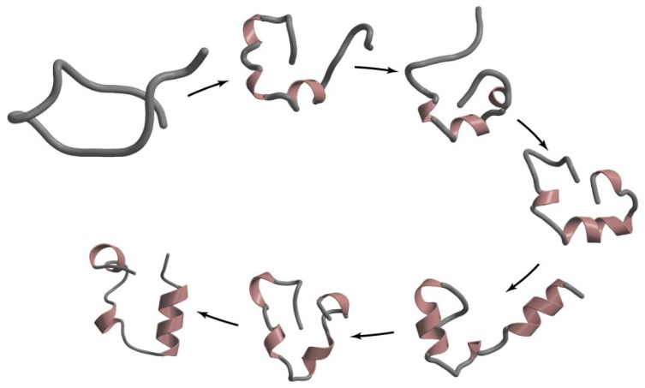
Folding kinetics
Difficult to study since transition states are transient
Solutions:
Using spectroscopic (NMR, EPR) and other (hydrogen-exchange, thermochemistry) tools
Changing experimental conditions to trap metastable transition states
Analyzing the effect of mutations on those states
Still, the folding process is not completely understood
?

Slide 43
Folding kinetics
Molten globule
A folding intermediate that appears within milliseconds, (‘visible’ to some experimental methods)
A native-like secondary structure (identity and location) and distribution of polar/nonpolar residues
However:
Few tertiary contacts
Increased flexibility
Often non-native loops
Some exposed nonpolar residues

Slide 44
Folding kinetics
Molten globule → Native structure
Completion of secondary structures
Better packing of the hydrophobic core
Fixation of loop structure

Slide 45
Models of protein folding
Framework
Hydrophobic collapse
Nucleation-condensation
Notes:
Figure 5-3. Proposed models for protein folding. (a) The framework model. (b) The hydrophobic collapse model. (c) The nucleation-condensation model. The green shapes represent the polypeptide chain, whereas the black cylinders are α-helices, representing here secondary structure.

Slide 46
Models of protein folding
Framework model
Hierarchical folding: secondary structures → supersecondary structures → domains → entire chain is folded
Logics: solves Levinthal’s paradox; first stage reduces the entropy cost for the other stages
Problems: secondary structures unstable in open chain; fits mainly all-α proteins.
Notes:
The Framework model can be rationalized in proteins that contain only alpha-helices, because such structures can form locally. However, the formation of beta-sheets requires more global contacts, and its hard to imagine how such structures can form without a collapse of the chain.

Slide 47
Models of protein folding
Hydrophobic collapse model
The core is formed first by collapse of nonpolar residues, then secondary structures and tertiary contacts form
Logics: tertiary stabilization of secondary structures.
Problem: desolvation of polar backbone groups
Notes:
The biggest problem of the hydrophobic collapse model is that in involves the burial of polar backbone groups inside the hydrophobic core of the protein, without pairing them in hydrogen bonds. Such process should have a large desolvation penalty, preventing it from happening.

Slide 48
Models of protein folding
Nucleation-condensation model
Both hydrophobic collapse and secondary-element formation take place simultaneously during folding
Secondary elements are stabilized by the nonpolar core and tertiary contacts while they are being formed

Slide 49
Models of protein folding
The nucleation-condensation model seems more likely
Certain aspects of the three models are supported by different studies
Thus, it seems that there is no single universal folding mechanism
Notes:
Figure 5-3. Proposed models for protein folding. (a) The framework model. (b) The hydrophobic collapse model. (c) The nucleation-condensation model. The green shapes represent the polypeptide chain, whereas the black cylinders are α-helices, representing here secondary structure.

Slide 50
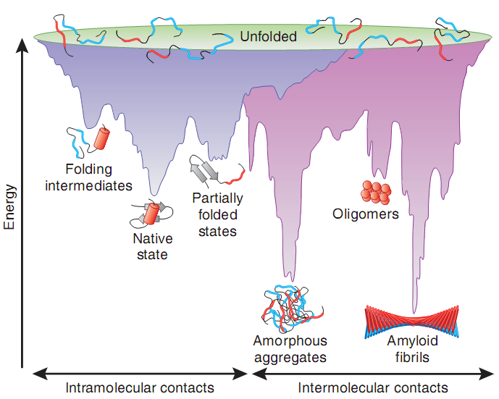
Unfolding/misfolding may lead to aggregation
The native structure - the most stable for monomers
Aggregates and amyloid fibers may be more stable → pathologies
Nat Struct Mol Biol. (2009) 16: 574-81
Notes:
Figure 5-4. The energy landscape of protein folding and aggregation.
The purple surface represents the folding process of single-chain proteins, via intramolecular contacts, to form their native structure. It is equivalent to the scheme shown in Figure 5-2. The pink area shows a similar process, but one, which involves intermolecular contacts between different polypeptide chains, and results in amorphous aggregates, oligomers, or amyloid ﬁbrils (see Box 5-1). Notice that parts of both energy landscapes overlap. That is, aggregates and amyloid fibrils may be formed during de novo folding, but also by destabilization of the native state into partially folded states. Cell-toxic oligomers may occur as off-pathway intermediates of amyloid ﬁbril formation.

Slide 51
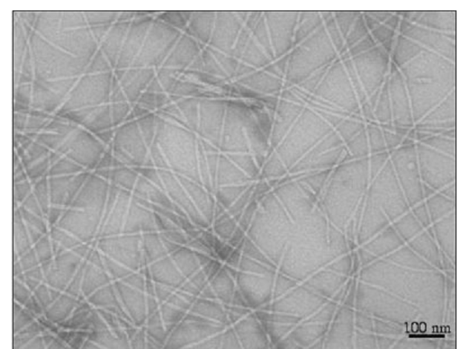
Folding-related pathologies
Loss of function: e.g. cystic fibrosis (deletion of Phe in CFTR chloride channel → disruption of folding)
Gain-of-function: e.g., misfolding and amyloid formation (amyloidosis: Alzheimer’s, Parkinson’s, Huntington’s, ALS, MCD..)
Amyloid fibrils
Microsc Res Tech. (2005) 67: 210-7
Notes:
Amyloids are associated with over 20 different diseases, in most of which a different protein creates the fibers (overall 18 different proteins). For example, amyloid-β (outside the cell) and tau (inside the cell) in Alzheimer’s disease, α-synuclein in Parkinson’s disease, huntingtin in Huntington’s disease, superoxide dismutase in ALS, and prion in mad cow disease.
Box 5-1 Figure 1. A transmission electron micrograph of amyloid fibrils.

Slide 52
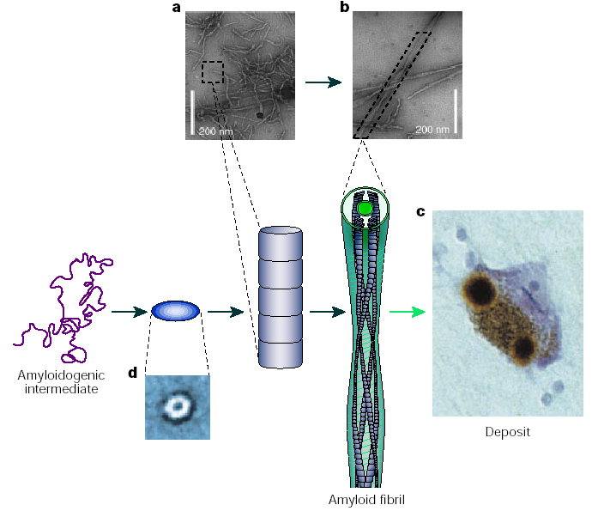
Misfolding and amyloid formation
Amyloid fibrils formation
Nature (2003) 426: 884-90
(unfolded/partially unfolded)
soluble filament
soluble aggregate
(insoluble)
Notes:
The deposits may appear in the ECM (plaques), as happens with amyloid-β in Alzheimer’s disease, or inside the cell (inclusions), as happens with α-synuclein in Parkinson’s disease.
The mechanism of toxicity is unknown; it was believed to involved the insoluble fibrils, but today it is thought to involve the soluble (amorphous) units, which are released from the fibers.
Box 5-1 Figure 2. A schematic representation of the general mechanism of aggregation to form amyloid fibrils. Unfolded or partially unfolded proteins associate with each other to form small, soluble aggregates that undergo further assembly into proto-fibrils or proto-filaments (a) and then mature fibrils (b). The fibrils often accumulate in plaques or other structures such as the Lewy bodies associated with Parkinson’s disease (c). Some of the early aggregates seem to be amorphous or micellar in nature, although others form ring-shaped species with diameters of approximately 10 nm (d)

Slide 53
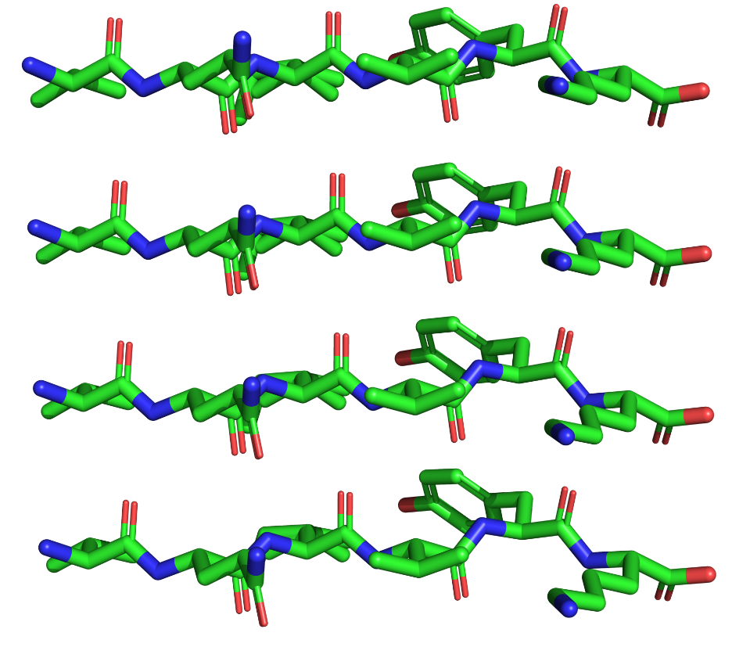
Misfolding and amyloid formation
Amyloid fibrils have a cross-β-sheet conformation and exposed nonpolar groups → aggregation → protofilaments → fibrils

Slide 54
Misfolding and amyloid formation
(courtesy of Meytal Landau and Einav Tayeb-Fligelman )
Notes:
Box 5-1 Figure 3. The structures of amyloid fbrils (curtesy of Meytal Landau and Einav Tayeb-Fligelman). The cross-β structure of the amyloid forming peptide KLVFFA from amyloid β. In the structure, the β strands are positioned perpendicularly to the fibril axis (PDB entry 3ow9). The image on the left shows the supersecondary structure of the fiber, whereas the right image shows the surface of the structure, colored by the Kessel-Ben-Tal Scale of hydrophobicity

Slide 55
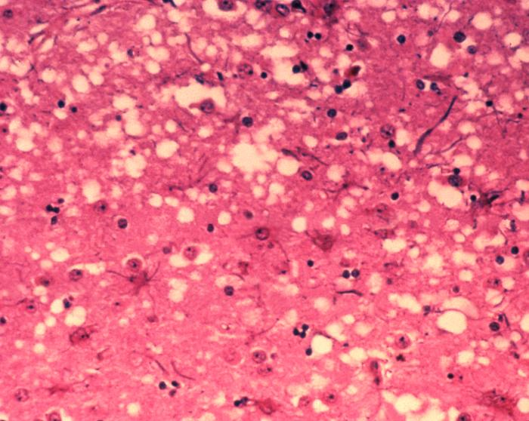
Misfolding and amyloid formation
Spongiform encephalopathies (MCD, CJD, scrapie)
Prions – appear in both normal and pathological forms; can infect healthy individuals by promoting structural changes
Sponge-like brain of cow with MCD
(APHIS [2003] Wikimedia (URL))
Notes:
Some amyloidosis, like Alzheimer’s and Parkinson’s are spontaneous (e.g. due to mutation or overproduction), whereas others, like MCD, CJD and scrapie, are caused by infection. The latter involve a protein – prion (PrP).
The prion exists in two forms. The first form (PrP^{c}) is a normal membrane protein (anchored or TM) that is thought to function in cell-cell adhesion and communication. The infectious form (PrP^{Sc}) is mutated, protease-resistant, has a large β content, and when it binds to PrP^{c} , it catalyzes the conformational change of PrP^{c} to PrP^{sc} (i.e. amyloid-forming).
Prion can infect people by ingesting contaminated food because they are resistant to GI proteolysis. There is evidence that the resistance has to do with their ability to oligomerize.

Slide 56
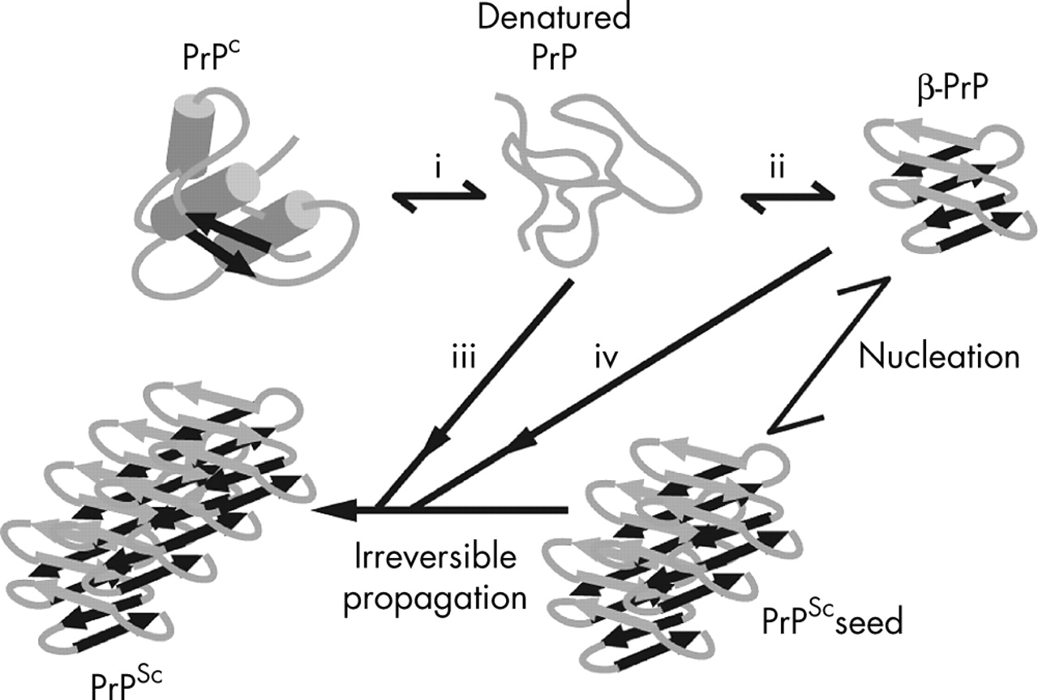
Misfolding and amyloid formation
Spongiform encephalopathies (MCD, CJD, scrapie)
Prions – protein exists in two forms, benign and pathological. The shift between them involves a α→β structural change
Proposed mechanism for prion propagation
(J. Neurol. Neurosurg. Psychiatry [2005] 76: 906-919)
Notes:
Some amyloidosis, like Alzheimer’s and Parkinson’s are spontaneous (e.g. due to mutation or overproduction), whereas others, like MCD, CJD and scrapie, are caused by infection. The latter involve a protein – prion (PrP).
The prion exists in two forms. The first form (PrP^{c}) is a normal membrane protein (anchored or TM) that is thought to function in cell-cell adhesion and communication. The infectious form (PrP^{Sc}) is mutated, protease-resistant, has a large β content, and when it binds to PrP^{c} , it catalyzes the conformational change of PrP^{c} to PrP^{sc} (i.e. amyloid-forming).

Slide 57
In vivo folding
Improper folding may result from:
Size:
Multiple domains
Complex αβ topology (e.g. the TIM barrel fold)
External changes:
Heat shock (thermal denaturation)
Extreme pH
High salt concentration
High osmotic pressure
Exposure to toxins or heavy metals
Inflammation, chronic oxidative stress (ageing)
Notes:
Even in the absence of genetic abnormalities cellular proteins may unfold/misfold. This may happen in large and/or complex proteins, during heat shock or as a result of exposure to certain chemicals.
Proteins with complex topologies require assistance in folding because their architecture includes numerous long-range interactions, and they are therefore likely to get trapped in local minima during folding.

Slide 58
In vivo folding
Wrong folding may be manifested in:
Exposure of hydrophobic residues → aggregation in dense cytoplasm (40% dry material) → sedimentation and loss of function
Formation of improper S-S bonds
Improper proline isomerization
Notes:
The cytoplasm is very dense, which increases the probability of unfolded/misfolded proteins to interact with each other non-specifically via their exposed nonpolar residues and aggregate.

Slide 59
Assisted folding
Molecular chaperones:
Ubiquitous (10% in E. Coli)
Diverse – more than 20 distinct classes
Roles:
Prevent aggregation of unfolded/misfolded proteins
Facilitate unfolding of proteins before transport into a cellular compartment
Many are overexpressed during heat shock (HSPs)
Notes:
Chaperones can be divided to:
Stabilizers – include small HSPs that monitor the folding status of cellular proteins, and the larger, ATP-dependent HSP70s that unfold proteins when they pass into the ER, mitochondria or chloroplasts. HSPs act routinely, but become overexpressed when the cell is under stress.
Chaperonins (e.g. GroEL-GroES) - large, cage-like complexes that act downstream to stabilizers and assist the folding of misfolded proteins in an ATP-dependent manner.

Slide 60
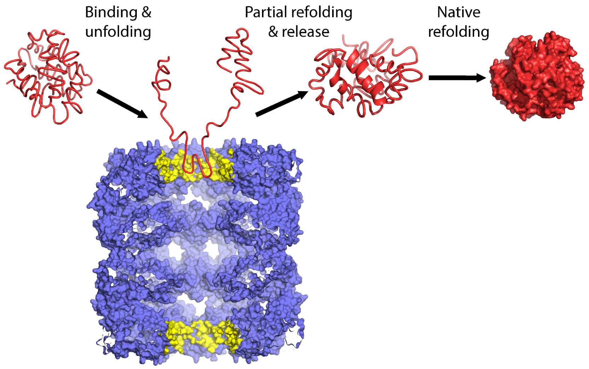
Chaperonins
Group I chaperonins: found in bacteria (GroEL), mitochondria (Hsp60), and chloroplasts (cpn60)
Introduction to Proteins, Kessel and Ben-Tal, 2018
PNAS (2013) 110: 7199-204
Notes:
Group II includes chaperonins in the eukaryotic cytosol (TRiC/CCT) and the Archaeal thermosomes. Their lid is built-in.
GroEL can hold proteins up to 60 kDa in size. Larger proteins may be folded by other systems, but it’s unclear exactly how.
Figure 5.2.6. Scheme of apo GroEL acting as an unfolding facilitator. Apo-GroEL (blue) mediates iterative cycles of binding to the upper cavity (yellow), unfolding, release, and out-of-cage refolding, thereby converting high-affinity misfolded polypeptide substrates (left) into partially-unfolded intermediates (center) that fold spontaneously in solution into low-affinity native products (right). The figure is taken from [155].

Slide 61
Chaperonins
The mechanism requires ATP hydrolysis
Introduction to Proteins, Kessel and Ben-Tal, 2018
PNAS (2013) 110: 7199-204
Notes:
Figure 5.2.6. Scheme of apo GroEL acting as an unfolding facilitator. Apo-GroEL (blue) mediates iterative cycles of binding to the upper cavity (yellow), unfolding, release, and out-of-cage refolding, thereby converting high-affinity misfolded polypeptide substrates (left) into partially-unfolded intermediates (center) that fold spontaneously in solution into low-affinity native products (right). The figure is taken from [155].

Slide 62
The GroEL-GroES system
The most studied chaperonin system
GroEL: 14 subunits, arranged in two heptameric rings
GroES: 7 subunits that are arranged in a dome-like structure
trans ring
GroEL
cis ring
GroES
Introduction to Proteins, Kessel and Ben-Tal, 2018
Notes:
Figure 5.2.1. The structure of the bacterial GroEL-GroES-ADP chaperonin complex. The multi-subunit structure (PDB entry 1aon) is shown in a sphere representation, with each chain colored differently. The various parts of the structure are marked.

Slide 63
The GroEL-GroES system
Apical domain binds the misfolded protein
Equatorial domain has ATPase activity
Apical domain
Equatorial domain
Introduction to Proteins, Kessel and Ben-Tal, 2018
Notes:
Figure 5.2.1. The structure of the bacterial GroEL-GroES-ADP chaperonin complex. The multi-subunit structure (PDB entry 1aon) is shown in a sphere representation, with each chain colored differently. The various parts of the structure are marked.

Slide 64
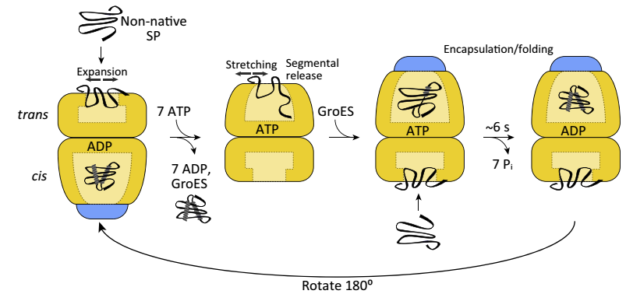
The GroEL-GroES system
Accepted model of assisted folding:
Binding of misfolded protein and 7ATP to upper ring
Trends Biochem Sci. (2016) 41: 62-76
1
2
3
Introduction to Proteins, Kessel and Ben-Tal, 2018
Notes:
Figure 5.2.3. The asymmetrical model for chaperonin-assisted protein folding. SP – substrate protein.

Slide 65
The GroEL-GroES system
Accepted model of assisted folding:
- Motions of misfolded protein → partial unfolding
- GroES binding → cage becomes polar → protein folds
1
2
3
Introduction to Proteins, Kessel and Ben-Tal, 2018
Notes:
The binding of the protein to GroEL induces expansion and stretching motions in the protein, which lead to its partial unfolding.
Figure 5.2.3. The asymmetrical model for chaperonin-assisted protein folding. SP – substrate protein.

Slide 66
The GroEL-GroES system
Accepted model of assisted folding:
Protein folding inside GroEL results from a large conformational change in GroEL, induced by ATP + GroES binding
Introduction to Proteins, Kessel and Ben-Tal, 2018
Notes:
Figure 5.2.5. Conformational and polarity changes in GroEL upon nucleotide binding. (a) The conformational change. The image shows a superimposition of the apo (nucleotide unbound) form of GroEL (PDB entry 1mnf, colored in blue) and the ADP-bound form (PDB entry 1aon, colored in yellow). In both cases a single subunit is shown, containing the apical (top), intermediate (middle) and equatorial (bottom) domains. The green arrow shows the hinge motion resulting from the conformational change. The substrate peptide, taken from the nucleotide-unbound form) is shown as a red ribbon.

Slide 67
The GroEL-GroES system
Accepted model of assisted folding:
The conformational change renders the inner walls of the apical domain polar → burial of nonpolar residues in protein core and externalization of polar residues (i.e., folding..)
Introduction to Proteins, Kessel and Ben-Tal, 2018
Notes:
(b) The corresponding polarity change. The image shows a surface representation of the two forms of GroEL, colored according to polarity as in Figure 5.2.3. In the peptide-bound form (left image) nonpolar residues of the apical domain face the bound peptide. The hinge motion that follows nucleotide binding moves the nonpolar residues upwards, leaving a larger and more polar cavity in the vicinity of the substrate peptide (right image).

Slide 68
The GroEL-GroES system
Accepted model of assisted folding:
ATP → ADP and ATP binding to other ring → release of GroES and folded protein
Trends Biochem Sci. (2016) 41: 62-76
1
2
3
Introduction to Proteins, Kessel and Ben-Tal, 2018
Notes:
Figure 5.2.3. The asymmetrical model for chaperonin-assisted protein folding. SP – substrate protein.

Slide 69
Summary
Folded proteins are inherently dynamic
Protein dynamics is diverse in terms of timescales and amplitudes of motions
Protein dynamics is crucial to the proper biological activity of proteins
Protein dynamics is driven by the thermal energy in the surroundings (RT) but can be affected by ligand binding, post-translational modifications, and changes in environmental conditions. These often result in conformational and functional changes in the protein.

Slide 70
Summary
Protein folding involves a drop in energy and entropy, as reflected in the energy landscape of the process. This landscape is different for each protein and involves multiple energy minima and barriers.
The exact kinetics and mechanisms of protein folding are not entirely clear
Misfolding of proteins may lead to disease
Cells include quality assurance mechanisms that detect misfolded proteins and assist their refolding
Introduction to Proteins, Kessel and Ben-Tal, 2018

