Slide 1
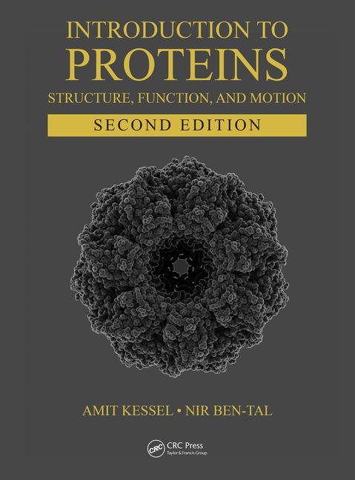
This PPT presentation is provided as suppl. material to the book:
Introduction to Proteins: Structure, Function, and Motion
2nd Edition (2018)
Amit Kessel & Nir Ben-Tal

Slide 2
Chapter 7:
Membrane Proteins
(cont.)

Slide 3
Structure-Function Relationship in G Protein-Coupled Receptors (GPCRs)
Brian K. Kobilka & Robert J. Lefkowitz, 2012 Nobel Prize in Chemistry

Slide 4
Types of membrane-bound receptors
1. Ion channels
2. Tyrosine kinases
3. Serine/threonine kinases
4. Guanylate cyclases
5. Cytokine receptors (defined by ligand type)
6. G protein-coupled receptors (GPCRs)

Slide 5
GPCRs: background
By far the largest and most common family of membrane receptors: 1-5% of the vertebrate genome, > 800 genes in humans
Appear in most life forms (plants – unclear)
Diverse ligands: proteins, peptides, small organic molecules, elemental ions, and even photons of light
Participate in numerous physiological processes and involved in numerous diseases (targeted by 30-50% of the clinically prescribed drugs)
Notes:
GPCRs seem to be missing in plants, although this matter is controversial. G-proteins do exist in plants, but it has been claimed that they are activated by receptor-like kinases (RLKs) rather than by GPCRs.
GPCRs are involved in diseases like hypertension, congestive heart failure, stroke, cancer, thyroid dysfunction, congenital bowel obstruction, abnormal bone development, night blindness, and neonatal hyperparathyroidism. Their involvement may result from being either inactive or overactive. For example, overactive GPCRs may affect the formation and spreading of tumors by trans-activating cancer-related receptors like epidermal growth factor receptor (EGFR), and by promoting cells migration during metastasis.

Slide 6
GPCR signaling involves G-proteins
Notes:
Figure 7.31. The main players in a typical signal transduction cascade. (b) The cAMP-PKA cascade. Binding of an external chemical messenger (hormone, neurotransmitter, etc.) to a membrane-bound protein receptor induces the activation of an enzyme called a G-protein, which acts as a transducer. The activation of the G-protein leads to the activation of adenylyl cyclase (AC), which catalyzes the conversion of ATP into cyclic AMP. The latter acts as an intracellular messenger. It binds to and activates the enzyme amplifier PKA, which, in turn, phosphorylates a large set of cytoplasmic proteins. The phosphorylated proteins may activate other cellular components, or perform a certain function (that is, they may act as sensors and/or effectors). In any case, this signal transduction eventually leads to changes in the cell's behavior, i.e., to a biological response.

Slide 7
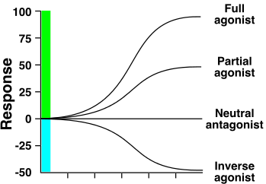
GPCR signaling: types of agonists
ligand concentration
Notes:
Figure 7.32. Idealized dose response curves of a cellular receptor to full agonist, partial agonist, neutral antagonist, and inverse agonist. The constitutive activity of the receptor is assumed to be zero. Note, however, that many receptors have a baseline activity even in the absence of agonist.

Slide 8
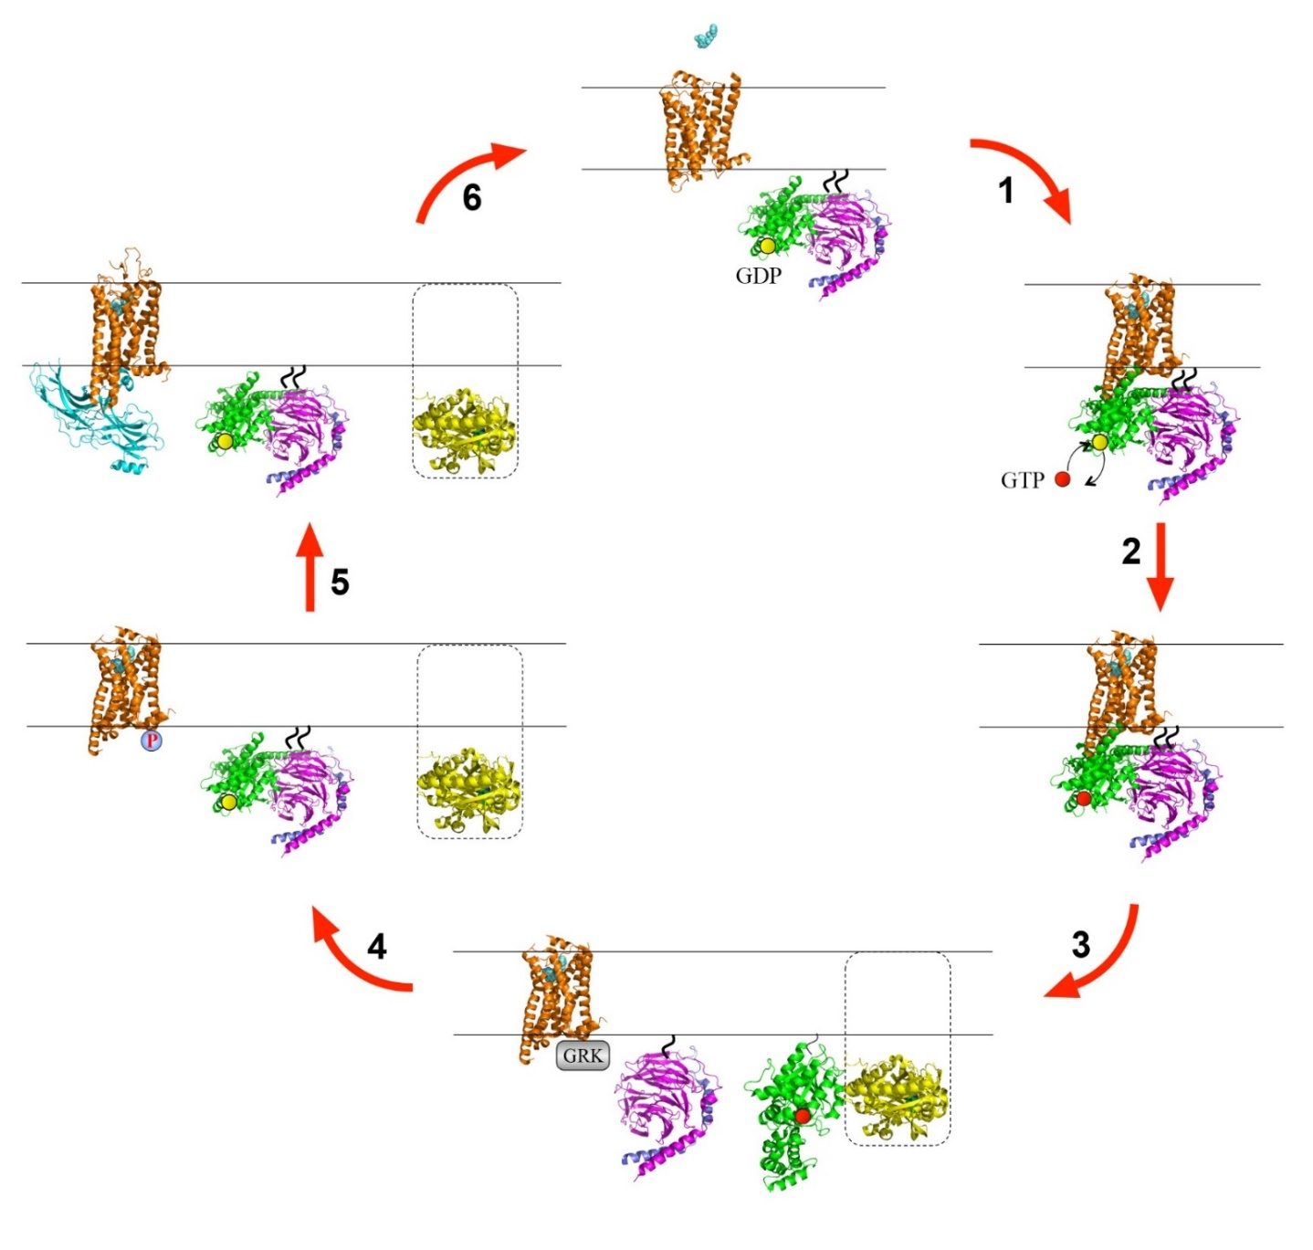
The GPCR signaling cycle
Notes:
Figure 7.33. The GPCR signaling cycle. The cycle includes 6 basic steps: (1) binding of agonist (aquamarine spheres) to the extracellular domain of the inactive GPCR (orange ribbon), followed by the binding of G-protein to the intracellular part of the GPCR. The GPCR structures shown here are those of the β₂-adrenergic receptor: the inactive structure is taken from PDB entry 2rh1 and the active structure is taken from entry 3sn6. In the G-protein’s resting state, the Gα subunit, represented by the green ribbon, is attached to the βγ subunits, represented by the purple and blue ribbons, respectively. Gα in this state is bound to GDP (yellow sphere). The Gα subunit and the Gγ subunit are covalently attached to the membrane (short wavy curves). (2+3) Activation of the G-protein, which involves exchange of GDP with GTP (red sphered) in Gα’s nucleotide binding site (2), separation of Gα from Gβγ and binding of Gα to an effector protein (3). The Gα-effector complex shown here is taken from PDB entry 1cul. The effector in this complex is the enzyme adenylyl cyclase, and only the catalytic subunits are shown (yellow ribbon). The entire region of adenylyl cyclase, which also consists of a transmembrane domain, is marked by the dashed line. The binding of the Gβγ complex to its effector protein is not shown. (4) after a certain amount of time Gα hydrolyses its bound GTP molecule, which causes Gα to separate from its effector protein and re-bind to the Gβγ complex. Following the activation of the GPCR and G-protein, the GPCR undergoes deactivation to terminate the signal. This process includes binding of a G-protein-coupled receptor kinase (GRK) to the intracellular domain of the GPCR (3), phosphorylation of the domain by the GRK (4), and binding of arrestin (cyan) to the phosphorylated domain (5. PDB entry 4zwj). The binding prevents the GPCR from re-binding to the G-protein and also induces the internalization and recycling of the GPCR (see subsection 7.5.5). The entire activation-deactivation cycle is brought to completion with arrestin’s departure from the GPCR and return of the system to its resting state.

Slide 9
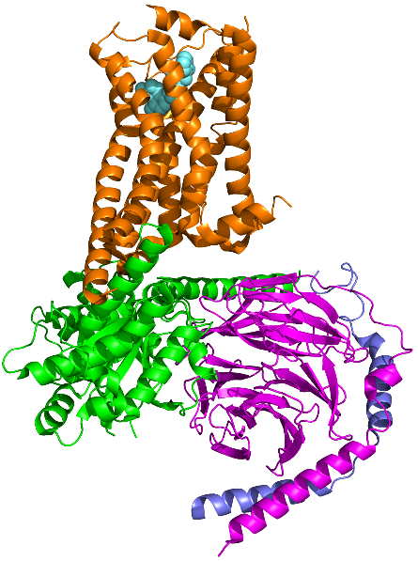
1
GPCR
α
β
GDP
γ
GTP
G-protein
2
Notes:
Figure 7.29. The GPCR signaling cycle. The cycle includes 6 basic steps: (1) binding of agonist (aquamarine spheres) to the extracellular domain of the inactive GPCR (orange ribbon), followed by the binding of G-protein to the intracellular part of the GPCR. The GPCR structures shown here are those of the β₂-adrenergic receptor: the inactive structure is taken from PDB entry 2rh1 and the active structure is taken from entry 3sn6. In the G-protein’s resting state, the Gα subunit, represented by the green ribbon, is attached to the βγ subunits, represented by the purple and blue ribbons, respectively. Gα in this state is bound to GDP (yellow sphere). The Gα subunit and the Gγ subunit are covalently attached to the membrane (short wavy curves). (2+3) Activation of the G-protein, which involves exchange of GDP with GTP (red sphered) in Gα’s nucleotide binding site (2), separation of Gα from Gβγ and binding of Gα to an effector protein (3). The Gα-effector complex shown here is taken from PDB entry 1cul. The effector in this complex is the enzyme adenylyl cyclase, and only the catalytic subunits are shown (yellow ribbon). The entire region of adenylyl cyclase, which also consists of a transmembrane domain, is marked by the dashed line. The binding of the Gβγ complex to its effector protein is not shown. (4) after a certain amount of time Gα hydrolyses its bound GTP molecule, which causes Gα to separate from its effector protein and re-bind to the Gβγ complex. Following the activation of the GPCR and G-protein, the GPCR undergoes deactivation to terminate the signal. This process includes binding of a G-protein-coupled receptor kinase (GRK) to the intracellular domain of the GPCR (3), phosphorylation of the domain by the GRK (4), and binding of arrestin (cyan) to the phosphorylated domain (5. PDB entry 4zwj). The binding prevents the GPCR from re-binding to the G-protein and also induces the internalization and recycling of the GPCR (see subsection 7.5.5). The entire activation-deactivation cycle is brought to completion with arrestin’s departure from the GPCR and return of the system to its resting state.

Slide 10
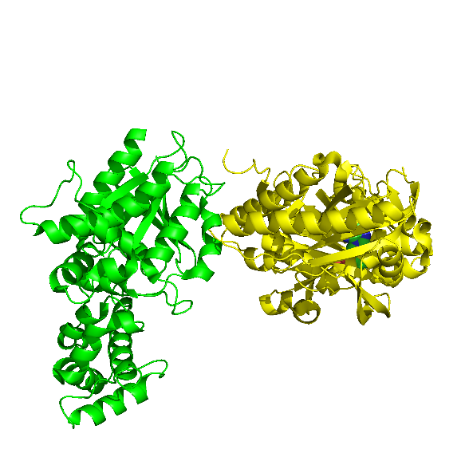
3
GRK
adenylyl cyclase
4
P
Notes:
Figure 7.29. The GPCR signaling cycle. The cycle includes 6 basic steps: (1) binding of agonist (aquamarine spheres) to the extracellular domain of the inactive GPCR (orange ribbon), followed by the binding of G-protein to the intracellular part of the GPCR. The GPCR structures shown here are those of the β₂-adrenergic receptor: the inactive structure is taken from PDB entry 2rh1 and the active structure is taken from entry 3sn6. In the G-protein’s resting state, the Gα subunit, represented by the green ribbon, is attached to the βγ subunits, represented by the purple and blue ribbons, respectively. Gα in this state is bound to GDP (yellow sphere). The Gα subunit and the Gγ subunit are covalently attached to the membrane (short wavy curves). (2+3) Activation of the G-protein, which involves exchange of GDP with GTP (red sphered) in Gα’s nucleotide binding site (2), separation of Gα from Gβγ and binding of Gα to an effector protein (3). The Gα-effector complex shown here is taken from PDB entry 1cul. The effector in this complex is the enzyme adenylyl cyclase, and only the catalytic subunits are shown (yellow ribbon). The entire region of adenylyl cyclase, which also consists of a transmembrane domain, is marked by the dashed line. The binding of the Gβγ complex to its effector protein is not shown. (4) after a certain amount of time Gα hydrolyses its bound GTP molecule, which causes Gα to separate from its effector protein and re-bind to the Gβγ complex. Following the activation of the GPCR and G-protein, the GPCR undergoes deactivation to terminate the signal. This process includes binding of a G-protein-coupled receptor kinase (GRK) to the intracellular domain of the GPCR (3), phosphorylation of the domain by the GRK (4), and binding of arrestin (cyan) to the phosphorylated domain (5. PDB entry 4zwj). The binding prevents the GPCR from re-binding to the G-protein and also induces the internalization and recycling of the GPCR (see subsection 7.5.5). The entire activation-deactivation cycle is brought to completion with arrestin’s departure from the GPCR and return of the system to its resting state.

Slide 11
5
arrestin
Notes:
Figure 7.29. The GPCR signaling cycle. The cycle includes 6 basic steps: (1) binding of agonist (aquamarine spheres) to the extracellular domain of the inactive GPCR (orange ribbon), followed by the binding of G-protein to the intracellular part of the GPCR. The GPCR structures shown here are those of the β₂-adrenergic receptor: the inactive structure is taken from PDB entry 2rh1 and the active structure is taken from entry 3sn6. In the G-protein’s resting state, the Gα subunit, represented by the green ribbon, is attached to the βγ subunits, represented by the purple and blue ribbons, respectively. Gα in this state is bound to GDP (yellow sphere). The Gα subunit and the Gγ subunit are covalently attached to the membrane (short wavy curves). (2+3) Activation of the G-protein, which involves exchange of GDP with GTP (red sphered) in Gα’s nucleotide binding site (2), separation of Gα from Gβγ and binding of Gα to an effector protein (3). The Gα-effector complex shown here is taken from PDB entry 1cul. The effector in this complex is the enzyme adenylyl cyclase, and only the catalytic subunits are shown (yellow ribbon). The entire region of adenylyl cyclase, which also consists of a transmembrane domain, is marked by the dashed line. The binding of the Gβγ complex to its effector protein is not shown. (4) after a certain amount of time Gα hydrolyses its bound GTP molecule, which causes Gα to separate from its effector protein and re-bind to the Gβγ complex. Following the activation of the GPCR and G-protein, the GPCR undergoes deactivation to terminate the signal. This process includes binding of a G-protein-coupled receptor kinase (GRK) to the intracellular domain of the GPCR (3), phosphorylation of the domain by the GRK (4), and binding of arrestin (cyan) to the phosphorylated domain (5. PDB entry 4zwj). The binding prevents the GPCR from re-binding to the G-protein and also induces the internalization and recycling of the GPCR (see subsection 7.5.5). The entire activation-deactivation cycle is brought to completion with arrestin’s departure from the GPCR and return of the system to its resting state.

Slide 12
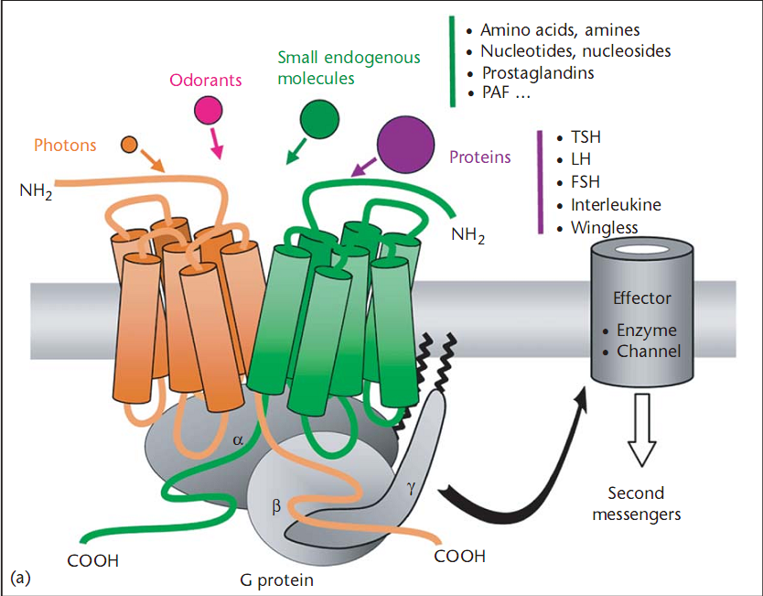
GPCRs ligands and effectors
Notes:
Figure 7.34. G-protein-coupled receptors (GPCRs). (a) The overall structure of the GPCR–G-protein system. I. A schematic depiction of GPCRs, taken from ^{[335]}. The left side of the image shows a GPCR dimer, bound to its cognate G-protein. The upper-left side shows the different ligands that may bind to the extracellular side of the GPCR and activate it, and the upper-right side shows examples of two of the possible ligands, i.e., proteins and small molecules. The effector molecule, i.e., the enzyme or channel that may be affected by the activated GPCR, and as a result induce the action of a second messenger, is shown on the right side of the figure.

Slide 13
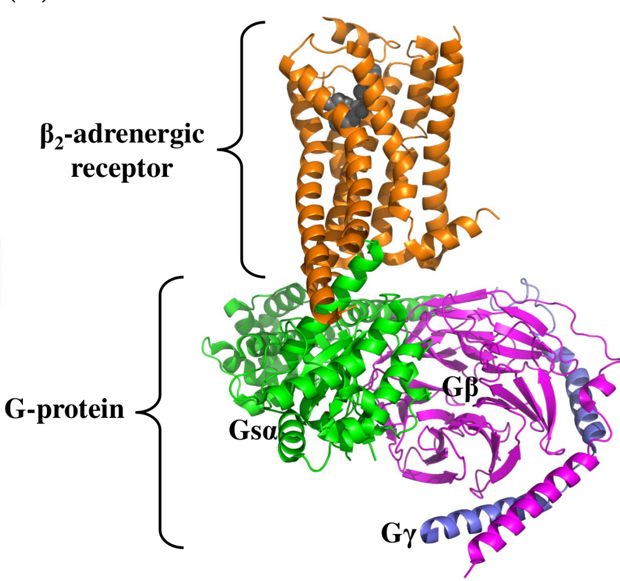
The 3D structure of GPCRs
Notes:
II. The 3D structure of the β₂-adrenergic receptor in complex with Gs-protein (PDB entry 3sn6). The GPCR is shown in orange, with the agonist presented as grey spheres. The α, β, and γ subunits of the G-protein are colored in green, magenta, and blue, respectively.

Slide 14
GPCRs structural similarities
GPCRs have very similar structures despite low sequence identity
Rhodopsin and β₂-AR: 21% identity, TM rmsd = 1.6 Å
The TMD is the most conserved, and contains 7 TM helices
Rhodopsin: the first solved structure, served as model for other GPCRs
N'
C'
Rhodopsin
Notes:
Rhodopsin, the first GPCR whose structure was solved, has always been a model for other GPCRs, mostly because of its overwhelming abundance and stability.
The transmembrane segments are interconnected by loops of varying length at both the extracellular and intracellular sides (termed ECL1-3 and ICL1-3, respectively).
Most GPCRs also share certain sequence motifs and a disulfide bond between a cysteine residue at the extracellular tip of TM3 and another cysteine residue in ECL2
(b) The crystal structure of inactive bovine Rhodopsin (PDB entry 1hzx). The N' of the polypeptide chain faces the extracellular side of the membrane. Each of the 7 trans-membrane helices in the core of the protein is colored differently. (c-e) Other GPCRs of known structure, colored by secondary structure and positioned the same as Rhodopsin in b.

Slide 15
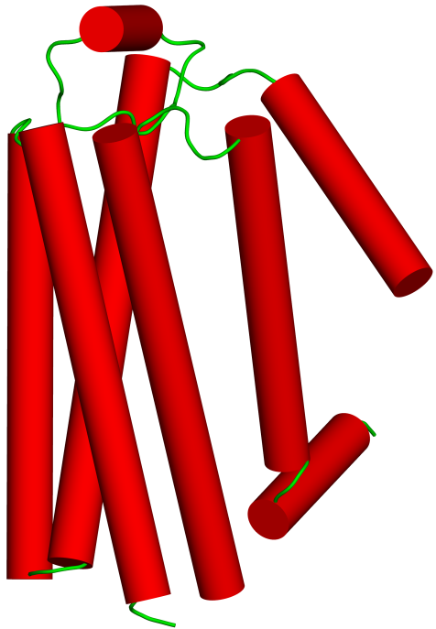
GPCRs structural similarities
Exoplasm
N'
N'
N'
C'
C'
C'
Cytoplasm
β₁ adrenergic Receptor
β₂ adrenergic Receptor
A_{2A} Adenosine Receptor
Notes:
GPCR may contain more helices beyond the seven that span the membrane. This happens in the β-adrenergic receptors, which contain an eighth helix, positioned along the extracellular membrane plane
(c-e) Other GPCRs of known structure, colored by secondary structure (top) and evolutionary conservation (bottom, cyan - lowest, maroon - highest. See color-code in figure). The conservation is calculated by the ConSurf web server (http://consurf.tau.ac.il) [384, 385]), and positioned the same as rhodopsin in b. (c) The β1-adrenergic receptor bound to the antagonist cyanopindolol. (PDB entry 2vt4). The structure contains several point mutations in the transmembrane region, as well as deletions in the C' region, which were made to increase its stability. (d) The β2-adrenergic receptor bound to the inverse agonist carazolol (PDB entry 2rh1). (e) The adenosine (A2A) receptor bound to the antagonist ZM241385 (PDB entry 3eml).

Slide 16
GPCRs structural similarities
β₁ adrenergic Receptor
β₂ adrenergic Receptor
A_{2A} Adenosine Receptor
Notes:
(c-e) Other GPCRs of known structure, colored by secondary structure (top) and evolutionary conservation (bottom, cyan - lowest, maroon - highest. See color-code in figure). The conservation is calculated by the ConSurf web server (http://consurf.tau.ac.il) [384, 385]), and positioned the same as rhodopsin in b. (c) The β1-adrenergic receptor bound to the antagonist cyanopindolol. (PDB entry 2vt4). The structure contains several point mutations in the transmembrane region, as well as deletions in the C' region, which were made to increase its stability. (d) The β2-adrenergic receptor bound to the inverse agonist carazolol (PDB entry 2rh1). (e) The adenosine (A2A) receptor bound to the antagonist ZM241385 (PDB entry 3eml).

Slide 17
GPCRs classes
Class A or 1 (rhodopsin class): ~85% of GPCRs
Subclass I - receptors for small ligands
Subclass II - receptors for peptides
Subclass III - receptors for glycoprotein hormones
Class B or 2 (secretin class): receptors for large protein/peptide hormones:
Glucagon, secretin, corticotropin-releasing factor..
Class C or 3 (glutamate class)
Metabotropic glutamate receptors (mGluRs), Ca²⁺-sensing receptors (CaSRs), GABA_{B} receptors, sweet and amino acid taste receptors, odorant receptors in fish
Notes:
The classes are defined by phylogenetic analysis.
Rhodopsin and the β-adrenergic receptors are the most studied GPCRs. This is because they were the first to be sequenced and cloned, and their 3-dimensional structures were also the first to be solved. Today, the PDB contains 178 GPCR structures that have been experimentally determined. These correspond to ~25 different receptors.

Slide 18
GPCRs classes
Class D or 4: fungal mating pheromone receptors
Class E or 5: cAMP receptors in slime mold
Involved in developmental control of the organism
Class F or 6 (Frizzled/Smoothened class):
Involved in many cellular and physiological processes (e.g. embryonic development)
Activate key signaling pathways, such as the Wnt pathway.

Slide 19
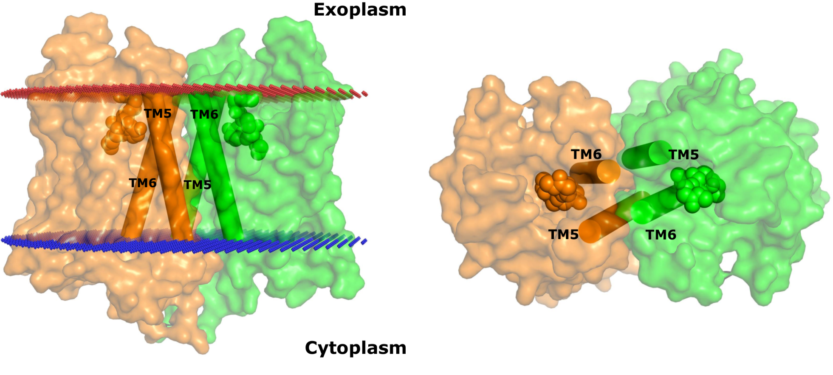
Many GPCRs form dimers or oligomers
Class A – mostly regulation (cooperativity, crosstalk)
Class C – each chain may have different roles
μ-opioid receptor:
Notes:
Another feature that may be different between the classes is the effect of dimerization/oligomerization: in class A GPCRs both monomeric and homo-dimeric (or oligomeric) forms are active, and the role of dimerization/oligomerization is mostly regulatory (cooperativity, crosstalk).
In class C GPCRs only the hetero-dimer is active, and each chain may have a different role. For example, in the GABA_{B} receptor one polypeptide chain binds the ligand whereas the other binds the G-protein ^{[393]}, and is also needed for bringing the entire receptor to the cell surface.
Figure 7.35. A two-fold symmetric dimer formed by the μ-opioid receptor. The receptor (PDB entry 4dkl) is shown in a surface representation from the side (a) and top (extracellular) (b). Each monomer is colored differently. The two bound ligands (one in each monomer) are shown as spheres. The red and blue lines mark the predicted boundaries of the membrane (the OPM database [135]). The dimerization is mediated by a four-helix bundle motif, formed by TM5 and TM6 (shown as cylinders). On their opposite side TMs 5 and 6 line the ligand-binding sites, which may be related to the role of dimerization in regulating receptor activity.

Slide 20
Shared features of GPCRs
Most of what we know about GPCR structure and activation - from studies & structures of class A GPCRs
Specific features:
ECD: adapted for ligand type & activity
TMD: - NPxxY and CWxP motifs – activation
- Cholesterol-binding site – allostery,
dimerization
ICD: D/ERY motif – stabilization of inactive state

Slide 21
The extracellular domain (ECD)

Slide 22
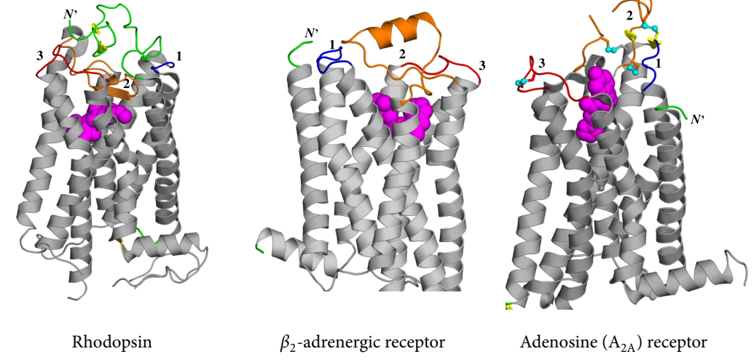
GPCRs differ mainly in their ECD
Notes:
This is to be expected, as the EC domain is the one facing the different ligands. ECL2 is particularly important in that sense, as it is the largest loop and can therefore assume different conformations:
Rhodopsin: ECL2 blocks entrance, because (1) ligand is light, therefore requires no entrance, (2) solvent access would hydrolyze the retinal-receptor bond.
Β₂-AR: the ECD is open and ECL2 forms a very short helix.
A_{2A} receptor: ECL2 lacks secondary structure (but still rigid due to S-S bonds) – allows ligand to bind externally.
Figure 7.36. The extracellular regions of different class A GPCRs. (a) Bovine rhodopsin (PDB entry 1hzx). The 1st, 2nd and 3rd extracellular loops are in blue, orange, and red (respectively), whereas the N-terminus is in green (the loop numbers are also noted in the image). The retinal cofactor is presented as magenta spheres, within the transmembrane region (in grey). (b) Human β₂-adrenergic receptor (PDB entry 2rh1). The ligand, carazolol, is presented as magenta spheres. (c) Human adenosine (A_{2A}) receptor (PDB entry 3eml). Sulfur atoms of loop-related disulfide bonds are shown as small cyan spheres, and the ligand as magenta spheres.

Slide 23
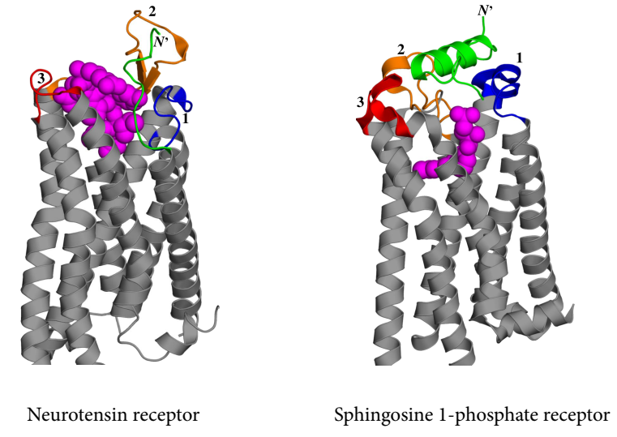
GPCRs differ mainly in their ECD
Notes:
Neurotensin receptor: The ECD is open with ECL2 forming a hairpin structure – allows binding of 13-mer peptide ligand.
Sphingosine 1-phosphate receptor: The ECD is capped by the N’ (as a helix) and ECL1 (block the entrance of the ligand). The highly hydrophobic ligands are thought to enter through the membrane.
(d) Rat neurotensin receptor (PDB entry 4xee). (e) Human sphingosine 1-phosphate receptor (PDB entry 3v2w).

Slide 24
The transmembrane domain (TMD)

Slide 25
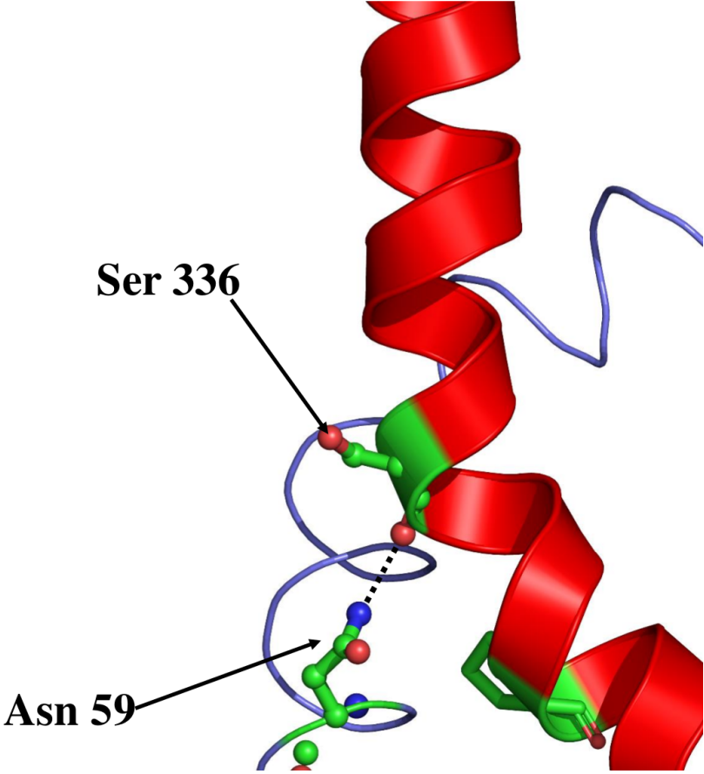
GPCRs share a NPxxY motif on TM7
This region is involved in key conformational changes occurring during GPCR activation
The Pro-induced helical distortion is stabilized by hydrogen bonds
Notes:
Figure 7.37. Stabilization of helical kink by hydrogen bond. TM7 of the β₂-adrenergic receptor is shown as a red ribbon. The kink of the helix is seen clearly. The proline residue that induces the kink is presented as sticks. The kink breaks the backbone hydrogen bond involving the carbonyl oxygen of Ser336. However, the latter is stabilized by Asn59 of TM1 (blue ribbon), which hydrogen-bonds to Ser336 (dotted black line).

Slide 26
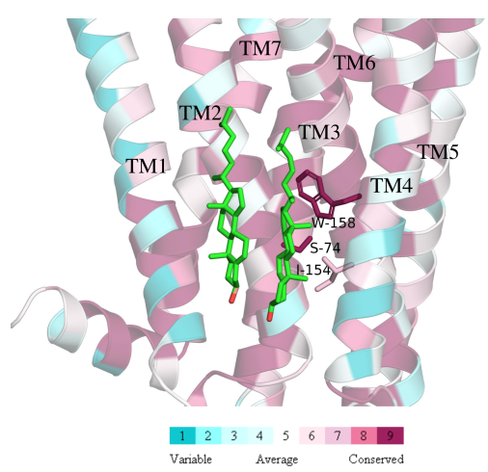
GPCRs-cholesterol interactions
GPCRs contain a cholesterol-binding site
The interaction with Trp-158 is evolutionarily conserved
This may be an allosteric site of GPCRs for regulating activity and/or dimerization
Notes:
Figure 7.38. Cholesterol binding to the β₂-adrenergic receptor (PDB entry 3d4s). The cholesterol molecules are shown as sticks (colored by atom type), whereas the receptor is represented as ribbons, colored according to evolutionary conservation level (cyan - lowest, maroon - highest; see color code in figure). The conservation levels are calculated using ConSurf (http://consurf.tau.ac.il) ^{[386, 387]}. The evolutionarily conserved residues Trp-158, Ile-154 and Ser-74 are shown as sticks. These residues are adjacent to the site of many therapeutic agents that act on class A GPCRs ^{[407]}, and their location is an attractive target for future drugs.

Slide 27
Ligand binding configuration
In small molecule-binding GPRCs the ligand may bind at different positions and orientations
A_{2A} adenosine receptor ligand
β₂ adrenergic receptor ligand
Rhodopsin's retinal
Trp 265
(transmission switch)
Notes:
The ligands of all class A GPCRs interact with both the transmembrane and EC domains, but the position of the binding pocket varies significantly in the different receptors.
In rhodopsin, the retinal is in physical proximity with Trp-265, which is part of the conserved CWxP motif , and serves as a ‘transmission switch’ that propagates the signal to the intracellular region upon activation.
Figure 7.39. Ligand-binding sites in class A GPCRs. (a) The sites of rhodopsin, the β₂-adrenergic receptor, and the A_{2A} receptors are represented by their respective ligands, as blue, red, and green sticks. Rhodopsin's Trp-265 is shown in magenta. For clarity, only rhodopsin's helices are shown, in grey.

Slide 28
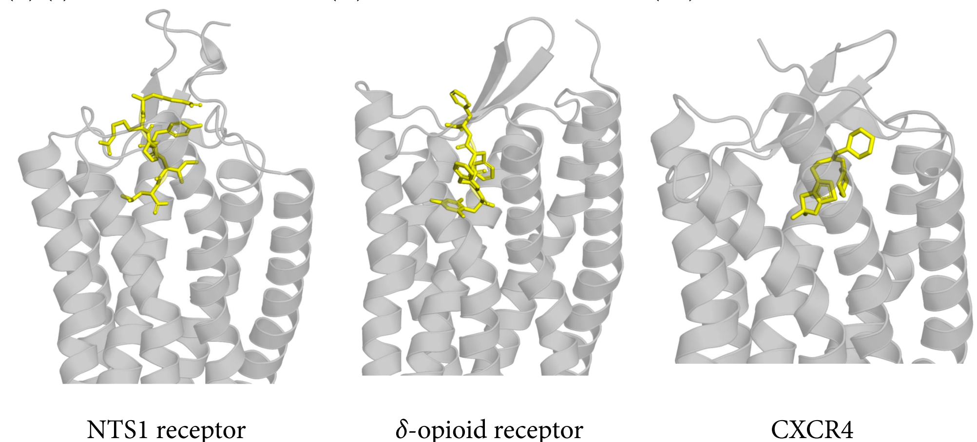
Ligand binding configuration
In peptide-binding GPRCs the ligand tends to bind closer to the extracellular domain
Notes:
Figure 7-39. Conservation of the ligand-binding site location in GPCRs. (b) Peptide binding to class A GPCRs. (I) the neurotensin 1 (NTS1) receptor (PDB entry 4xee), (II) the δ-opioid receptor (PDB entry 4rwa), and (III) CCXR4 (the human chemokine receptor 4, PDB entry 3odu). As the image demonstrates, in peptide-binding receptors, the peptides, shown as yellow sticks, tend to bind closer to the extracellular domain of the GPCR than compared to the small ligands of other class A GPCRs.

Slide 29
The intracellular domain (ICD)

Slide 30
The D/ERY motif and ionic lock in rhodopsin
Stabilizes the inactive state, broken upon activation
In other GPCRs – absent partially/completely in the inactive state
R-135
E-247
TM6
TM3
ionic lock
Rhodopsin
Notes:
The ICD has a relatively conserved conformation, probably due to the limited types of binding partners (G-proteins, arrestins, GRK)
In other the inactive states of other GPCRs the ionic lock is either absent or in equilibrium between formed and broken conformations.
Figure 7.40. The D/ERY motif. The figure shows the Arg residue of the D/ERY motif in the intracellular domain of rhodopsin (colored by atom type) and the β₂-adrenergic receptor (red). In rhodopsin, this residue forms an ionic interaction (dashed line) with an adjacent Glu residue (colored by atom type). However, in the β₂-adrenergic receptor it is too far from its respective Glu (red) to be engaged in a salt bridge.

Slide 31
The D/ERY motif and ionic lock in rhodopsin
This may explain why other class A GPCRs have baseline activity even in the absence of agonist
R-135
E-247
TM6
TM3
ionic lock
Rhodopsin
Notes:
Figure 7-40. The D/ERY motif. The figure shows the Arg residue of the D/ERY motif in rhodopsin (colored by atom type) and in the β₂AR (red). In rhodopsin, this residue forms an ionic interaction (dashed line) with an adjacent Glu residue (colored by atom type). However, in the β₂AR it is too far from its respective Glu (red) to be engaged in a salt bridge.

Slide 32
GPCR activation

Slide 33
Available structures
Studying GPCR activation requires knowledge of both active and inactive structures
There are many known inactive GPCR structure but only a few active ones
Partially active – bound only to agonist
Fully active – bound to agonist AND intracellular effector (G-protein, GRK, arrestin) or antibody
Available (fully) active structures
Rhodopsin
β₂-adrenergic receptor
Muscarinic (M2) receptor

Slide 34
GPCR activation: rhodopsin
Rhodopsin –visual receptor in the animal retina
Uses retinal as the photo-reactive cofactor
Photon absorption isomerizes retinal
This induces a conformational change and creates a G-protein (transducin) binding site
11-cis retinal
All-trans retinal
Notes:
The first information on GPCR activation came from rhodopsin. This GPCR is unique in that its ligand is light, and in that it contains an organic cofactor to transmit the light’s signal.
Figure 7.41. Structural changes in rhodopsin following its activation. (b) The retinal cofactor. The figure shows in one step the activation process in which 11-cis retinal (left) transitions into all-trans retinal (right) using the electromagnetic energy of a photon (hν). Carbon atoms 11 and 12 are noted, and the rotation around the bond connecting them is represented by the circular arrow.

Slide 35
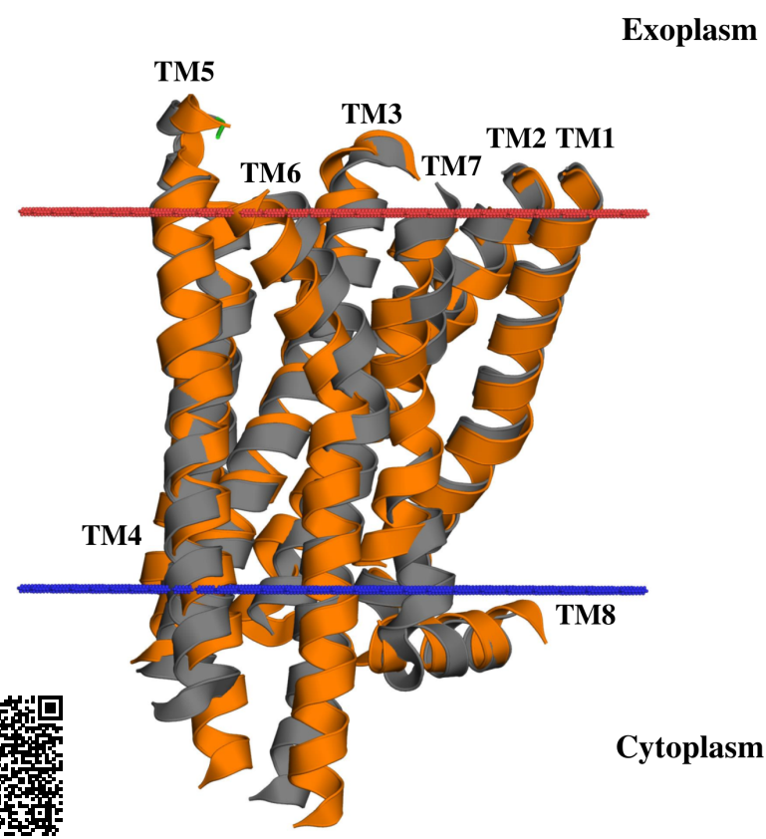
GPCR activation: rhodopsin
The active and inactive structures of rhodopsin are overall similar
Notes:
Figure 7.41. Structural changes in rhodopsin following its activation. (a) General view of activation-induced shifts of helices ^{ϴ1}. The two structures presented here are of inactive (grey; PDB 1gzm) and active rhodopsin (orange; PDB 3pqr). For clarity, the loops have been removed. The red and blue lines mark the predicted boundaries of the membrane (the OPM database ^{[119]}).

Slide 36
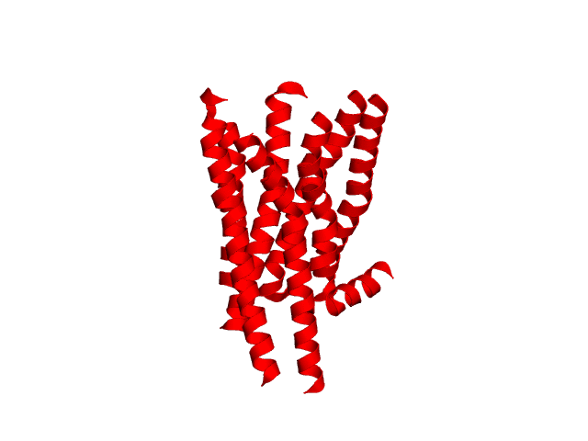
GPCR activation: rhodopsin
A dynamic view (GIF animation):
Notes:
Figure 7.41. Structural changes in rhodopsin following its activation. The animation was produced by intrapolation between the active and inactive conformations.

Slide 37
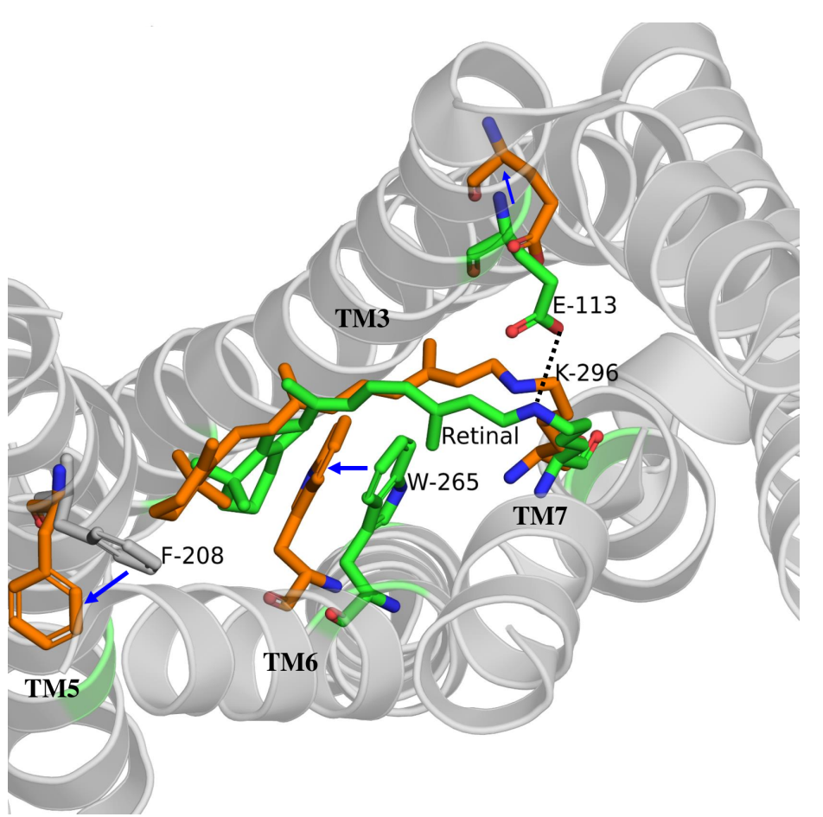
GPCR activation: rhodopsin
Changes in the TMD upon activation:
Retinal’s isomerization → shifts of F-208 and W-265
Disruption of the E113-K296 salt bridge
See magnified figure
Notes:
The view is from the extracellular side.
Trp-265 and Phe-208 are part of a mechanism called the ‘transmission switch', which participates in the propagation of the signal to the intracellular part of rhodopsin upon activation.
Figure 7.41. Structural changes in rhodopsin following its activation. (c) Conformational changes in the retinal-binding pocket ^{ϴ2}. The backbone of the inactive state (PDB 1gzm) is shown from the extracellular side as grey ribbons. Residue conformations corresponding to the inactive state are colored by atom type, whereas those corresponding to the active state (PDB 3pqr) are in orange. Movements of specific residues are marked by blue arrows. The movements of Trp 265 and Phe-208 are clearly seen, as well as the breaking of the salt bridge between Glu-113 and Lys-296 (dashed line).

Slide 38
GPCR activation: rhodopsin
Notes:
Trp-265 and Phe-208 are part of a mechanism called the ‘transmission switch', which participates in the propagation of the signal to the intracellular part of rhodopsin upon activation.
Figure 7.41. Structural changes in rhodopsin following its activation. (c) Conformational changes in the retinal-binding pocket ^{ϴ2}. The backbone of the inactive state (PDB 1gzm) is shown from the extracellular side as grey ribbons. Residue conformations corresponding to the inactive state are colored by atom type, whereas those corresponding to the active state (PDB 3pqr) are in orange. Movements of specific residues are marked by blue arrows. The movements of Trp 265 and Phe-208 are clearly seen, as well as the breaking of the salt bridge between Glu-113 and Lys-296 (dashed line).

Slide 39
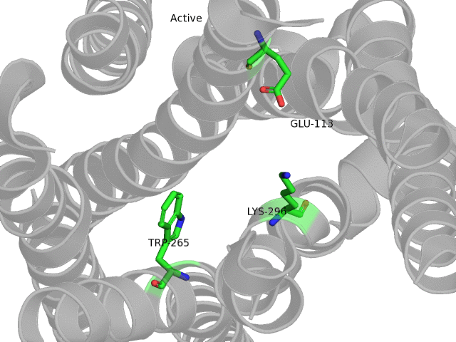
GPCR activation: rhodopsin
A dynamic view (GIF animation):
Notes:
The animation was produced by intrapolation between the active and inactive structures.

Slide 40
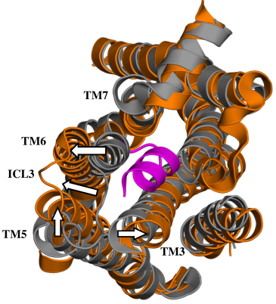
GPCR activation: rhodopsin
These are translated to larger changes in the ICD:
TM 3 and 6 shift away from center → room for transducing
Notes:
The view if from the intracellular side.
Rhodopsin was solved in complex with a short fragment of transducin’s G_{α} subunit.
(d) Changes in the intracellular side of rhodopsin, allowing the binding of transducin ^{ϴ3}. The structures and representation of the active and inactive forms of rhodopsin are the same as in panel a, but the view is from the intracellular side. (I) Transducin binding. The C-terminal 11-amino acids of transducin is presented as a purple ribbon. The white arrows denote the direction of movement of TMs 3, 5, and 6, as well as of ICL3, when rhodopsin shifts from the inactive to active state. This movement clearly creates space for the transducin fragment.

Slide 41
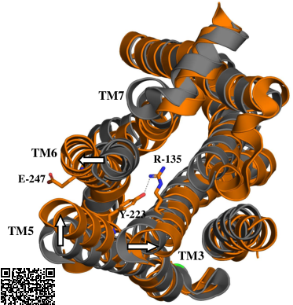
GPCR activation: rhodopsin
These are translated to larger changes in the ICD:
TM 3 and 6 shift away from center → disruption of Glu-247–Arg-135 'ionic lock' (D/ERY motif) → Arg-135 stabilized by Tyr-223
Notes:
As mentioned above, in the other structurally determined GPCRs the ionic lock is absent, at least part of the time, which has been proposed to account for the differences in baseline activity between the GPCRs: whereas rhodopsin is completely inactive in the dark, the other three GPCRs (as many others) retain some activity even when they do not bind their agonist.
(d-II) The conformational change of rhodopsin also includes a large movement of Tyr-306 of the NPxxY motif, which stabilizes the active conformation. A hydrogen bond between Tyr-306 and TM6 is shown.

Slide 42
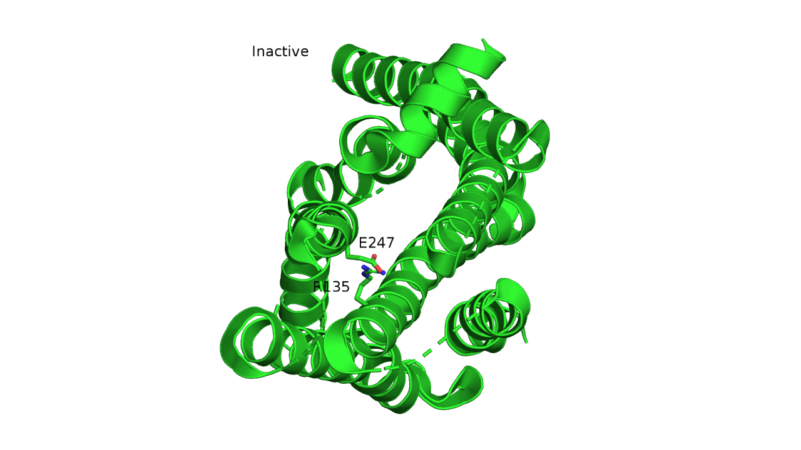
GPCR activation: rhodopsin
A dynamic view (GIF animation):
Notes:
The animation was produced by intrapolation between the active and inactive structures.

Slide 43
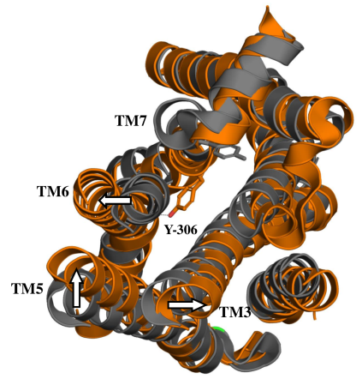
GPCR activation: rhodopsin
These are translated to larger changes in the ICD:
Tyr-306 (NPxxY motif) shift → stabilizes the active conformation
Notes:
Similar movements are observed also in the equivalent positions of Tyr-306 in the β₁- and β₂-adrenergic receptors, the muscarinic (M₂) receptor, and the A_{2A} receptor.
(d-III) The conformational change disrupts the inactive state-related ionic lock, which involves Glu-247 of TM6 and Arg-135 of TM3’s D/ERY motif. In its new position, Arg-135 is stabilized by a hydrogen bond with Tyr-223 (dashed line).

Slide 44
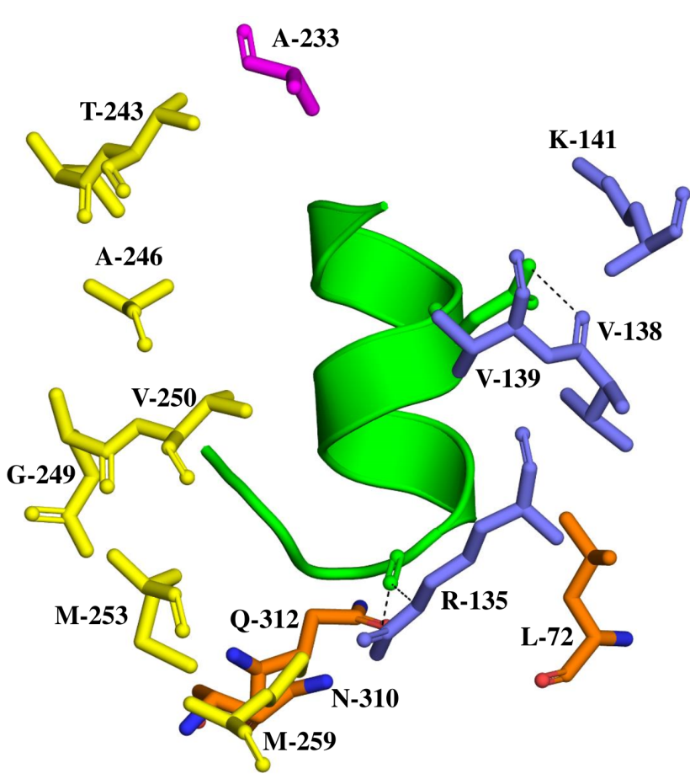
GPCR activation: rhodopsin
Transducin stabilizes the active conformation of rhodopsin via multiple interactions
Notes:
(e) Stabilization of rhodopsin's active conformation by transducin. Transducing is presented in green. Residues of rhodopsin's helices 5 and 6, which are involved in nonpolar and van der Waals interactions with transducin are colored in magenta (helix 5) and cyan (helix 6). Finally, Arg 135 and Gln 312, which hydrogen-bond to transducin are colored in blue and orange, respectively.

Slide 45
GPCR activation: the agonist effect
β₂-adrenergic receptor structure – with bound agonist and entire G-protein
Notes:
Rhodopsin does not bind a physical ligand, therefore it cannot provide information on how ligand binding to the rest of the GPCRs leads to activation. This information is provided by second active structure that we have – that of the beta2-adrenergic receptor. Moreover, since this structure was determined with a complete bound G-protein, it also provides better information on how the receptor activation leads to G-protein activation.
The G-protein in the crystallized structure is nucleotide-free, which means it was captured in the middle of the GDP-GTP exchange process.
Figure 7-34. (a)II. The 3D structure of the β₂-adrenergic receptor in complex with Gs-protein (PDB entry 3sn6). The GPCR is shown in orange, with the agonist presented as grey spheres. The α, β, and γ subunits of the G-protein are colored in green, magenta, and blue, respectively.

Slide 46
Adrenergic receptors respond to adrenaline and noradrenaline
Noradrenaline
Adrenaline
Notes:
Adrenaline and noradrenaline are synthesized by both the adrenal medulla and the nervous system, although in the latter noradrenaline is more common.
Figure 7.2.1. The molecular structures of adrenaline and noradrenaline. Adrenaline is formed by N-methylation of noradrenaline.

Slide 47
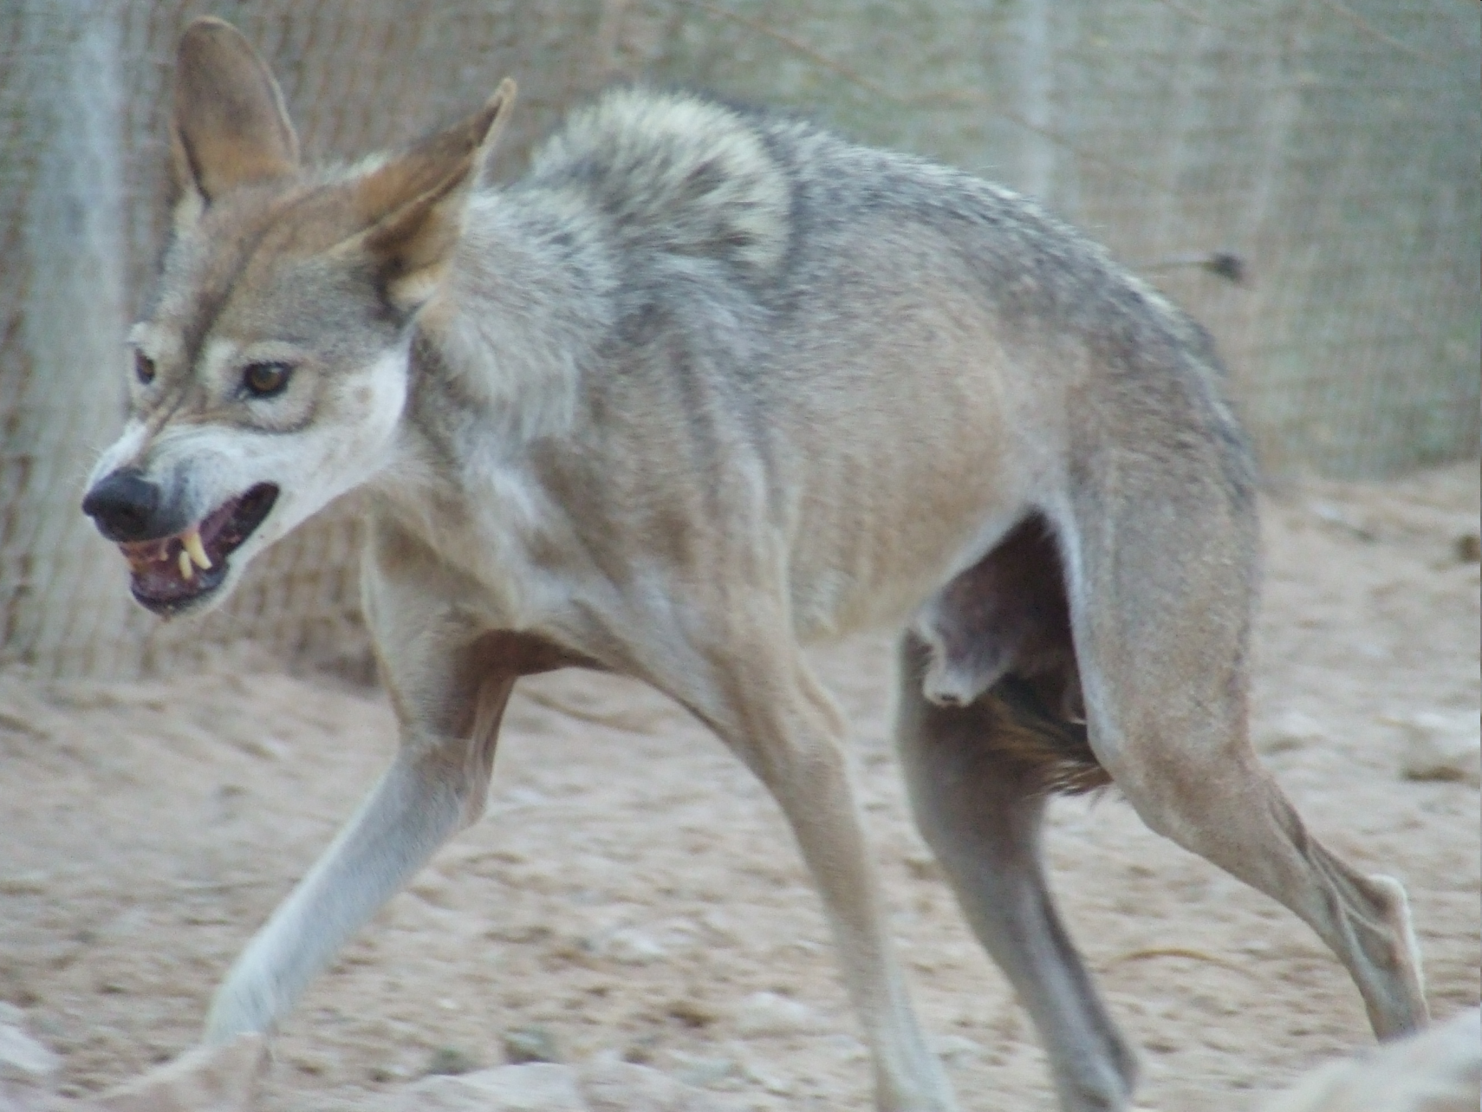
Adrenergic receptors mediate 'fight or flight' neurotransmission
Notes:
Figure 7.2.2. A wolf in a fight-or-flight posture. The image is taken from ^{[429]}.

Slide 48
Adrenergic receptors activation has different physiological outcomes
1. Increased heart rate and stroke volume
2. Diversion of blood from the skin and GI tract to the heart, lungs, brain, and skeletal muscles
3. Increased blood pressure
4. Pupil dilation
5. Windpipe dilation
6. Relaxation of GI smooth muscle

Slide 49
Adrenergic receptors activation has different physiological outcomes
7. Increased blood clotting rate → less danger of haemorrhages following injury
8. Increased sweating → cooling down of overly worked body
9. Increased metabolic rate, resulting from the breakdown of both liver lipid storages and muscle glycogen storages

Slide 50
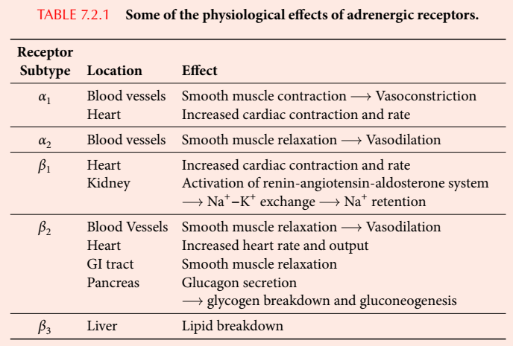
There are 5 subtypes of adrenergic receptors

Slide 51
The adrenergic system is targeted by different pharmaceutical drugs
β₂ agonists (asthma)
α₂ agonists (hypertension)
β₁ blockers (angina pectoris, hypertension, arrhythmias)
Reuptake inhibitors (depression)
MAO inhibitors (depression)

Slide 52
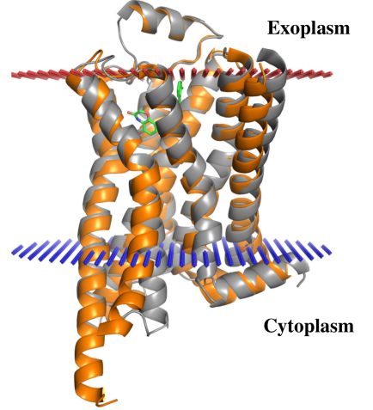
GPCR activation: the agonist effect
As in rhodopsin - small structural changes in the ECD and larger changes in the ICD
Notes:
Figure 7.42. Structural changes in the β₂-adrenergic receptor following its activation. (a) Superimposition of the active and inactive structures of the β₂-adrenergic receptor. The inactive structure (grey; PDB entry 2rh1) is bound to the inverse agonist carazolol, and the active structure (orange; PDB entry 3sn6) is bound to the agonist BI-167107.

Slide 53
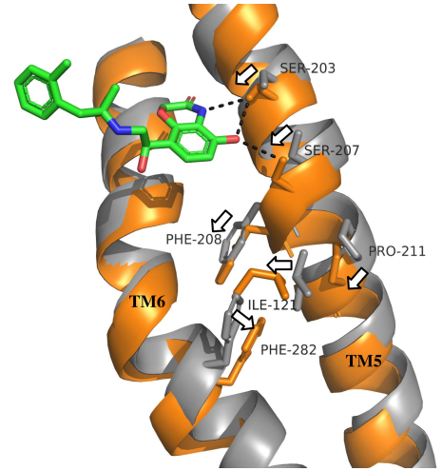
GPCR activation: the agonist effect
Agonist-TM5 hydrogen bonds:
TM5 is pulled inwardly → rearrangement of nonpolar interactions downstream
Notes:
Serines 203 and 207 are highly conserved, in agreement with their activation role.
In contrast to rhodopsin, Phe-208 is the only residue comprising the transmission switch that plays a part in the activation of the β-adrenergic receptor. Trp-286 does not.
(b) Agonist-induced movements of TMs 5 and 6, and of key residues that act as molecular switches. The agonist is shown as sticks, colored by atom type. The hydrogen bonds between the agonist and residues in TM5 are shown as dashed lines. The resulting movement of TM5 leads to local movements of the downstream nonpolar residues Phe-208, Pro-211, Ile-121, and Phe-282, and the hydrophobic contacts between them. The movement of each of the above residues is marked by arrows.

Slide 54
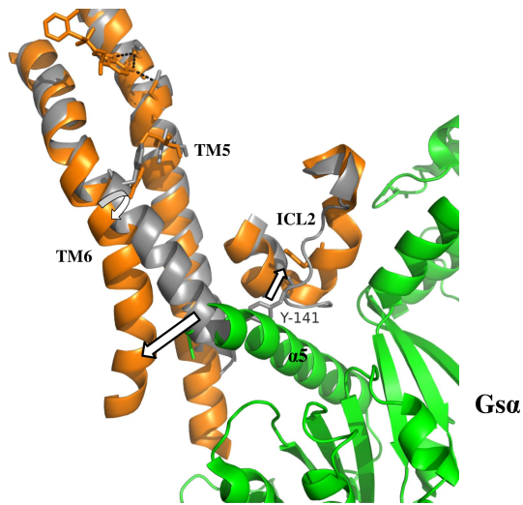
GPCR activation: the agonist effect
Agonist-TM5 hydrogen bonds:
→ TM6 is pushed outwardly → insertion of G_{α} helix to TMD
Notes:
Here, the hinge movement is around Phe-282, and does not involve a proline residue. However, the adjacent Gly-280 (just below Phe-282) most likely facilitates this movement.
(c) Conformational changes in the intracellular side of the receptor upon agonist binding. The changes described in b induce a large hinge movement (curved arrow) in TM6, which creates room in its intracellular side for the α5 helix of G_{α} (marked). In addition, ICL2 shifts away from TM6, with a large change in the position of Tyr-141. Smaller changes in the position of TM3 and TM7 are not shown. As can be clearly seen, the position of TM6 in the inactive state clashes with the helix of Gα, which prevents the binding of the latter to the GPCR.

Slide 55
GPCR activation: the agonist effect
Similar conformational changes in all active GPCRs:
Large TM6 shift, smaller shifts of TMs 3, 5, and 7
TM shifts create room for G-protein
Notes:
(e) Comparison between movements of helices in rhodopsin and those in the β₂-adrenergic receptor, β₁-adrenergic receptor (where the inactive and active structures correspond to PDB entries 2vt4 and 2y03, respectively) and muscarinic (M₂) receptor. The inactive and active conformations of all three GPCRs are colored in grey and orange, respectively. The arrows mark movements of the intracellular sides of the helices, were the length of each arrow is proportional to the degree of movement. For clarity, the helices are shown as cylinders and the loops are not shown.

Slide 56
GPCR activation: the agonist effect
G-protein activation :
GPCR binding → hinge motion in G_{α} → exchange of GDP with GTP
(Nature 000, 1-7 (2011) doi:10.1038/nature10361)

Slide 57
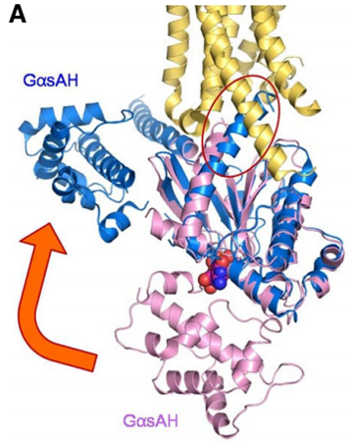
GPCR activation: the agonist effect
Agonist-TM5 hydrogen bonds:
GPCR binding → hinge motion in G_{α} → exchange of GDP with GTP
(Mol. Cells (2015) 38:105-111)
Notes:
(d) Superimposition of the structure of Gα in complex with β₂-adrenergic receptor (PDB entry 3sn6; Gα is color in cyan and β₂-adrenergic receptor is colored in gold) and free Gα bound to guanosine 5'-O-(3-thiotriphosphate) (GTPγS) (PDB entry 1AZT; Gα is colored in pink and GTPγS is shown as blue and red spheres). The G_{α}sAH and GαsRas domains that hold the GTP molecule are marked. The superimposition shows that the GαsAH domain is largely displaced with respect to GαsRas in the nucleotide-free state compared to the nucleotide-bound state (orange arrow). The carboxy end of the α5 helix of Gα is circled in red.

Slide 58
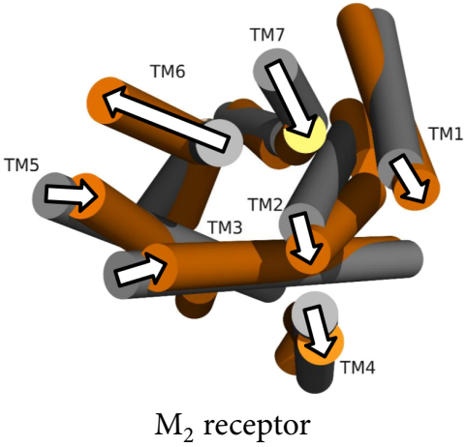
GPCR activation: the agonist effect
The M₂ receptor
Mediates cholinergic transmission
Contains 5 subtypes
Targeted by drugs for treating Alzheimer’s disease, Parkinson’s disease, and schizophrenia
Known inactive structures - M₂ and M₃ (2012)
Known (fully) active structure - M₂ (2013)
Largest changes: TMs 5,6,7

Slide 59
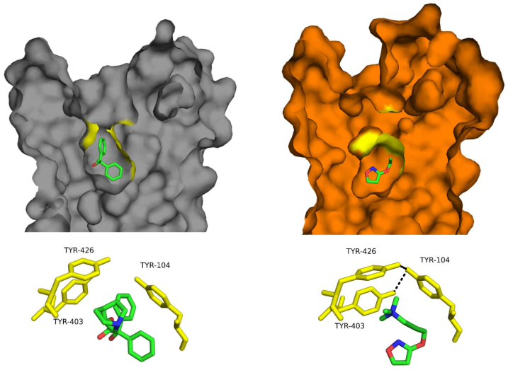
GPCR activation: the agonist effect
The M₂ receptor
Activation leads to complete burial of the agonist inside the pocket (‘aromatic lid’)
Notes:
Figure 7.43. Activation of M₂ receptor and allostery. (a) Conformational changes in the ligand-binding site of the M₂ receptor. Top: A cross-section through the binding site of the inactive (grey; PDB entry 3uon) and active (orange; PDB entry 4mqs) structures of the M₂ receptor. The inactive structure is bound to the antagonist QNB, and the active structure is bound to the agonist iperoxo. The aromatic lid residues above the ligands are colored in yellow. Activation induces conformational changes that lead to the complete occlusion of the agonist from the solvent. Bottom: Activation-induced closure of the aromatic lid (yellow sticks).

Slide 60
GPCR activation: the agonist effect
The M₂ receptor
Both agonist and antagonist interact with Asn-404
Agonist is smaller → closer to TM3 → pulls TM6 closer to TM3 in TMD and away from it in the ICD
Notes:
(b) Propagation of the conformational change in TM6 from the ligand-binding site to the intracellular site of the receptor. The image shows a superimposition of the active and inactive structures of M₂ receptor. For clarity, only TMs 3 and 6 are shown. In the inactive state the antagonist is hydrogen-bonded to Asn-404 on TM6 (black dashed line). Activation of the GPCR induces a small movement of TM6 towards TM3 and allows Asn-404 to remain hydrogen-bonded to the agonist (orange dashed line), which is located more distantly from TM6 than the antagonist. The pivot motion of TM6 around Thr-399 (curved white arrow) converts the small movement of the helix near the ligand-binding site to a large movement at the intracellular site, away from TM3. A coordinated movement of TM3 away from TM6 allows a hydrogen bond to be formed between Asp-120 and Asn-58. The activation also involves a conformational change in TM7, which changes the orientation of Tyr-440 (the NPxxY motif), thus allowing it to interact with Tyr-206. Note that although the interaction shown here as a direct hydrogen bond (black dashed line), in reality it is mediated by a water molecule, which is missing in the solved structure.

Slide 61
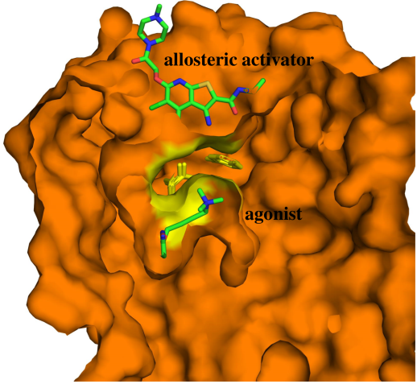
GPCR activation: the agonist effect
The M₂ receptor
Allosteric activator acts by stabilizing an active conformation
Notes:
The mode of action of allosteric activators is supported by the M₂ structure, which, when bound to agonist, is identical whether or not the activator is also bound.
Allosteric modulation is common in GPCRs. The modulators are chemically diverse and include lipids (e.g. fatty acids, phospholipids, and cholesterol), amino acids, ions (e.g. Na⁺), and different small molecules.
(c) Binding of the allosteric activator LY2119620 to the agonist-bound M₂ receptor (PDB entry 4mqt). LY2119620 binds above the agonist pocket, where it is separated from the agonist iperoxo by the aromatic lid residues (in yellow). (d) Membrane-facing position of an allosteric site in the P2Y₁ receptor (PDB entry 4xnv). The allosteric site is occupied by the negative modulator BPTU (with blue carbon spheres). The orthosteric site, which resides in the extracellular loops region of the receptor, is shown with a bound antagonist (orange spheres; PDB entry 4xnw). Co-crystallized lipid molecules are also shown, in pink).

Slide 62
GPCR activation: summary
Small changes in ECD and TMD are transmitted and amplified to the ICD by a variety of molecular triggers (ionic locks, transmission switches)
The triggers are often part of highly conserved motifs (D/ERY, NPxxY)
Large ICD helices shifts (mainly TM6, also TMs 3,5,7):
Create a G-protein binding site
Promote nucleotide exchange in G_{α}

Slide 63
GPCR desensitization
Ser/Thr phosphorylation by GRKs, on:
ICL3
C’ of GPCR
Notes:
GRKs act on activated GPCRs (agonist-bound)

Slide 64
GPCR desensitization
Arrestin binding:
Prevents GPCR-G-protein binding
Promotes GPCRs internalization and recycling
Notes:
The GPCR is still in its activated (agonist-bound) form when bound to arrestin.
The bound arrestin recruits clathrin and its adaptor protein AP-2, which induces the internalization of the GPCRs into the cell via clathrin-coated vesicles, followed by their recycling or degradation.

Slide 65
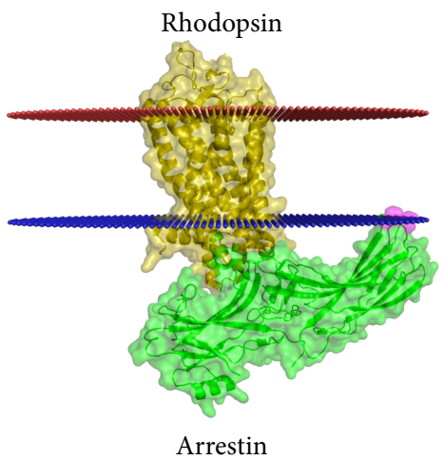
GPCR desensitization
Arrestin binding
Visual arrestin interacts also with the membrane
This stabilizes the complex
Notes:
Rhodopsin here is not phosphorylated and the binding to arrestin was achieved by using mutations in both binding partners. Thus, arrestin in this complex is in its pre-activated state.
Figure 7.44. Binding of arrestin to active rhodopsin. (a) The overall structure of the complex (PDB entry 4zwj), where rhodopsin is in gold and arrestin is in green. The conserved hydrophobic patch in arrestin is colored in pink. The red and blue lines mark the predicted boundaries of the membrane (the OPM database ^{[119]}).

Slide 66
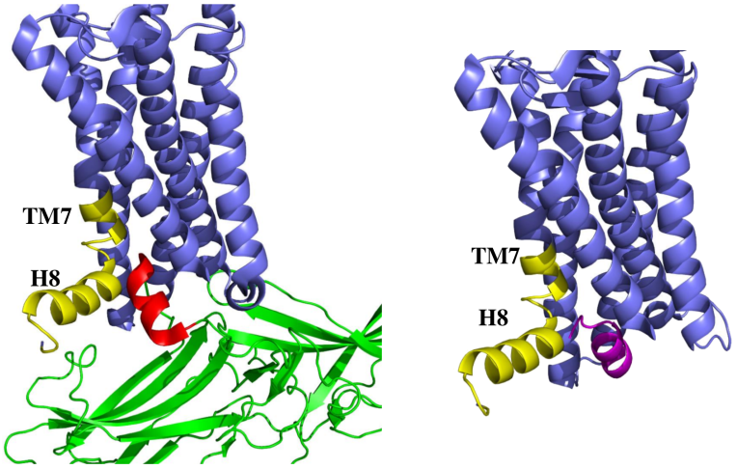
GPCR desensitization
Arrestin binding
Arrestin and transducin bind rhodopsin similarly (helical segment, interacting with TM and H8)
Arrestin also binds to rhodopsin’s ICL2
Notes:
(b) Left: the interaction of arrestin’s short helical segment with rhodopsin’s TM7 and helix 8, where rhodopsin is in blue, the trunsducin segment is in magenta, and the TM7-H8 binding site is in yellow. Right: the structure of active rhodopsin bound to a short segment of the Gα subunit of transducin (PDB entry 3pqr), where the trunsducin segment is in magenta. The segment binds to same intracellular pocket of rhodopsin as arrestin’s short segment, although the orientations of the two segments within the pocket are different.

Slide 67
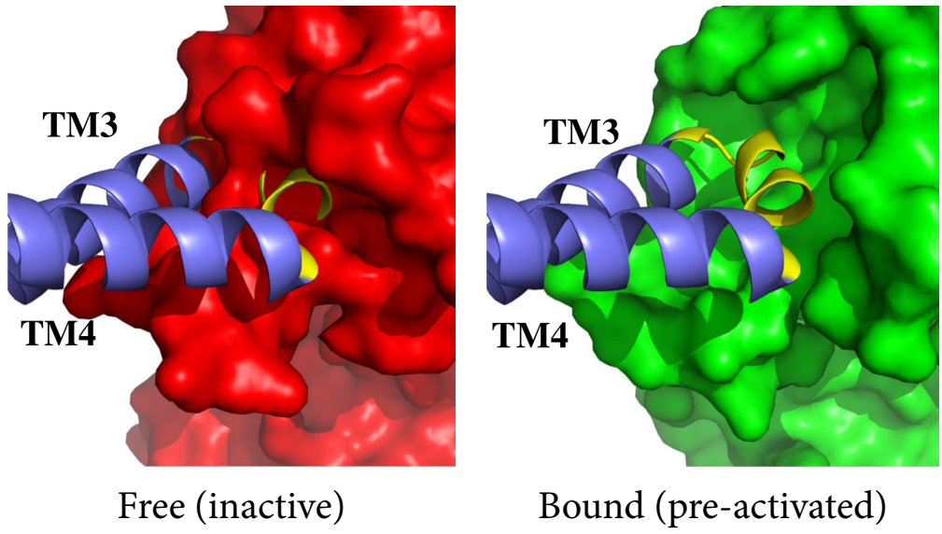
GPCR desensitization
Arrestin binding
Binding involves conformational changes in arrestin to accommodate rhodopsin’s ICL2
Notes:
(c) Interaction between arrestin and rhodopsin’s ICL2 (colored yellow). Left: free arrestin in its basal (inactive) state (red, PDB entry 1cf1), superimposed on the pre-activated arrestin. Right: the rhodopsin-arrestin complex. The pre-activated arrestin has an open conformation that accommodates ICL2. For clarity, only TM3, TM4 and ICL2 are shown in rhodopsin. The ICL2-interacting pocket is close, and sterically clashes with the short helix of ICL2.

Slide 68
Class B GPCRs
Bind large peptide hormones
Targeted by drugs for treating diabetes, stress response, cardiovascular regulation, etc.
Known structure: the corticotropin-releasing factor (CRF) and glucagon receptors (inactive)
Notes:
To stabilize the structures, large portions had to be removed. Thus, the known structures represent mainly the TM domain.

Slide 69
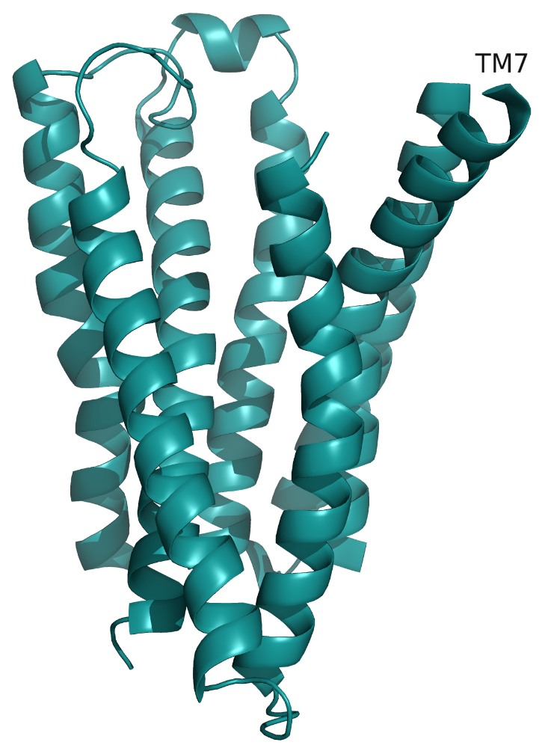
Class B GPCRs
Parts of the ECD and the peptide ligand are missing
Thus, the structures are not very informative
CRF receptor
Glucagon receptor
Notes:
Both receptors have some non-class A features: V shape (CRF1R), long TM1 (glucagon receptor).
The CRF receptor was complexed with a non-peptide antagonist (not shown) and in the glucagon receptor the antagonist was not resolved. Thus, in both cases the binding site for the peptide agonist cannot be detected.
Figure 7.45. The transmembrane domain of class B GPCRs. (a) The inactive corticotropin-releasing factor receptor 1 (CRFR1) bound to the non-peptide antagonist CP-376395 (PDB entry 4k5y). The full structure of the receptor (blue ribbons), with the bound ligand shown as yellow sticks. TM7, which has an unusual kink, is marked. (b) The inactive glucagon receptor (PDB entry 4l6r). The receptor was crystallized in the presence of the antagonist NNC0640, but the latter was not resolved in the structure.

Slide 70
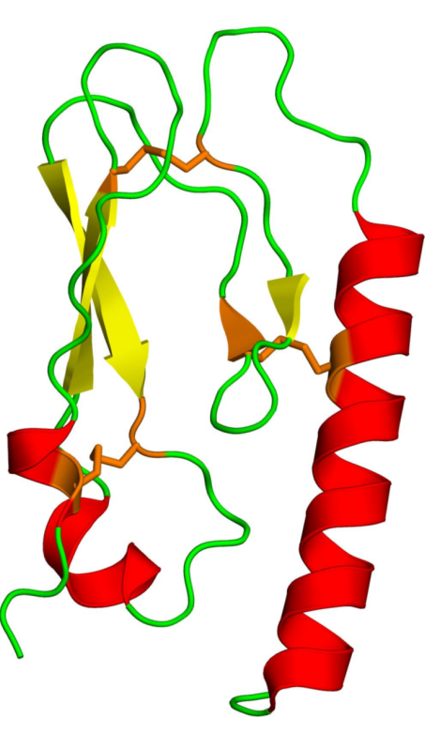
Class B GPCRs
The isolated ECD is stabilized by three disulfide bonds
Notes:
Figure 7.46. Ligand binding in class B GPCRs. The extracellular domain (ECD) of the human Gip receptor, in complex with the hormone Gip (PDB entry 2qkh). (a) The structure of the ECD, colored by secondary structure. The disulfide bonds are represented as orange sticks.

Slide 71
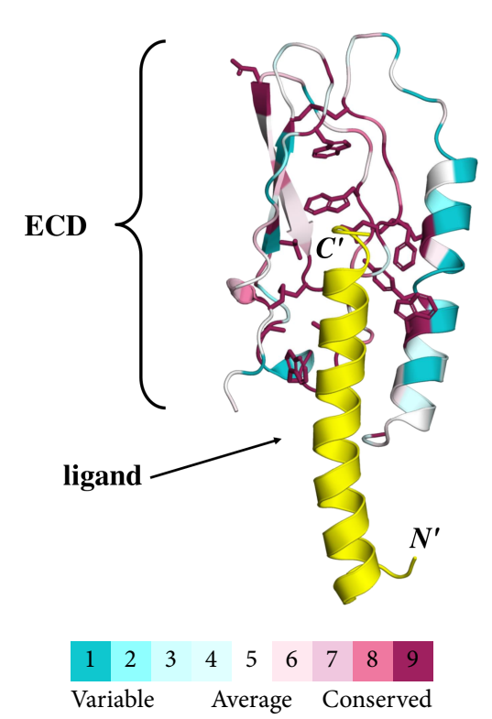
Class B GPCRs
The bound peptides acquire an α-helical conformation upon binding
The ECD includes highly conserved aromatic residues that interact with the peptide’s C’
The N' interacts with extracellular loops and TMD helices
Notes:
(b) General view of the ECD-Gip complex. The ECD is colored by conservation (cyan - lowest, maroon - highest. See color-code in figure), and the peptide ligand is in yellow, with its termini noted. The side chains of the highly conserved residues in ECD are shown as sticks. Expectedly, most of the highly conserved residues in ECD face the peptide ligand. The conservation is calculated by the ConSurf web server (http://consurf.tau.ac.il) ^{[383, 384]}.

Slide 72
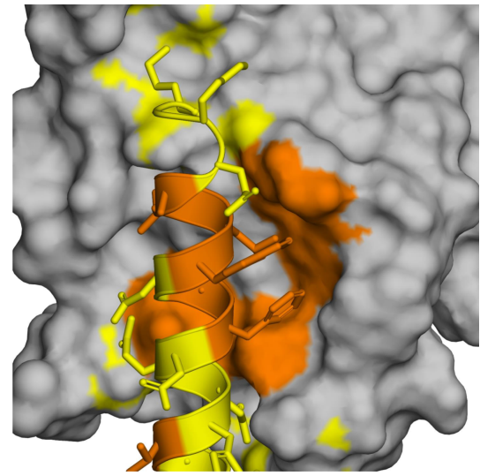
Class B GPCRs
ECD-peptide interactions are mainly nonpolar, but also polar
Polar residues
Nonpolar residues
Notes:
(c) ECD-ligand interactions. The surface of the receptor's ECD is shown in gray. The ligand peptide is shown as a ribbon, with its side-chains represented as sticks. In both the ligand and ECD residues interacting with it, polar residues are in yellow and nonpolar residues in orange. The interactions are similar between different class B GPCRs, and the ECD loops 2 and 4, which mediate them, are also the parts undergoing the most significant conformational changes following activation.

Slide 73
Class C GPCRs
Metabotropic glutamate receptors (mGluRs)
GABA_{B} receptors
Ca²⁺-sensing receptors (CaSRs)
Pheromone receptors
Sweet and amino acid taste receptors (TAS1R)
Odorant receptors (in fish)
Notes:
Most of the knowledge on class C GPCRs comes from studies of the mGluR.

Slide 74
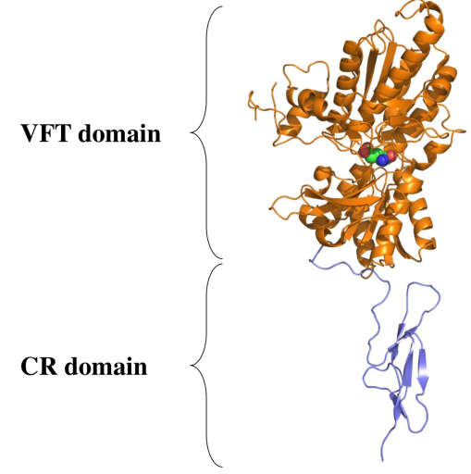
Class C GPCRs: the mGlu receptor
Class C GPCRs bind their ligands only through the ECD (unlike classes A,B)
The VFT domain binds the ligand and mediate dimerization
Notes:
There are 8 subtypes of mGluR.
Glutamate is the principal excitatory neurotransmitter in the central and peripheral nervous systems, and it is involved in numerous neurological functions like memory and learning, sensory and motor functions, emotions, etc. Thus, mGluR malfunctioning leads to diseases like epilepsy, neurodegeneration, chronic pain, schizophrenia, anxiety, and autism. Accordingly, mGlu receptors are promising targets of different neurological and psychiatric drugs.
Figure 7.47. The structure of the metabotropic glutamate receptor (mGluR). (a) The extracellular domain of mGlu3 monomer in complex with glutamate ^{[471]} (PDB entry 2e4u). The Venus fly trap (VFT) and cysteine-rich (CR) domains are noted.

Slide 75
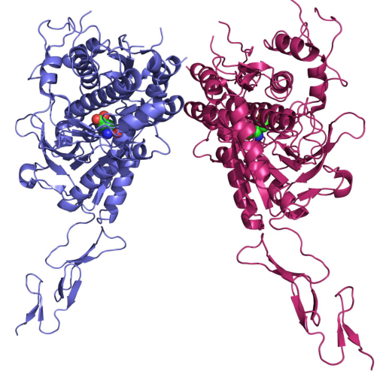
Class C GPCRs: the mGlu receptor
The mGluR forms disulfide-linked homodimers
The GABA_{B} and taste 1 (TAS1) receptors form non-crosslinked heterodimers
Notes:
The S-S bonded region is missing in the structure.
(b) The dimeric structure of the EC domain of mGlu3. Each monomer is in a different color. The monomers interact via the VFT domain. The disulfide bond between the monomers is located in a disordered region that was not resolved in the structure.

Slide 76
Class C GPCRs: the mGlu receptor
The TMDs of mGluR1 and mGluR5 are overall similar to those of class A and B GPCRs
Allosteric binding site - deeper than in class A
mGluR5
mGluR1
Notes:
The structure of the TMD of mGluR5 was determined with an allosteric modulator. Modulation of this domain has great potential for drugs treating anxiety disorders (negative modulation), as well as schizophrenia and disorders of cognitive function (positive modulation).
In mGluR5, large flexible portions of the ECD and ICD had to be removed – positioning of ECD with respect to the TMD is still unknown. In mGluR1 the linker region is present.
(c) The transmembrane domain of mGluR5 (PDB entry 4oo9) and mGluR1 (PDB entry 4or2), in complex with the negative allosteric modulators mavoglurant and FITM (respectively), shown as yellow sticks. ECL2, which caps the entrance to the allosteric site, is colored in magenta. The region in mGluR1 linking the transmembrane domain to the ECD domain is colored in green.

Slide 77
Class C GPCRs: the mGlu receptor
The postulated structure of the entire monomeric mGluR1:
mGluR1
Notes:
(d) The postulated structure of the entire monomeric mGluR (for a more elaborate structure and domains interactions, see ^{[401]}). The structure was produced by joining the TMD and ECD through the linker regions.

Slide 78
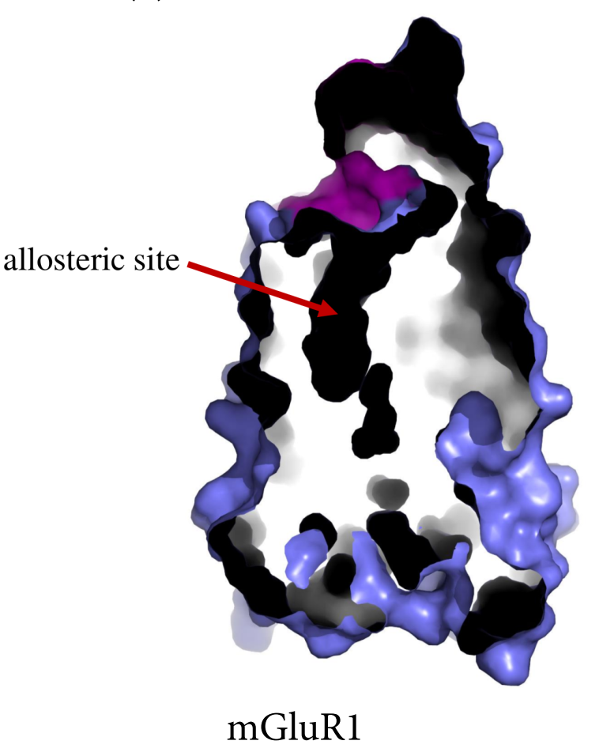
Class C GPCRs: the mGlu receptor
The entrance to the allosteric site in both structures is occluded by ECL2 and it is quite narrow
Notes:
(e) A cross section through mGluR1, showing the narrow allosteric site.

Slide 79
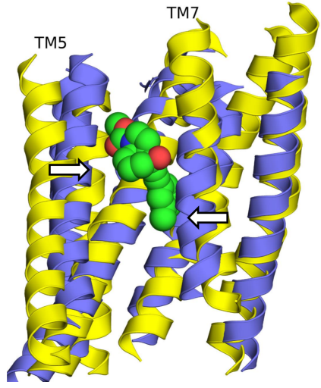
Class C GPCRs: the mGlu receptor
This is mainly due to TMs 5, 7 (more inward compared to class A and class B GPCRs)
Notes:
(f) Superposition of mGluR5 and rhodopsin (PDB entry 1gzm), showing the differences is the relative orientations of TMs 5 and 7 between them. For clarity, only transmembrane helices are shown.

Slide 80
Class F GPCRs: SMO receptor
Smoothened (SMO)
A GPCR-like protein (activates intracellular partners other than G-protein)
Constitute a part of the hedgehog (Hh) signaling pathway (regulates animal embryonic development)
Few structures of SMO have been determined, in complex with different ligands
Notes:
Although SMO works with intracellular partners other than G-protein in the hedgehog pathway (e.g. the the kinesin-like protein Costal-2 (Cos2).), it has also been shown to activate G-proteins. The exact way in which SMO activates the mammalian pathway is less understood, and may involve G-proteins.

Slide 81
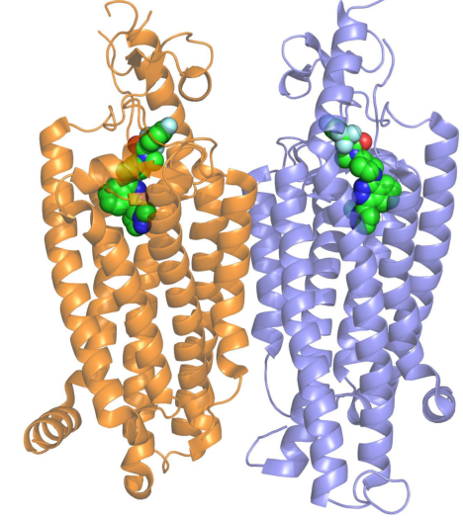
Class F GPCRs: SMO receptor
The GPCR TMD domain is preserved despite a < 10% sequence identity to class A GPCRs
Differences - mostly in TMs 5-7 (like in mGluR)
SMO bound to antagonist
Notes:
The low sequence identity results in the absence of most of the conserved motifs of class A GPCRs, including D/ERY (TM3), CWxP (TM6) and NPxxY (TM7).
Figure 7.48. The smoothened protein (SMO). (a) The structure of the dimeric human SMO, bound to the antagonist LY2940680 (PDB entry 4jkv). Each subunit is colored differently, and the ligand is shown as spheres, colored by atom type.

Slide 82
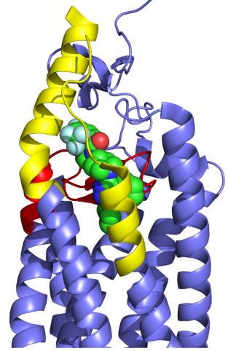
Class F GPCRs: SMO receptor
The ligand binds to the interface between the TMD and complex ECD, and interacts mainly with ECL2 and ECL3
Notes:
(b) The location of the ligand at the interface between the TMD and the ECD allows the ligand to interact extensively with ECL2 (red) and ECL3 (yellow).

Slide 83
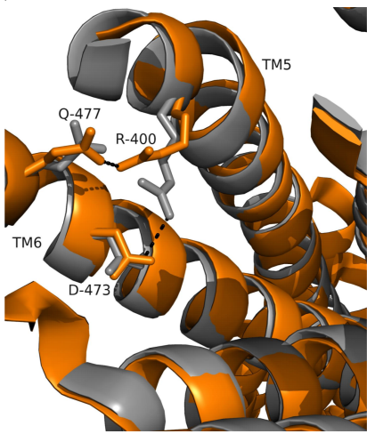
Class F GPCRs: SMO receptor
Partial activation (agonist alone)
Arg-400--Asp-473 ionic lock lost
Arg-400--Asn-477 Hbond forms
Extracellular view
Notes:
The orange structure has been determined in the absence of an intracellular partner, therefore it represents a partially active state.
(c,d) Superposition of an antagonist-bound structure and an agonist-bound structure of SMO (PDB entries 4n4w and 4qin, respectively). For clarity, ECD segments and intracellular loops have been removed. (c) An extracellular view of the superposed structures, showing differences in non-covalent interactions that involve Arg-400, Asp-473, and Asn-477.

Slide 84
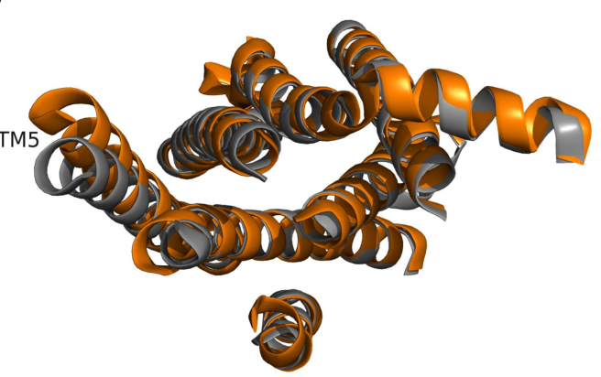
Class F GPCRs: SMO receptor
Partial activation (agonist alone)
Only big difference in TMD is in TM5
Intracellular view
Notes:
The small conformational changes in the ICD upon activation may represent a principal difference between class A and class F GPCRs, but not necessarily; it may result from the fact that the receptor is only partially active.
(d) An intracellular view of the superposed structures showing conformational changes in the orientation of transmembrane helices.

Slide 85
GPCR-Acting Drugs

Slide 86
GPCRs-acting drugs
GPCRs participate in numerous physiological processes
Therefore, they are involved in numerous diseases
Accordingly, they are targeted by 30-50% of the clinically prescribed drugs

Slide 87
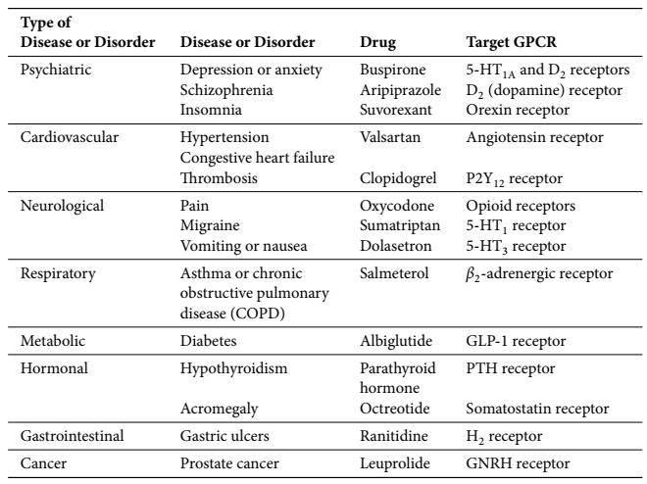
GPCRs-acting drugs: diseases/conditions

Slide 88
GPCRs-acting drugs: types
Orthosteric
Constitute most of the GPCR-acting drugs
Bind to the orthosteric site of the GPCR
Act as agonists, antagonists, or inverse agonists
Example: haloperidol is a D2 (dopamine) receptor antagonist
Allosteric
Bind to an allosteric site in the GPCR
Act as an activator or inhibitor
Highly sought for but difficult to design
Example: maraviroc is a CCR5 receptor inhibitor

Slide 89
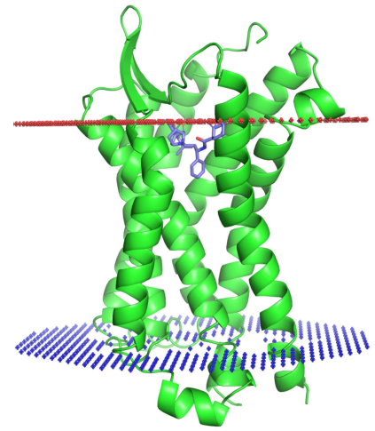
GPCRs-acting drugs: allosteric drugs
Maraviroc:
CCR5
Notes:
Maraviroc is an allosteric, antiretroviral drug. By stabilizing the inactive conformation of CCR5 (an HIV co-receptor) the drug prevents it from binding to the virus, thus blocking virus entry into the cells.
Figure 7.49. Binding of the drug maraviroc to CCR5. (a) An overall view of the receptor. The receptor is shown as a green ribbon, and maraviroc, which is bound to the ECD-TMD interface, is shown as blue sticks.

Slide 90
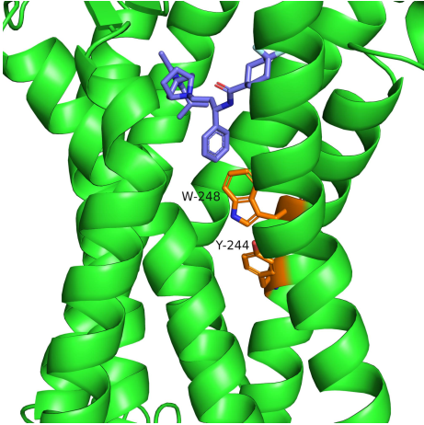
GPCRs-acting drugs: allosteric drugs
Maraviroc:
Notes:
Maraviroc supposedly prevents CCR5 from acquiring an active conformation by interacting with Trp-248 (an activation switch) via nonpolar and aromatic interactions, thus preventing Trp-248 from moving. In other class A GPCRs, the counterparts of Trp-248 and Y-244 form an activation switch that undergoes conformational changes upon agonist binding and relay the signal to the ICD.
(b) A magnification of the maraviroc binding site. The drug forms nonpolar interactions with Trp-248, which is thought to prevent the protein from undergoing activation-induced conformational changes. Trp-248 and Tyr-244 constitute a switch that relays the ligand-induced activation process to the intracellular domain. Thus, preventing Trp-248 from moving is expected to inhibit CCR5 activation, which in turn prevents CCR5-HIV binding and viral entry into the cell.

Slide 91
GPCRs-acting drugs: goals
Biased drugs
Activate specific signaling pathways, therefore more specific (fewer side effects)
Dual-acting drugs
Bind to different receptors or other proteins, therefore allow their coupling to obtain better results
Monoclonal antibodies
Bind in a highly specific manner (fewer side effects)
Drugs that affect GPCR trafficking/desensitization

