Slide 1
This PPT presentation is provided as suppl. material to the book:
Introduction to Proteins: Structure, Function, and Motion
1st Edition (2010)
Amit Kessel & Nir Ben-Tal

Slide 2
Antimicrobial Peptides (AMPs)

Slide 3
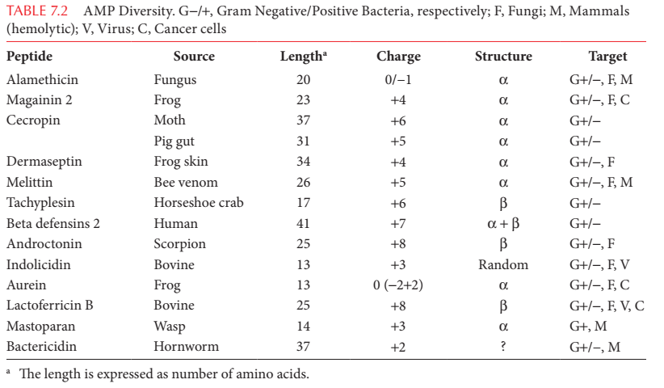
AMPs are extremely diverse
Notes:
Table 7-2. AMPs diversity. G-/+ Gram negative/positive bacteria, respectively; F – fungi; M – mammals (hemolytic); V – virus; C – cancer cells
* The length is expressed as number of amino acids.

Slide 4
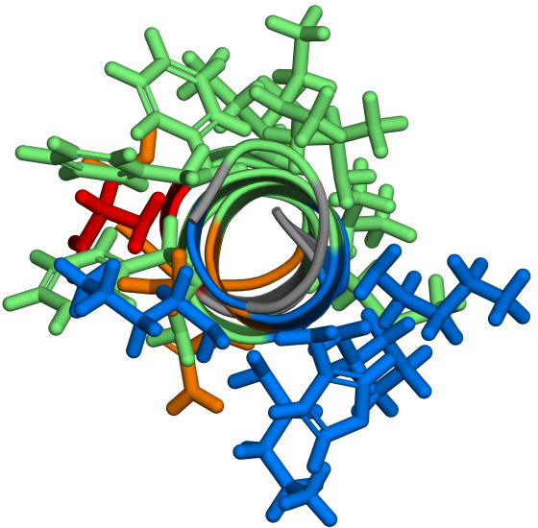
AMPs are extremely diverse
However, they can be grouped into the following types:
Small, anionic
α-helical, cationic
Magainin
Notes:
Figure 7-22. Classes of AMPs. (a) α-helical cationic peptides. The structure shown is that of magainin (PDB entry 2mag), with basic residues in blue, polar-neutral residues in orange, acidic residues in red, and nonpolar residues in green. To illustrate the amphipathic nature of the peptide, it is shown both from the side and from the top.

Slide 5
AMPs are extremely diverse
3. Cationic, enriched with specific amino acids (Arg, Phe, Pro or Trp)
Indolicidin (enriched with Trp and Arg)
Notes:
(b) Cationic peptides enriched with Trp. The structure shown is that of indolicidin (PDB entry 1g89), colored as in (a).

Slide 6
AMPs are extremely diverse
4. Stabilized by disulfide bonds
Tachyplesin
Notes:
(c) S-S bonded peptides. The structure shown is that of tachyplesin (PDB entry 1wo1), presented as a ribbon. The disulfide bonds are shown as sticks and balls, and are colored in yellow.

Slide 7
AMPs are extremely diverse
5. Cationic, derived from larger proteins
Lactoferricin
Notes:
(d) Peptides derived from proteins. The structure shown is that of lactoferricin (PDB entry 1z6v), presented as a ribbon.

Slide 8
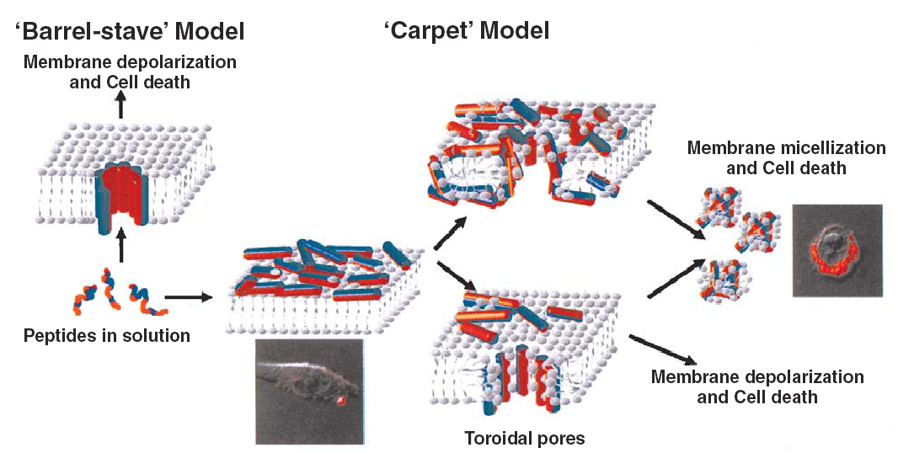
Many AMPs act on the microbial membrane
Membrane lysis may occur by different mechanisms
A.
B.
Shai-Matzusaki-Huang Model
Notes:
Figure 7-23. Mechanisms of membrane lysis by AMPs. (a) The 'barrel stave' and (b) the ´Shai-Matzusaki-Huang´ models. The membrane is depicted as a simple lipid bilayer, and the amphipathic peptides are depicted as cylinders with their polar side colored in red and their nonpolar side colored in blue.

Slide 9
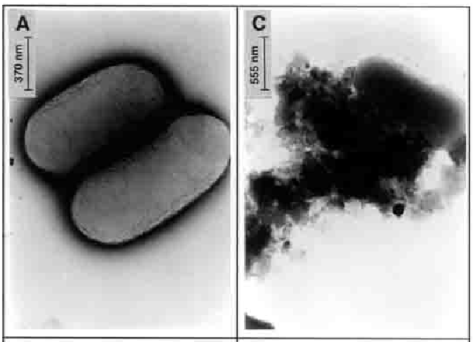
Many AMPs act on the microbial membrane
Lysis of E. coli membrane by LL-37
Notes:
(c) Membrane lysis: electron micrographs of negatively stained E. coli untreated (left) and treated (right) with the antimicrobial peptide LL-37.

Slide 10
Many AMPs act on the microbial membrane
Membrane lysis may occur by different mechanisms
Formation of torroidal pores
Notes:
(d) Formation of torroidal pores. The amphipathic peptides are worm-shaped, with white polar side and shaded nonpolar side. In this mechanism, the peptides, after reaching a critical number, micellize parts of the lipid bilsyer, thus creating pores.

Slide 11
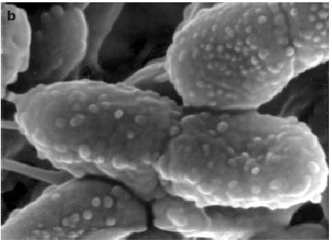
Many AMPs act on the microbial membrane
Membrane blebbing in P. aeruginosa cells, induced by cathelicidin
Notes:
(e) Membrane blebbing in P. aeruginosa cells, induced by the ovine cathelicidin AMP SMAP29. The image is a scanning electron micrograph of the bacteria during the initial action of the AMP. The blebbing appears in the form of blisters on the bacteria's surface.

Slide 12
Common properties of AMPs
Cationicity: attracts AMP to negatively-charged bacterial membranes → responsible for selectivity against bacteria
Electrostatic potential of magainin
Notes:
Electrostatic potential of an AMP, showing the regions where the positive potential (blue) is concentrated, and which regions are overall neutral (white).

Slide 13
Common properties of AMPs
Amphipathicity:
Allows the AMP to interact with both polar and nonpolar regions of the membrane
Facilitates membrane lysis

Slide 14
Common properties of AMPs
Amphipathicity
1. Primary
Melittin
Indolicidin
Notes:
Figure 7-24. Amphipathicity. (a) Primary amphipathicity, as demonstrated by melittin (left) and indolicidin (right).

Slide 15
Common properties of AMPs
Amphipathicity
2. Secondary
Magainin
Notes:
(b) Secondary amphipathicity, as demonstrated by magainin. The amphipathic nature of the peptides is illustrated by their electrostatic potential, which shows the regions where the positive potential (blue) is concentrated, and which regions are overall neutral (white). The amphipathicity reflects the distribution of polar residues over the peptide, and includes both positive and negative charges. In the case of the AMPs shown here, the strong positive potentials resulting from fully charged residues mask the small negative potentials, resulting from partially charged residues (e.g. at the C-terminus).

Slide 16
Representing amphipathicity
a
90°
G-I-G-K-F-L-H-S-A-K-K-F-G-K-A-F-V-G
b
1 2 3 4 5 6 7 8 9 10 11 12 13 14 15 16 17 18
Notes:
Box 7-2 Figure 1. Graphic representation of amphipathicity. (a) Helical wheel projection (right) of the first 14 residues of the helical peptide magainin, shown in full length on the left. Nonpolar residues are in yellow, basic residues are in blue, and polar-neutral residues are in green. Indeed, a vertical line going from Phe 12 to Val 17 would separate the hydrophobic face on the right and the polar/charged face on the left. The projection was generated by the University of Virginia's online server (b) The sequence corresponding to (a), colored by the same color-code. The wheel is the view obtained by turning the helix in (a) 90º about its axis (red line), as shown in the figure.

Slide 17
Calculating the hydrophobic moment
In a canonical α-helix:
hydrophobic dipole moment
hydrophobicity of residue i
the angular frequency of the helix (100º)

Slide 18
Calculating amphipathicity
In a non-canonical helix:
a unit vector pointing from the projection of Cα to the center of the side-chain
structural hydrophobic dipole moment

