Slide 1
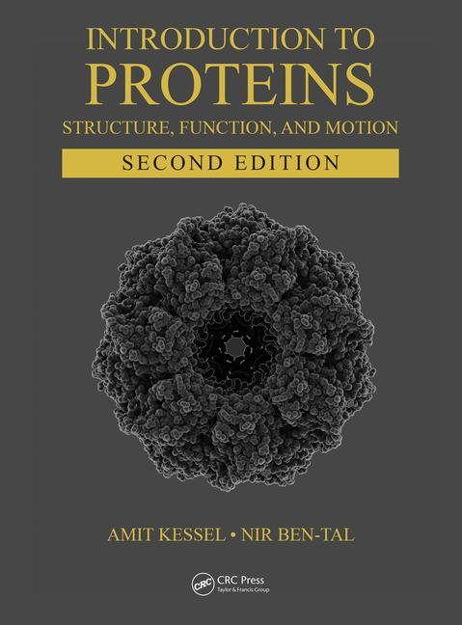
This PPT presentation is provided as suppl. material to the book:
Introduction to Proteins: Structure, Function, and Motion
2nd Edition (2018)
Amit Kessel & Nir Ben-Tal

Slide 2
Chapter 5:
Protein Structural Dynamics & Folding

Slide 3
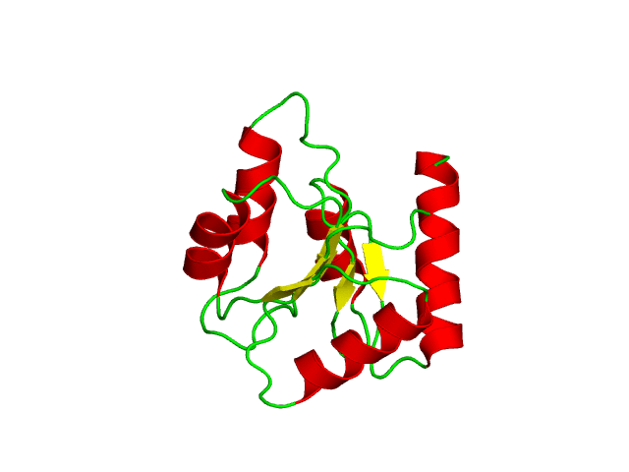
Overview
Proteins dynamics is functionally important
Dynamics results from motions around single bonds
Dynamics is diverse:
Time: 10⁻¹⁵-10⁴ sec
Amplitude: 0.01-100 Å
Backbone dynamics of chemotaxis Y protein (46 NMR structures)
Notes:
Figure 5.5. Backbone dynamics of folded proteins. The conformational dynamics of chemotaxis Y protein is illustrated by superimposing 46 allowed conformations of the single protein, solved by NMR (PDB entry 1cey). The structures are colored according to secondary structure (helices are red, sheets are yellow, and loops are green). The animation was produced by intrapolation between the 46 NMR conformations.

Slide 4
Overview
Dynamics is driven by the thermal energy in the surroundings
Dynamics can be affected by external factors:
Environmental conditions (pH, temperature)
Ligand binding
PTMs
Backbone dynamics of chemotaxis Y protein (46 NMR structures)
Notes:
The animation was produced by intrapolation between the 46 NMR conformations.

Slide 5
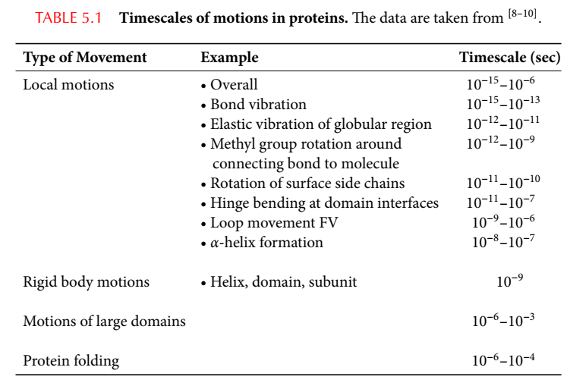
Types of motions in proteins
4
Notes:
Table 5-1. Timescales of motions in proteins. The data is taken from:
1. Zhong, D. (2007) Ultrafast catalytic processes in enzymes. Curr Opin Chem Biol. 11: 174-81.
2. Benkovic, S.J. and Hammes-Schiffer, S. (2003) A perspective on enzyme catalysis. Science. 301: 1196-202.
3. Akke, M. (2002) NMR methods for characterizing microsecond to millisecond dynamics in recognition and catalysis. Curr Opin Struct Biol. 12: 642-7.

Slide 6
Correspondence to biological processes
Fast vibrations/motions in enzymatic catalysis
Making/breaking of covalent bonds (10⁻¹⁴-10⁻¹⁰ sec)
Formation of hydrogen bonds (10⁻¹²-10⁻¹⁰ sec)
Electrons/protons/hydride ions transfer (10⁻¹² sec)
Electron tunneling (10⁻⁹-10⁻⁴ sec)
Water molecules reorganization (10⁻⁸ sec)

Slide 7
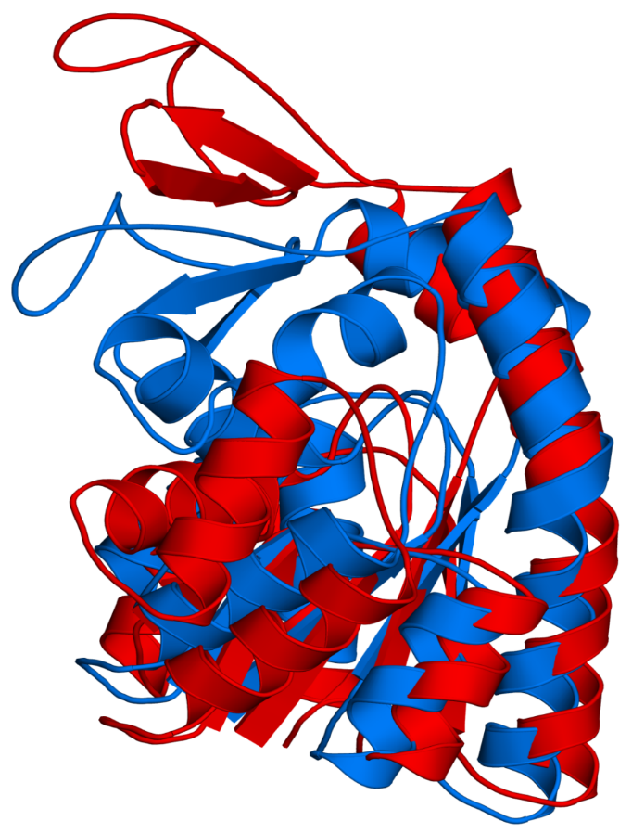
Correspondence to biological processes
Motions of side-chains, 2nd elements, and domains
Proton transport (10⁻⁹-10⁻⁴ sec)
Ligand binding (10⁻⁸-10¹ sec)
Single residues: positioning of residues around ligand
Segments: opening/closing of gating loops (e.g. hinge motion)
Local denaturation (10⁻⁵-10¹ sec)
Allostery (10⁻⁵-10⁰ sec) – often by changing the availability of the active site (e.g. by hinge motion)
Hinge motion
(molmovdb database: http://www.molmovdb.org)
Notes:
Many enzymes tend to undergo dynamic changes that close their binding sites upon substrate binding. This closure completely or partially prevents the solvent from accessing the binding site. In doing so, it strengthens protein-ligand electrostatic interactions that may be important for catalysis, and also reduces the solvent's ability to interact with the substrate at the expense of binding site groups (competing interactions).
Figure 5.1. Hinge motion in adenylate kinase. The motion of the loop in the upper-left region is illustrated by superimposition of the two conformations of the proteins (PDB entries 2eck, 4ake). The hinge region is circled.

Slide 8
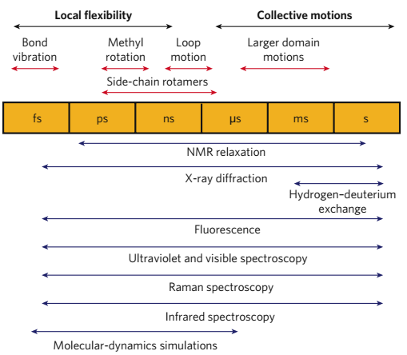
Different motions require different methods
(Henzler-Wildman & Kern (2007) Nature 450: 964-972)

Slide 9
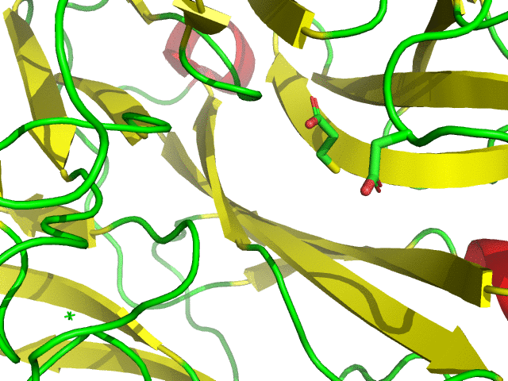
Theories on protein dynamics
Induced fit theory (Koshland 1959)
Proteins can adapt their structure to bound ligand
Small-scale induced fit of neuraminidase following Tamiflu binding
Notes:
The notion that proteins are inherently dynamic was not always recognized; At first it was thought that conformational changes in proteins are induced by ligand binding.
Conformational change in N1 neuraminidase following the binding of Tamiflu, a sialic-acid analogue (structures: 2hty, 2hu4). The animation was produced by intrapolation between the ligand-bound and ligand-free conformations.

Slide 10
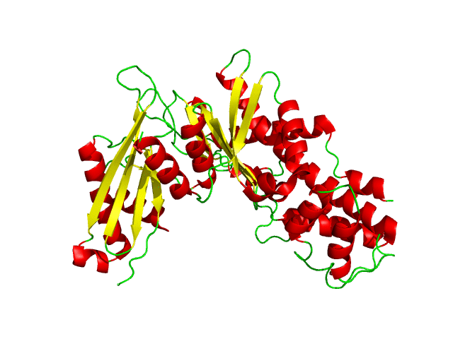
Theories on protein dynamics
Induced fit theory (Koshland 1959)
Proteins can adapt their structure to bound ligand
Large-scale induced fit of glucokinase following glucose binding
Notes:
Conformational change in glucokinase following the binding of glucose (structures: 1v4t, 1v4s). The animation was produced by intrapolation between the ligand-bound and ligand-free conformations.

Slide 11
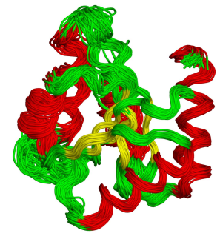
Theories on protein dynamics
Pre-existing equilibrium (MWC) theory (Monod et al., 1965)
Ligand-free proteins can exist in two different equilibrium conformations
Conformational selection theory
Proteins are in equilibrium between many different conformations/substates (ensemble)
Notes:
Actually, Linus Pauling preceded Monod in suggesting a pre-existing equilibrium; In 1940 he proposed that antibodies might acquire different configurations with identical energies. This implied that proteins could undergo conformational changes in the absence of bound ligand or substrate. Unfortunately, Pauling did not turn his idea into a detailed model.
Figure 5.5. Backbone dynamics of folded proteins. The conformational dynamics of chemotaxis Y protein is illustrated by superimposing 46 allowed conformations of the single protein, solved by NMR (PDB entry 1cey). The structures are colored according to secondary structure (helices are red, sheets are yellow, and loops are green).

Slide 12
Theories on protein dynamics
Currently accepted theory
The transition between the substates is driven by the surroundings’ thermal energy (k_{B}T), converted to kinetic energy (K) and then to atomic motions and bond vibrations:
K ∝ k_{B}T = ½mv²
Average kinetic energy
velocity
mass
* The energy available for 1 mol of proteins is RT = 0.6 kcal/mol (25 °C). k_{B}T is the energy available for one molecule (k_{B}T = RT/N_{A})
Notes:
More accurately, in monatomic ideal gases: K=3/2k_{B}T. This is because there are three independent directions a molecule can move, for each the average energy is ½ k_{B}T.
The Boltzmann constant (k_{B}) is 3.3∙10^{–24} cal·K⁻¹. The corresponding constant for one mol (R) is 1.989 cal·mol⁻¹·K⁻¹. It is, in fact, k_{B} multiplied by Avogadro’s number (6.022×10²³ mol⁻¹).

Slide 13
Theories on protein dynamics
Currently accepted theory
The probability (P) to acquire each conformation depends on its energy (ΔG):
The native conformation has the lowest energy → most populated
Other conformations are also sampled frequently, as long as they are within the RT range (energy ≤ 0.6 kcal higher than that of the native structure)
Ligand binding may stabilize higher-energy conformations
P ∝ e ^{(-ΔG/RT)}
Notes:
ΔG is the energy difference between the current conformation and the energy of a reference conformation (e.g. the previous one). Thus, it represents the probability of the transition process from the previous to the current conformation.
The assumption that the native state has the lowest energy relies on the fact that different methods and conditions produce the same structure for any specific protein.

Slide 14
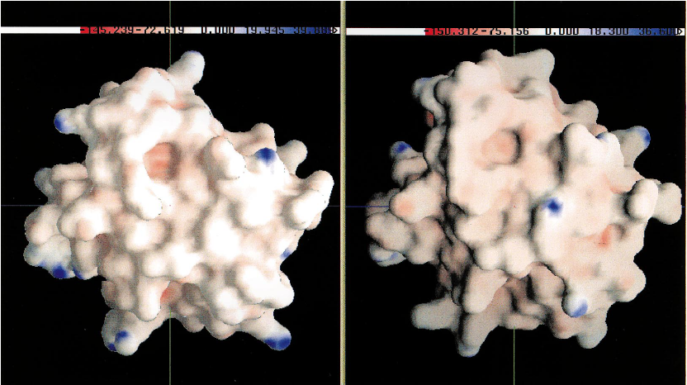
The biological significance of thermally-induced conformational changes
Changing active site properties
Conformational change → change in ε → change in Φ
Cytochrome c
Notes:
Figure 5.6. Electrostatic differences between two similar microstates. The figure shows the electrostatic potential of two microstates of cytochrome c, generated using MD simulations. Although highly similar in conformation, the potential of certain regions may differ significantly (e.g., see circled region). The figure was taken from ^{[190]}.

Slide 15
The biological significance of thermally-induced conformational changes
Facilitating substrate diffusion into buried active site
ps-ns ‘breathing’ → transient voids from surface to core
Amplifying short thermal fluctuations
Cooperative ps-ns motions → larger, μs-ms motions (e.g. active site opening)

Slide 16
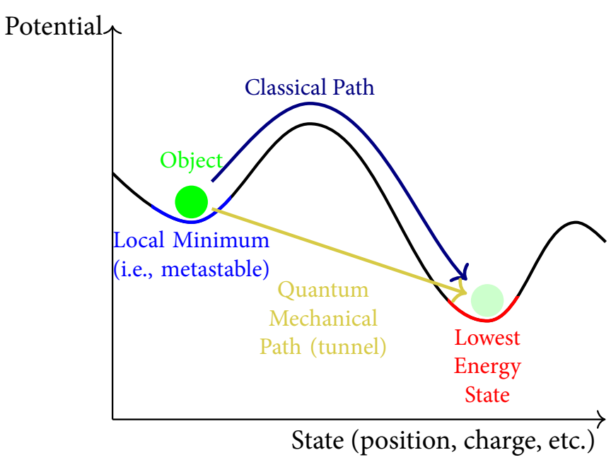
The biological significance of thermally-induced conformational changes
Optimization of quantum tunneling events
H⁺/H⁻/H∙ may transfer between protein/ligand groups despite large energy barriers, by QM tunneling
Notes:
Figure 5.7. Quantum tunneling. (a) Quantum tunneling vs. classical movement of a hydrogen atom between a hypothetical protein donor (X) and an acceptor (Y), depicted as the crossing of an energy barrier. The figure is taken from ^{[203]}.

Slide 17
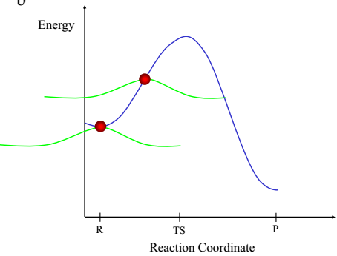
The biological significance of thermally-induced conformational changes
Optimization of quantum tunneling events
Mechanism: H only has to gain sufficient energy to reach the point when its wavelength exceeds the barrier’s width
X-H-Y
X-H Y
X H-Y
Notes:
(b) Explanation of quantum tunneling based on the wave properties of the reactant (i.e., the transferred hydrogen). The potential energy of a hydrogen reaction is depicted along the reaction coordinate (R - reactants, TS - transition state, P - products). The mean, most probable location of the hydrogen particle along the reaction coordinate is specified by the red sphere, and its probability distribution is represented by the green curve. As the plot shows, even when the hydrogen particle has only enough energy for 'climbing' halfway to the top of the energy barrier, it has a finite probability to appear at the other side of the barrier and complete the transfer.

Slide 18
The biological significance of thermally-induced conformational changes
Optimization of quantum tunneling events
Coupled vibrations (fs-ps) increase tunneling probability by optimizing geometric-electrostatic factors
X-H-Y
X-H Y
X H-Y
Notes:
(b) Explanation of quantum tunneling based on the wave properties of the reactant (i.e., the transferred hydrogen). The potential energy of a hydrogen reaction is depicted along the reaction coordinate (R - reactants, TS - transition state, P - products). The mean, most probable location of the hydrogen particle along the reaction coordinate is specified by the red sphere, and its probability distribution is represented by the green curve. As the plot shows, even when the hydrogen particle has only enough energy for 'climbing' halfway to the top of the energy barrier, it has a finite probability to appear at the other side of the barrier and complete the transfer.

Slide 19
External factors may affect dynamics
Which factors?
Ligand binding (allostery)
Post-translational modifications
Environmental factors (pH, temperature, etc.)
Mutations

Slide 20
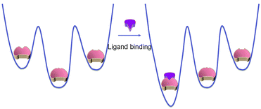
External factors may affect dynamics
Mechanism: biasing the conformational equilibrium towards certain conformations by changing the energy landscape of the protein
most stable
most stable
Tsai & Nussinov (2014) Phys Chem Chem Phys. 16:6332-41

Slide 21
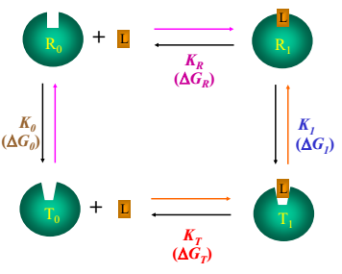
The ligand effect and allostery
The ligand effect
The ligands binds preferably to a protein conformation and stabilizes it
The binding biases the natural equilibrium towards the this conformation
Notes:
The selective binding of the ligand to a certain conformation results from the fact that this conformation has a lower energy when ligand-bound, whereas others have lower energy when unbound.
Figure 5.9. Schematic illustration of the mechanism of allosteric ligands. (b) A thermodynamic cycle (following ^{[254]}) describing the path from the free low-affinity conformation (T₀) to the ligand-bound, high-affinity conformation (R₁) (orange path). R and T are the low-affinity and high-affinity conformations, respectively. L is the ligand. 0 and 1 denote the ligand-free and ligand-bound states, respectively. The path may proceed via the ligand-bound low-affinity conformation (T₁) (orange path) or the free high-affinity conformation (R₁) (magenta path). The equilibrium constants (K) and related free energy changes (ΔG) associated with each step of the cycle are noted in different colors.

Slide 22
The ligand effect and allostery
Allostery
Definition: activity at the primary site is affected by ligand binding to a different site (allosteric site)
Exists in enzymes, receptors, channels, transporters, etc.
Used by cells to regulate biological processes (e.g. product inhibition, signaling-induced)
Notes:
Figure 8.1. (b) Allosteric regulators. The figure shows the protein fructose-1,6-bisphosphatase with 2,5-anhydro-D-glucitol-1,6-bisphosphate (AHG, an analogue of its substrate), and AMP (an allosteric inhibitor) (PDB entry 1fpd). As can be clearly seen, the allosteric ligand occupies a distinct binding site, which is quite distant from the catalytic site.

Slide 23
The ligand effect and allostery
Allostery
How it works: allosteric activators stabilize the active conformation(s); inhibitors stabilize the inactive one(s) - conformational selection model
inhibitor
activator
inactive
active
substrate
Allosteric regulation by changing active site fit to substrate
Notes:
Figure 5.9. Schematic illustration of the mechanism of allosteric ligands. (c) The effects of positive and negative allosteric ligands. Both types of ligands act as in (a), but they bind to different conformations. The first is inactive due to a substrate-incompatible binding site, and the second is active due to a substrate-compatible binding site.

Slide 24
The ligand effect and allostery
Allosteric regulators may stabilize multiple conformations of the ensemble

Slide 25
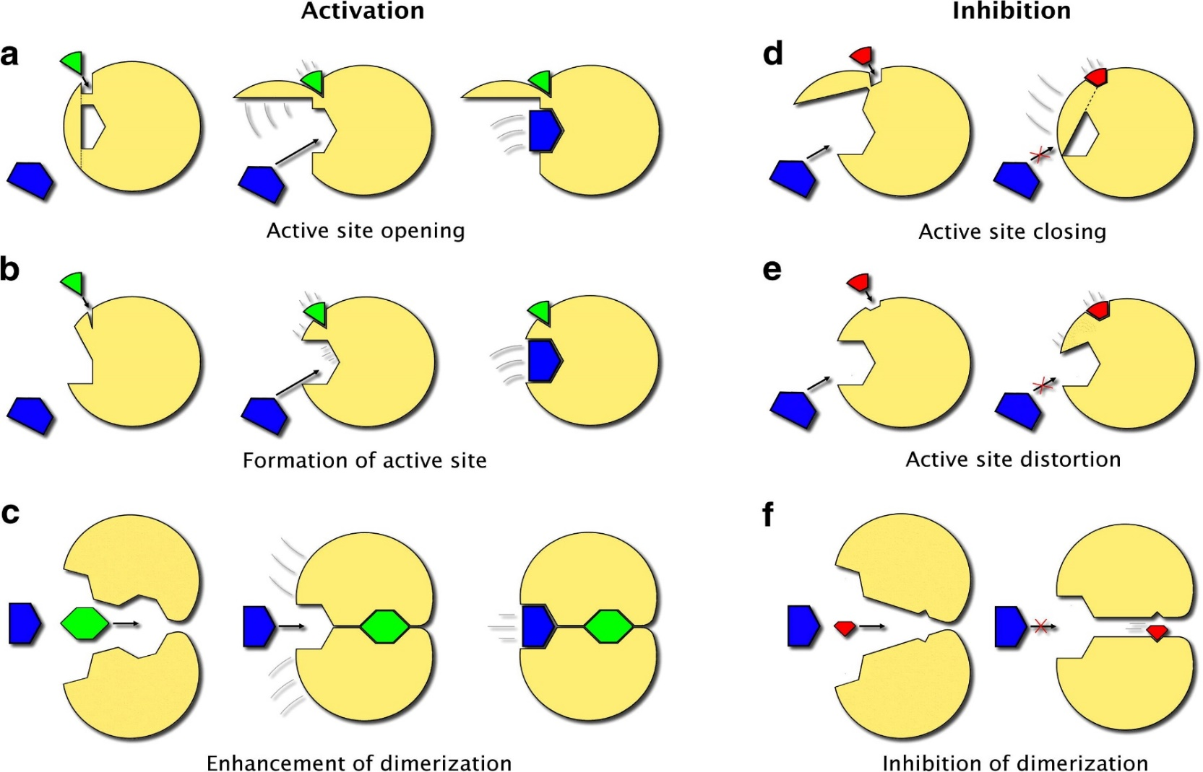
The ligand effect and allostery
Allosteric regulation may act on different levels (active site, oligomerization)
I
IV
II
V
III
VI
Notes:
Figure 5.9. Schematic illustration of the mechanism of allosteric ligands. (d) Specific mechanisms of allosteric activators and inhibitors, affecting active site accessibility, active site shape, and oligomerization capability. Adapted from ^{[259]}.

Slide 26
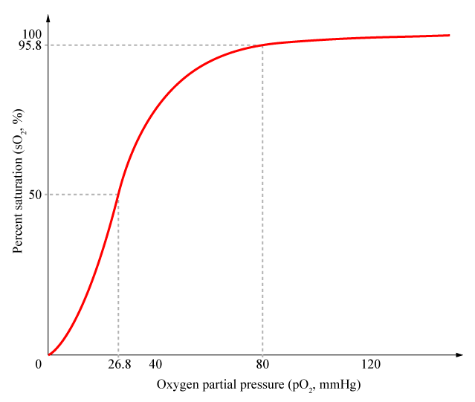
Allostery in hemoglobin
Hemoglobin displays cooperative binding of oxygen
Lungs
Tissues
Notes:
Figure 5.3.2. Hemoglobin-oxygen binding curve. The curve describes the dependence of the binding (represented by the % saturation) on the oxygen's concentration (represented by its partial pressure). In the lungs, high oxygen concentration leads to strong binding, whereas in peripheral tissues the binding is weak due to low oxygen concentrations. Furthermore, the sigmoid shape of the curve indicates positive cooperativity in oxygen binding. The image is adapted from ^{[264]}.

Slide 27
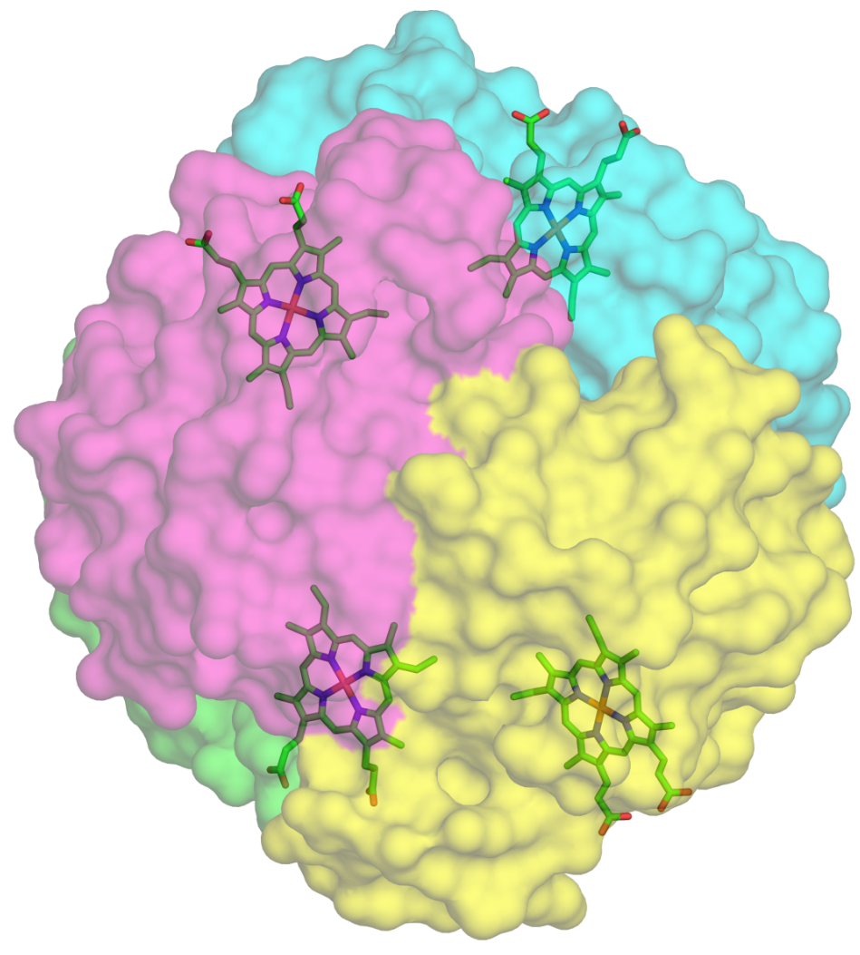
Allostery in hemoglobin
Hemoglobin has 4 subunits and binds oxygen using prosthetic groups
Notes:
Figure 5.3.3. Hemoglobin structure. (a) The four subunits are marked with different colors, and the heme groups are shown in bond-sticks models (PDB entry 1hho).

Slide 28
Allostery in hemoglobin
The heme group includes a porphyrin, which contains the oxygen-binding iron
Oxygen
Pyrrole ring
Notes:
Figure 5.3.3. Hemoglobin structure. (b) Structure of the heme group. Atoms are colored according to type, with the Fe²⁺ ion colored in gray. The location of the bound oxygen molecule is marked.

Slide 29
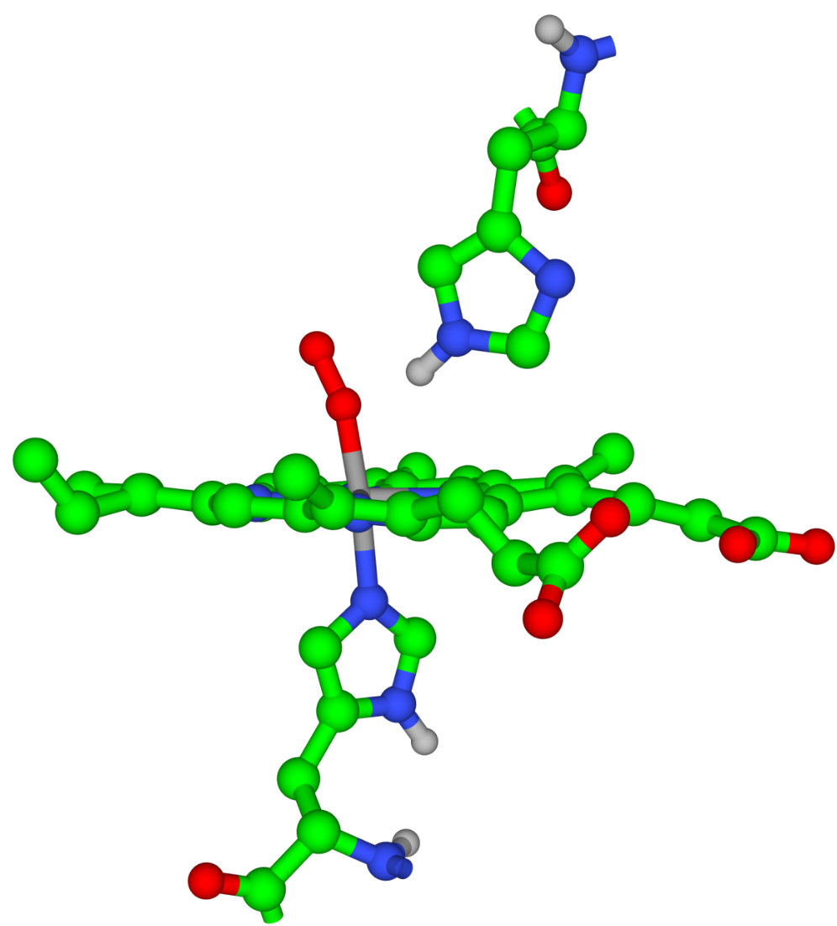
Allostery in hemoglobin
The distal His lowers the risk of carbon monoxide poisoning
Distal His
Proximal His
Notes:
Figure 5.3.3. Hemoglobin structure. (c) Proximal and distal histidine residues in hemoglobin.

Slide 30
Allostery in hemoglobin
Hemoglobin exists in two different states:
Deoxy – has low oxygen affinity
Oxy – has high oxygen affinity
Each state has a different quaternary structure
Max Perutz
Notes:
Figure 5.3.4. Max Ferdinand Perutz (1914-2002), Nobel Prize laureate in Chemistry, 1962. The Nobel Foundation ^{[275]}. Perutz, who determined the structure of hemoglobin by using X-ray diffraction, found that the oxy and deoxy states of hemoglobin have different quaternary structures

Slide 31
Allostery in hemoglobin
Deoxy hemoglobin is stabilized by salt bridges between subunits α₁α₂, α₁β₂, and α₂β.
The bridges break upon shifting to the oxy conformation
Notes:
Figure 5.3.5. A salt bridge that stabilizes the T state of hemoglobin ^{[270]}

Slide 32
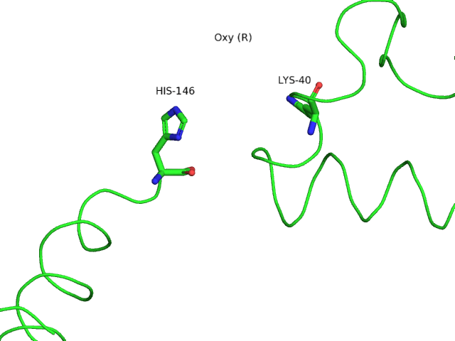
Allostery in hemoglobin
A dynamic view (GIF animation):
Notes:
Figure 5.3.5. A salt bridge that stabilizes the T state of hemoglobin ^{[270]}. The animation was produced by intrapolation between the two conformations.

Slide 33
Allostery in hemoglobin
Perutz's 'stereochemical model'
The oxy and deoxy states have different conformations (like the R and T states in the MWC model)
Oxygen, the substrate, also acts as an allosteric activator, inducing the deoxy→oxy (T→R) change
This creates positive cooperativity in oxygen binding
It also explains the different affinity to oxygen in the lungs (high oxygen pressure) compared to peripheral tissues (low oxygen pressure)
What are the structural changes occurring during the T→R change?

Slide 34
Allostery in hemoglobin
Fe moves into heme plane
Proximal His is pulled up
Notes:
Figure 5.3.6. Hemoglobin dynamics. The figure shows the effects of oxygen binding to hemoglobin on various regions of the molecule. The induced motions are demonstrated by superimposition of the oxy (red) and deoxy (blue) states. The dashed green arrows mark the directions of the motions. (a) Motion of the iron atom (green) from below the heme plane into the middle of the heme plane, and of the proximal histidine in the same direction

Slide 35
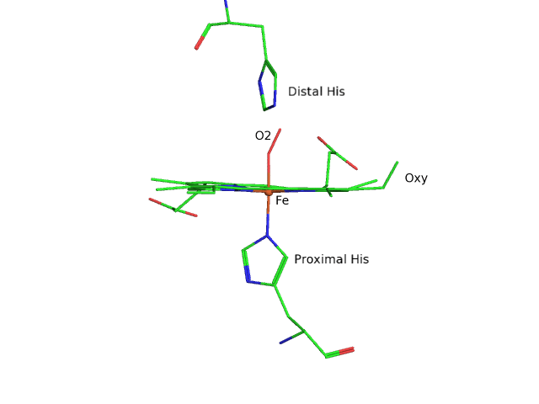
Allostery in hemoglobin
A dynamic view (GIF animation):
Notes:
Figure 5.3.6. Hemoglobin dynamics. The figure shows the effects of oxygen binding to hemoglobin on various regions of the molecule. The animation was produced by intrapolation between the oxygen-bound and oxygen-free conformations.

Slide 36
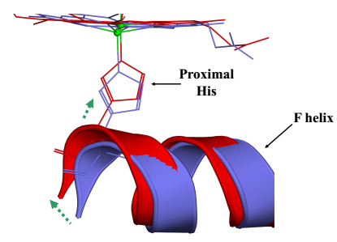
Allostery in hemoglobin
F-helix undergoes translation, changing tertiary structure of entire subunit
Notes:
Figure 5.3.6. Hemoglobin dynamics. The figure shows the effects of oxygen binding to hemoglobin on various regions of the molecule. The induced motions are demonstrated by superimposition of the oxy (red) and deoxy (blue) states. The dashed green arrows mark the directions of the motions. (b) The motion of the F helix

Slide 37
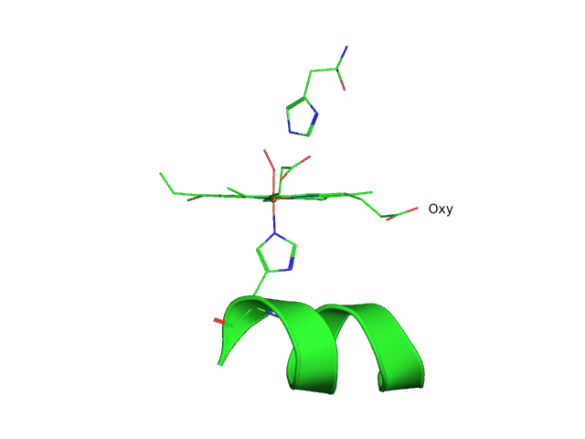
Allostery in hemoglobin
A dynamic view (GIF animation):
Notes:
Figure 5.3.6. Hemoglobin dynamics. The figure shows the effects of oxygen binding to hemoglobin on various regions of the molecule (b) The motion of the F helix. The animation was produced by intrapolation between the oxygen-bound and oxygen-free conformations.

Slide 38
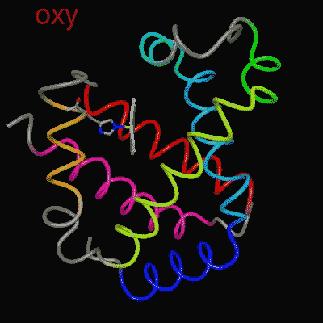
Allostery in hemoglobin
F-helix undergoes translation, changing tertiary structure of entire subunit

Slide 39
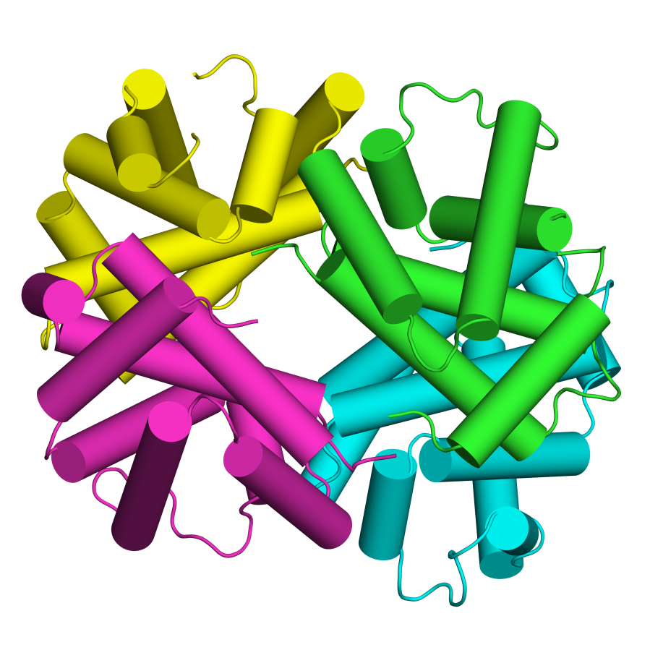
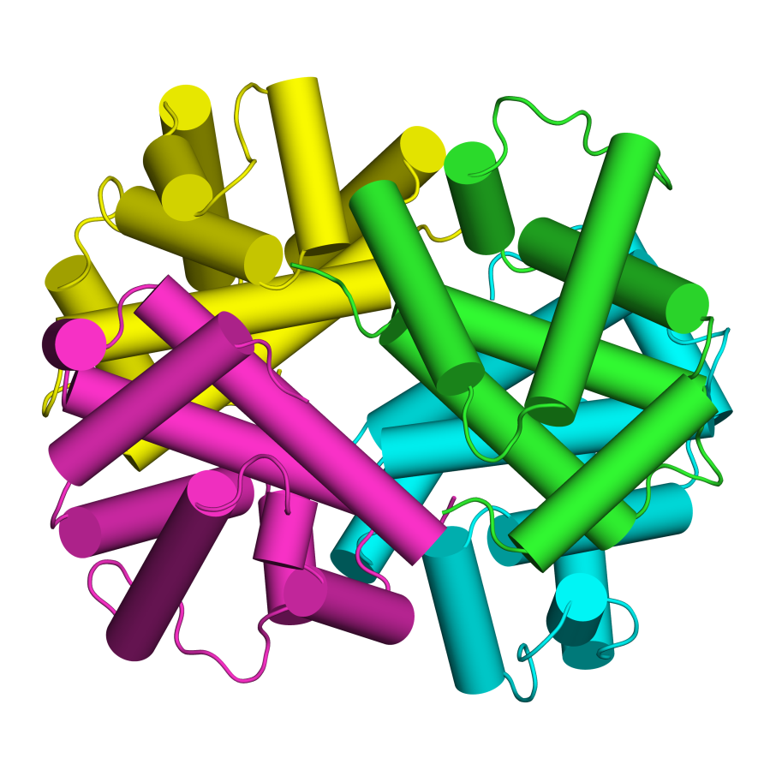
Allostery in hemoglobin
Change in a single subunit spreads to entire protein
Deoxy (T)
Oxy (R)
Notes:
Figure 5.3.6. Hemoglobin dynamics. The figure shows the effects of oxygen binding to hemoglobin on various regions of the molecule. (c) Motions at the level of the entire molecule ^{ϴ3}. Here the motions are complex, so we present the two structures and refer the reader to the global change in conformation. For example, note the change in the size of the central cavity between the two structures.

Slide 40
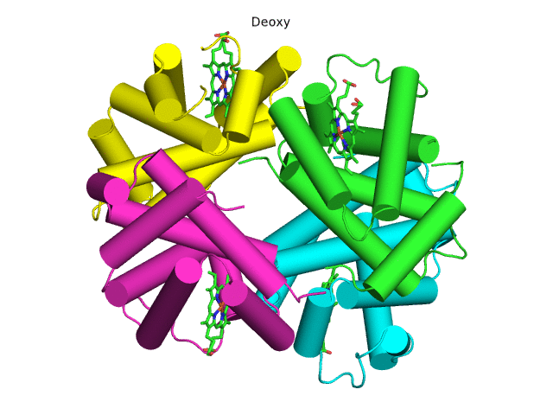
Allostery in hemoglobin
A dynamic view (GIF animation):
Notes:
Figure 5.3.6. Hemoglobin dynamics. The figure shows the effects of oxygen binding to hemoglobin on various regions of the molecule. (c) Motions at the level of the entire molecule ^{ϴ3}. Here the motions are complex, so we present the two structures and refer the reader to the global change in conformation. For example, note the change in the size of the central cavity between the two structures.

Slide 41
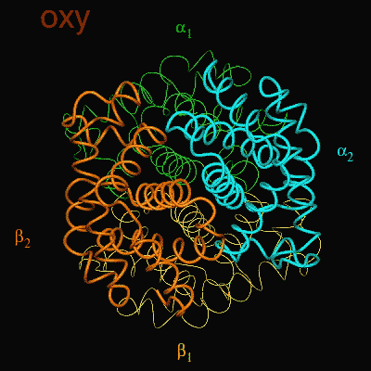
Allostery in hemoglobin
Change in a single subunit spreads to entire protein
The α₁β₁ dimer slides and rotates 15˚ with respect to the α₂β₂ dimer
The pocket between the beta subunits becomes narrower

Slide 42
Allostery in hemoglobin
Most of the hemoglobin is in the oxy state
Lungs
Most of the hemoglobin is in the deoxy state
Tissues

Slide 43
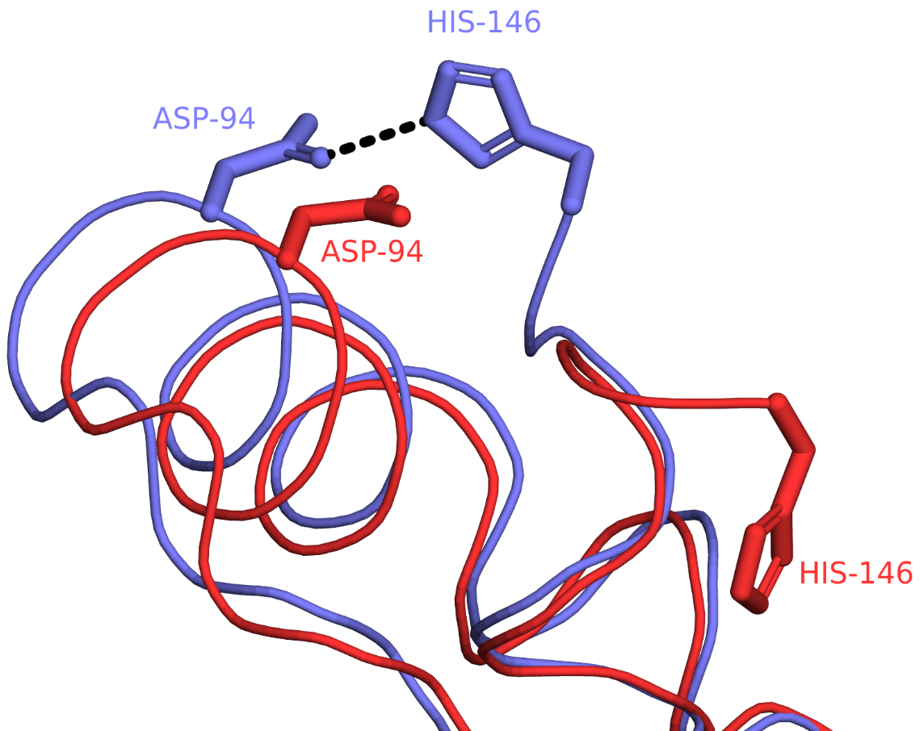
The Bohr (pH-induced) effect
Low pH stabilizes the deoxy conformation via salt bridges
Explains low oxygen affinity in peripheral tissues (pH=7.2) compared to lungs (pH=7.6)
-
+
-
Notes:
Whereas the Glu/Asp side-chains are almost always charged under physiological pH, those of His are only charged part of the time, because their pKa is close to the neutral pH. In peripheral tissues His-146 is protonated (positively charged) and forms a salt bridge with Asp-94, that stabilizes the T conformation. In the lung the bond breaks.
Thus, the R→T change happens due to a drop in both oxygen concentration and the pH when hemoglobin transports from the lungs to peripheral tissues.
Figure 5.3.7. The salt bridge between His-146 and Asp -94, which makes the largest contribution to the Bohr effect ^{[283]}. The salt bridge is present in the deoxy state (PDB entry 2dn2, colored in blue) and absent in the oxy state (PDB entry 2dn3, colored in red).

Slide 44
Conclusions
Allostery may occur via small, long-range structural changes
Dihydrofolate reductase (DHFR)
Notes:
Figure 5.10. Internal motions in the enzyme DHFR from E. coli (PDB entry 7dfr). The figure shows the catalytic site region of DHFR. For clarity, only some of the secondary structures and residues are shown. DHFR catalysis involves hydride (H⁻) transfer from NADPH (magenta) to DHF (cyan). DHF binding leads to closure of the Met-20 loop (orange) around it and to acceleration of catalysis. Interestingly, NMR studies show that this motion involves creation of a hydrogen bond between Gly-115 of the Met-20 loop and Asp-122 of the βF-βG loop (yellow), a region that does not include catalytic residues.

Slide 45
Conclusions
New studies suggest that allostery may even take place with no structural changes at all
In such cases, the change in activity results from ligand-induced change in the entropy of the protein
This occurs by changing the frequency and/or amplitude of the protein's thermal fluctuations
Notes:
Figure 5-9. Internal motions in the enzyme DHFR from E. coli (PDB entry 7dfr). The figure shows the catalytic site region of DHFR. For clarity, only some of the secondary structures and residues are shown. DHFR catalysis involves hydride (H⁻) transfer from NADPH (magenta) to DHF (cyan). DHF binding leads to closure of the Met-20 loop (orange) around it and to acceleration of catalysis. Interestingly, NMR studies show this motion to involve a creation of a hydrogen bond between Gly-115 of the Met-20 loop and Asp-122 of the βF-βG loop (yellow), a region that does not include catalytic residues.

Slide 46
Protein Folding

Slide 47
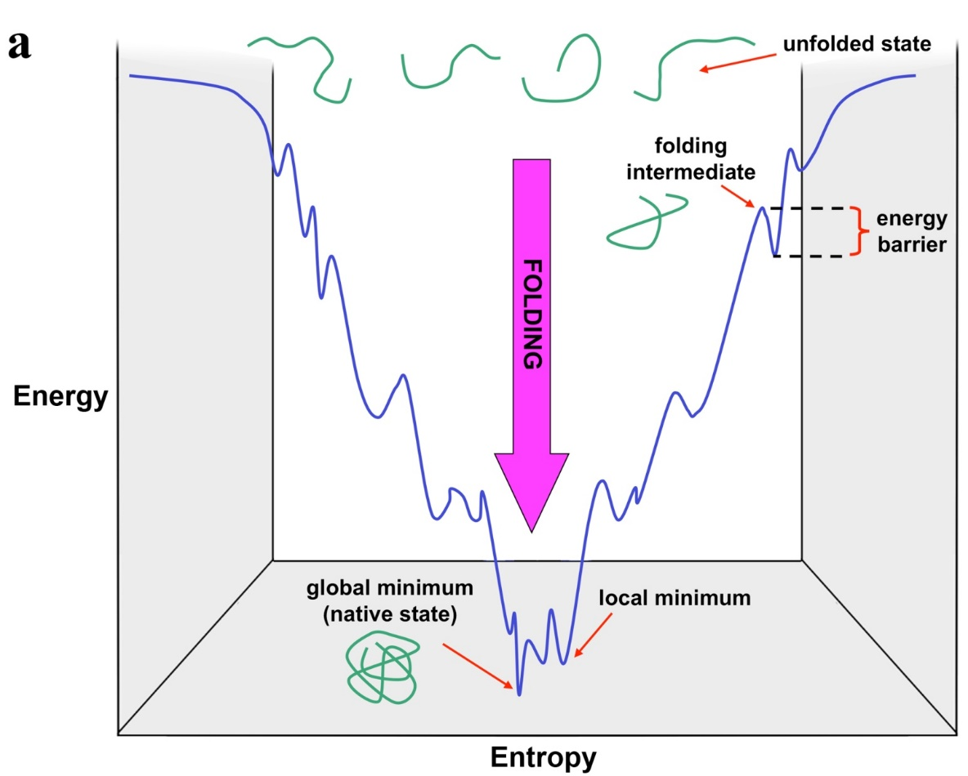
Folding energetics
Folding involves decrease in both entropy & energy (which over-compensates for the former)
Bottom well - the global energy minimum - represents the native state (different methods and conditions, produce the same structure for any specific protein)
Other wells - local minima
Notes:
Figure 5.2. The folding energy landscape in two dimensions. The green shapes in (a) represent the polypeptide chain of the folding protein. The funnel shape of the curve reflects the simultaneous decrease in energy and entropy of the protein during its folding.

Slide 48
Folding energetics
The energy barriers result from:
Unfavorable local interactions that are later compensated for by global interactions
Non-local interactions (entropy cost of folding regions far away in sequence)
Notes:
Figure 5.2. The folding energy landscape in two dimensions. The green shapes in (a) represent the polypeptide chain of the folding protein. The funnel shape of the curve reflects the simultaneous decrease in energy and entropy of the protein during its folding.

Slide 49
Folding energetics
3D:
Notes:
Figure 5.2. The folding energy landscape in three dimensions. The green shapes in (a) represent the polypeptide chain of the folding protein. The funnel shape of the curve reflects the simultaneous decrease in energy and entropy of the protein during its folding. (b) Adapted from ^{[38]}

Slide 50
Levinthal’s paradox (1968)
For a 100-residue protein, assuming that:
Each residue has 3 possible conformations
The conformation of each residue is independent of that of the other residues
Then: the entire polypeptide chain has 3¹⁰⁰ conformations!
Assuming that each conformational transition takes 1 ps, the folding time is 5×10³⁵ seconds = 1.6×10²⁸ years - longer than the age of the universe!!!
Still, protein folding takes only 0.1-100 seconds
Notes:
The funnel shape of the energy landscape of folding solves the question of how the protein can sample so many possible conformations at so little time. This question was illustrated by Cyrus Levinthal, with a paradox called after him.

Slide 51
Levinthal’s paradox (1968)
Conclusions:
Proteins do not sample the entire available conformational space
Folding involves residue-residue interactions that limit the number of possible conformations in the next step
This is demonstrated by the hypothetical energy landscape of protein folding

Slide 52
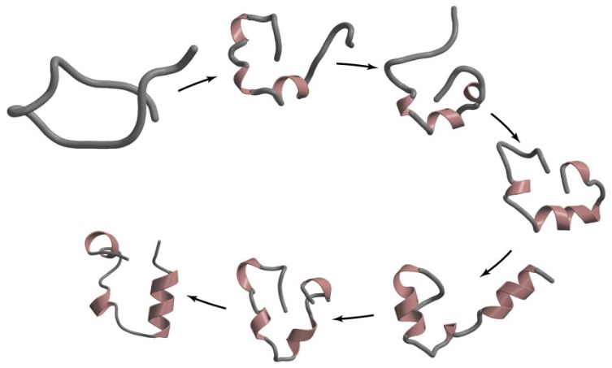
Folding kinetics
Difficult to study since transition states are transient
Solutions:
Using spectroscopic (NMR, EPR) and other (hydrogen-exchange, thermochemistry) tools
Changing experimental conditions to trap metastable transition states
Analyzing the effect of mutations on those states
Still, the folding process is not completely understood
?

Slide 53
Folding kinetics
Molten globule
A folding intermediate that appears within milliseconds, (‘visible’ to some experimental methods)
A native-like secondary structure (identity and location) and distribution of polar/nonpolar residues
However:
Few tertiary contacts
Increased flexibility
Often non-native loops
Some exposed nonpolar residues

Slide 54
Folding kinetics
Molten globule → Native structure
Completion of secondary structures
Better packing of the hydrophobic core
Fixation of loop structure

Slide 55
Models of protein folding
framework
Hydrophobic collapse
Nucleation-condensation
Notes:
Figure 5.3. Proposed models for protein folding. (a) The framework model. (b) The hydrophobic collapse model. (c) The nucleation-condensation model. The green shapes represent the polypeptide chain, whereas the black cylinders are α-helices, representing here secondary structure.

Slide 56
Models of protein folding
Framework model
Hierarchical folding: secondary structures → supersecondary structures → domains → entire chain is folded
Secondary elements are stabilized by the nonpolar core and tertiary contacts after they are being formed
Logics: 1st stage reduces the entropy cost for the other stages
However: highly-ordered expanded intermediates are not found

Slide 57
Models of protein folding
Hydrophobic collapse model
The core is formed first by collapse of nonpolar residues, then secondary structures and tertiary contacts form
However: a global collapse in the absence of secondary structures has not been found

Slide 58
Models of protein folding
Nucleation-condensation model
Both hydrophobic collapse and secondary-element formation take place simultaneously during folding
Secondary elements are stabilized by the nonpolar core and tertiary contacts while they are being formed

Slide 59
Models of protein folding
Each of the different models mentioned above can be observed in some, but not all, proteins
Thus, it seems that there is no single universal folding mechanism
Notes:
Figure 5.3. Proposed models for protein folding. (a) The framework model. (b) The hydrophobic collapse model. (c) The nucleation-condensation model. The green shapes represent the polypeptide chain, whereas the black cylinders are α-helices, representing here secondary structure.

Slide 60
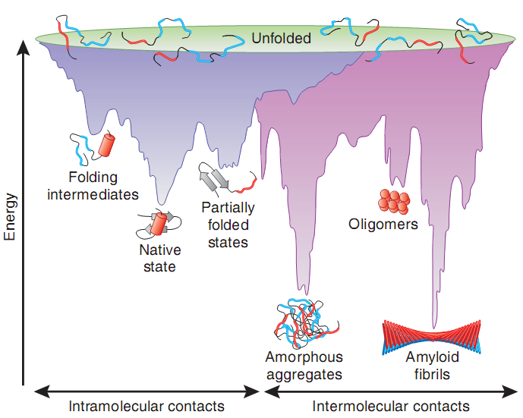
Unfolding/misfolding may lead to aggregation
The native structure - the most stable for monomers
Aggregates and amyloid fibers may be more stable → pathologies
Notes:
Figure 5.4. The energy landscape of protein folding and aggregation.
The purple surface represents the folding process in which single-chain proteins, via intramolecular contacts, form their native structure. It is equivalent to the scheme shown in Figure 5.2. The pink area shows a similar process, but one that involves intermolecular contacts between different polypeptide chains, and results in amorphous aggregates, oligomers, or amyloid ﬁbrils (see Box 5.1). Note that the two energy landscapes overlap in certain areas. That is, aggregates and amyloid fibrils may be formed during de novo folding, but also by destabilization of the native state into partially-folded states. Cell-toxic oligomers may occur as off-pathway intermediates of amyloid ﬁbril formation. The figure (and parts of the caption) are taken from ^{[63]}.

Slide 61
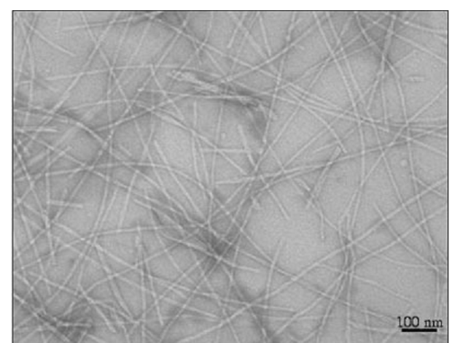
Folding-related pathologies
Loss of function: e.g. cystic fibrosis (deletion of Phe in CFTR chloride channel → disruption of folding)
Gain-of-function: e.g., misfolding and amyloid formation (amyloidosis: Alzheimer’s, Parkinson’s, Huntington’, ALS, MCD..)
Amyloid fibrils
Notes:
Amyloids are associated with over 20 different diseases, in most of which a different protein creates the fibers (overall 18 different proteins). For example, amyloid-β (outside the cell) and tau (inside the cell) in Alzheimer’s disease, α-synuclein in Parkinson’s disease, huntingtin in Huntington’s disease, superoxide dismutase in ALS, and prion in mad cow disease.
Figure 5.1.1. A transmission electron micrograph of amyloid fibrils. The figure was taken from ^{[74]}.

Slide 62
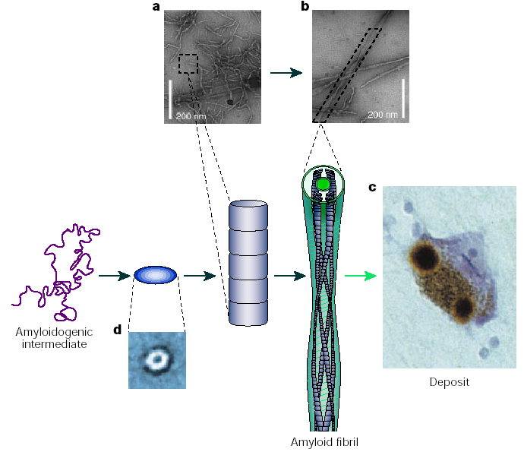
Misfolding and amyloid formation
Amyloid fibrils formation
Notes:
The deposits may appear in the ECM (plaques), as happens with amyloid-β in Alzheimer’s disease, or inside the cell (inclusions), as happens with α-synuclein in Parkinson’s disease.
The mechanism of toxicity is unknown; it was believed to involved the insoluble fibrils, but today it is thought to involve the soluble (amorphous) units, which are released from the fibers.
The mechanism of toxicity is unknown; it was believed to involved the insoluble fibrils, but today it is thought to involve the soluble (amorphous) units, which are released from the fibers.
Figure 5.1.2. A schematic representation of the general mechanism of aggregation to form amyloid fibrils (taken from ^{[82]}). Unfolded or partially unfolded proteins associate with each other to form small, soluble aggregates that undergo further assembly into protofibrils or protofilaments (a) and then mature fibrils (b) (electron micrographs with 200 nm scale bars; taken from ^{[83]}). The fibrils often accumulate in plaques or other structures, such as the Lewy bodies associated with Parkinson’s disease (c). Some of the early aggregates seem to be amorphous or micellar in nature, although others form ring-shaped species with diameters of approximately 10 nm. (d) Taken from ^{[84]}. Thus, the entire process of plaque formation includes the following steps; each is marked by a numbered arrow: (1) aggregation of the amyloidogenic protein to form a ring-shaped aggregate; (2) assembly of the aggregate into a protofibril (3); further assembly of the protofibril into protofilament; and (4) accumulation of the protofilaments as plaques, Lewy bodies, or other structures.

Slide 63
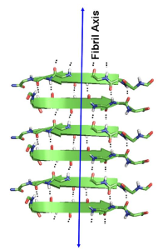
Misfolding and amyloid formation
Amyloid fibrils have a cross-β-sheet conformation and exposed nonpolar groups → aggregation → protofilaments → fibrils

Slide 64
Misfolding and amyloid formation
Amyloid fibrils have a cross-β-sheet conformation and exposed nonpolar groups → aggregation → protofilaments → fibrils
Notes:
Figure 5.1.3. The structures of amyloid fibrils (curtesy of Meytal Landau and Einav Tayeb-Fligelman). (a) The cross-β structure of the amyloid forming peptide KLVFFA from amyloid β. In the structure, the β strands are positioned perpendicularly to the fibril axis (PDB entry 3ow9). The image on the left shows the supersecondary structure of the fiber, whereas the right image shows the surface of the structure, colored by the Kessel-Ben-Tal Scale of hydrophobicity ^{[95]}.

Slide 65
Misfolding and amyloid formation
Recently, prokaryotic amyloid fibrils have been discovered, which have a cross-α structure
Notes:
Figure 5.1.3. The structures of amyloid fibrils (curtesy of Meytal Landau and Einav Tayeb-Fligelman). (b) The cross-α structure of PSMα3 from Staphylococcus aureus ^{[92]} (PDB entry 5i55) with the α-helices also being perpendicular to the fibril axis, reminisces of the classical cross-β architecture. The supersecondary structure and surface properties of the cross-α fiber are shown as in (a), demonstrating the amphipathic nature of the structure.

Slide 66
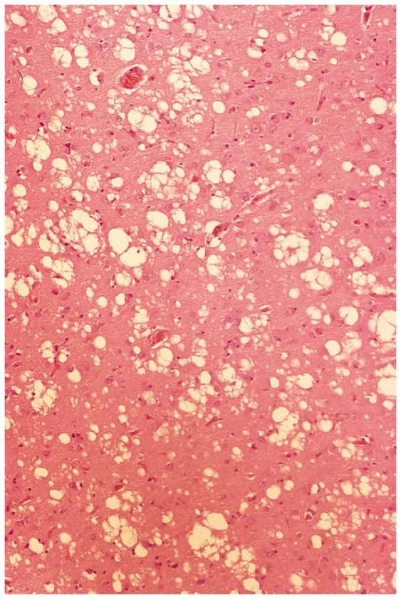
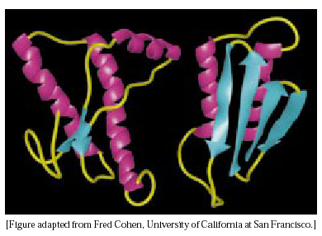
Misfolding and amyloid formation
Spongiform encephalopathies (MCD, CJ, scrapie)
Misfolding of prions → sedimentation as insoluble fibers → neurotoxicity and loss of brain functions
Models of native (left) and pathological (right) forms of the prion protein
Sponge-like brain of cow with MCD
Notes:
Some amyloidosis, like Alzheimer’s and Parkinson’s are spontaneous, whereas others, like MCD, CJD and scrapie, may be infectious. The latter involve a protein – prion (PrP).
The prion exists in two forms. The first form (PrP^{c}) is a normal membrane protein (anchored or TM) that is thought to function in cell-cell adhesion and communication. The infectious form (PrP^{Sc}) is protease-resistant, has a large β content, and can convert the normal form to pathological (i.e. amyloid-forming).

Slide 67
In vivo folding
Improper folding may result from:
Size:
Multiple domains
Complex αβ topology (e.g. the TIM barrel fold)
External changes:
Heat shock (thermal denaturation)
Extreme pH
High salt concentration
High osmotic pressure
Exposure to toxins or heavy metals
Inflammation, chronic oxidative stress (ageing)
Notes:
Even in the absence of genetic abnormalities cellular proteins may unfold/misfold. This may happen in large and/or complex proteins, during heat shock or as a result of exposure to certain chemicals.
Proteins with complex topologies require assistance in folding because their architecture includes numerous long-range interactions, and they are therefore likely to get trapped in local minima during folding.

Slide 68
In vivo folding
Wrong folding may be manifested in:
Exposure of hydrophobic residues → aggregation in dense cytoplasm (40% dry material) → sedimentation and loss of function
Formation of improper S-S bonds
Improper proline isomerization
Notes:
The cytoplasm is very dense, which increases the probability of unfolded/misfolded proteins to interact with each other non-specifically via their exposed nonpolar residues and aggregate.

Slide 69
Assisted folding
Molecular chaperones:
Ubiquitous (10% in E. Coli)
Diverse – more than 20 distinct classes
Roles:
Prevent aggregation of unfolded/misfolded proteins
Facilitate unfolding of proteins before transport into a cellular compartment
Many are overexpressed during heat shock (HSPs)
Notes:
The cytoplasm is very dense, which increases the probability of unfolded/misfolded proteins to interact with each other non-specifically via their exposed nonpolar residues and aggregate.
HSPs: heat-shock proteins

Slide 70
Types of chaperones
Stabilizers
Bind misfolded proteins or the unfolded chain of translated proteins
Prevent aggregation
Small heat-shock proteins (sHSPs)
ATP-independent - suitable as first response during heat shock, which depletes energy reserves
Replaced by ATP-dependent chaperonins after restoration of energy reserves
Also monitor cellular proteins under normal conditions
Notes:
sHSPs: 12-43 kDa.

Slide 71
Types of chaperones
Stabilizers
HSP70s
More diverse roles: transport through intracellular membranes, oligomerization
Require ATP to detach from target protein
Example: BiP helps membrane/secreted proteins that are transported into the E.R. lumen in unfolded state to refold
Notes:
sHSPs: small (12-43 kDa) heat-shock proteins. They are also important under normal conditions, monitoring the general folding status of cellular proteins.

Slide 72
Assisted folding: molecular chaperones
Chaperonins
E.g. GroEL-GroES, HSP60s
Large (~800 kDa) protein complexes
Act downstream to stabilizers - do not bind unfolded chains of translated proteins
Require ATP for action
Complex mechanism: encapsulate protein and promote its folding while changing conformation

Slide 73
Assisted folding: molecular chaperones
Assisting enzymes
PDI: formation and re-organization of disulfide bonds inside the ER lumen
PPI: peptide bond cis-trans isomerization in proline residues
Notes:
PDI - protein disulfide isomerase.
PPI - peptidyl prolyl cis-trans isomerase.

Slide 74
Chaperonins
Ubiquitous (2% (wt/vol) of the total mass of intracellular proteins)
Group I
Found in bacteria (GroEL), mitochondria (HSP60), and chloroplasts (cpn60)
Require a co-chaperonin for working: GroES (bacteria), HSP10 (mitochondria) and cpn10 (chroloplasts)
Group II
Found in Archaea (thermosomes), and eukaryotic cytosol (TRiC/CCT)
Do not require a co-chaperonin for working
Notes:
Group II chaperonins have a built-in lid, therefore they do not require a co-chaperonin.

Slide 75
Chaperonins
Ubiquitous (2% (wt/vol) of the total mass of intracellular proteins)
Mode of action:
The misfolded protein is encapsulated inside a cage-like structure → prevents aggregation with other misfolded proteins
The protein unfolds
A conformational change in the chaperonin induces folding of the caged protein
The process requires ATP hydrolysis

Slide 76
The GroEL-GroES system
The most studied chaperonin system
GroEL: 14 subunits, arranged in two heptameric rings
GroES: 7 subunits that are arranged in a dome-like structure
Notes:
Figure 5.2.1. The structure of the bacterial GroEL-GroES-ADP chaperonin complex. The multi-subunit structure (PDB entry 1aon) is shown in a sphere representation, with each chain colored differently. The various parts of the structure are marked.

Slide 77
The GroEL-GroES system
Equatorial domain has ATPase activity
Apical domain binds the misfolded protein
Notes:
Figure 5.2.1. The structure of the bacterial GroEL-GroES-ADP chaperonin complex. The multi-subunit structure (PDB entry 1aon) is shown in a sphere representation, with each chain colored differently. The various parts of the structure are marked.

Slide 78
The GroEL-GroES system
States and transitions of the system:
ATP binding to cis ring → conformational change of apical domain
Binding of GroES to apical domain
ATP hydrolysis → decrease in negative cooperativity
ATP binding to the trans ring
1
2
3
4
5
Notes:
Before ATP hydrolysis there’s a negative cooperativity between the cis and trans rings, so while ATP is bound to the cis ring the trans ring tends not to bind ATP.
Figure 5.2.2. Main molecular states of the GroEL-GroES chaperonin.

Slide 79
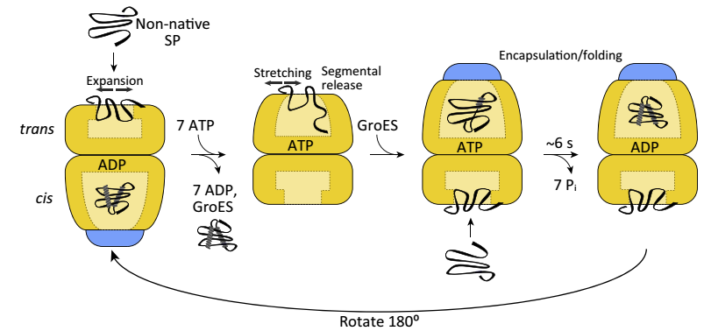
The GroEL-GroES system
Accepted model of assisted folding:
Protein + ATP binding to cis ring → protein motions → partial unfolding
1
2
3
Notes:
The binding of the protein to GroEL induces expansion and stretching motions in the protein, which lead to its partial unfolding.
Figure 5.2.3. The asymmetrical model for chaperonin-assisted protein folding. SP – substrate protein.

Slide 80
The GroEL-GroES system
Accepted model of assisted folding:
The misfolded protein binds to exposed nonpolar residues in GroEL
Notes:
Figure 5.2.4. The nonpolar lining of GroEL's inner walls. The structure used (PDB entry 1mnf) is that of GroEL bound to GroES (not shown), with each of the apical substrate-binding subunits bound to a short unfolded peptide. (b) A blowup of the peptide-binding residues from three GroEL subunits, viewed from the center of the lumen. This view was obtained by a 90º rotation of (a). The image demonstrates the nonpolar patch (yellow), which attracts misfolded proteins to GroEL. Also, highly polar residues (blue) seem to be placed between subunits, probably to prevent the bound protein from shifting from one to another.

Slide 81
The GroEL-GroES system
Accepted model of assisted folding:
GroES binding → displacing the protein inside the cage → protein folding
1
2
3
Notes:
Figure 5.2.3. The asymmetrical model for chaperonin-assisted protein folding. SP – substrate protein.

Slide 82
The GroEL-GroES system
Accepted model of assisted folding:
Protein folding inside GroEL results from a large conformational change in GroEL, induced by ATP + GroES binding
Notes:
Figure 5.2.5. Conformational and polarity changes in GroEL upon nucleotide binding. (a) The conformational change. The image shows a superimposition of the apo (nucleotide unbound) form of GroEL (PDB entry 1mnf, colored in blue) and the ADP-bound form (PDB entry 1aon, colored in yellow). In both cases a single subunit is shown, containing the apical (top), intermediate (middle) and equatorial (bottom) domains. The green arrow shows the hinge motion resulting from the conformational change. The substrate peptide, taken from the nucleotide-unbound form) is shown as a red ribbon.

Slide 83
The GroEL-GroES system
Accepted model of assisted folding:
The conformational change renders the inner walls of the apical domain polar → burial of nonpolar residues in protein core and externalization of polar residues (i.e., folding..)
Notes:
(b) The corresponding polarity change. The image shows a surface representation of the two forms of GroEL, colored according to polarity as in Figure 5.2.3. In the peptide-bound form (left image) nonpolar residues of the apical domain face the bound peptide. The hinge motion that follows nucleotide binding moves the nonpolar residues upwards, leaving a larger and more polar cavity in the vicinity of the substrate peptide (right image).

Slide 84
The GroEL-GroES system
Accepted model of assisted folding:
ATP binding to trans ring → release of GroES and folded protein
1
2
3
Notes:
Figure 5.2.3. The asymmetrical model for chaperonin-assisted protein folding. SP – substrate protein.

Slide 85
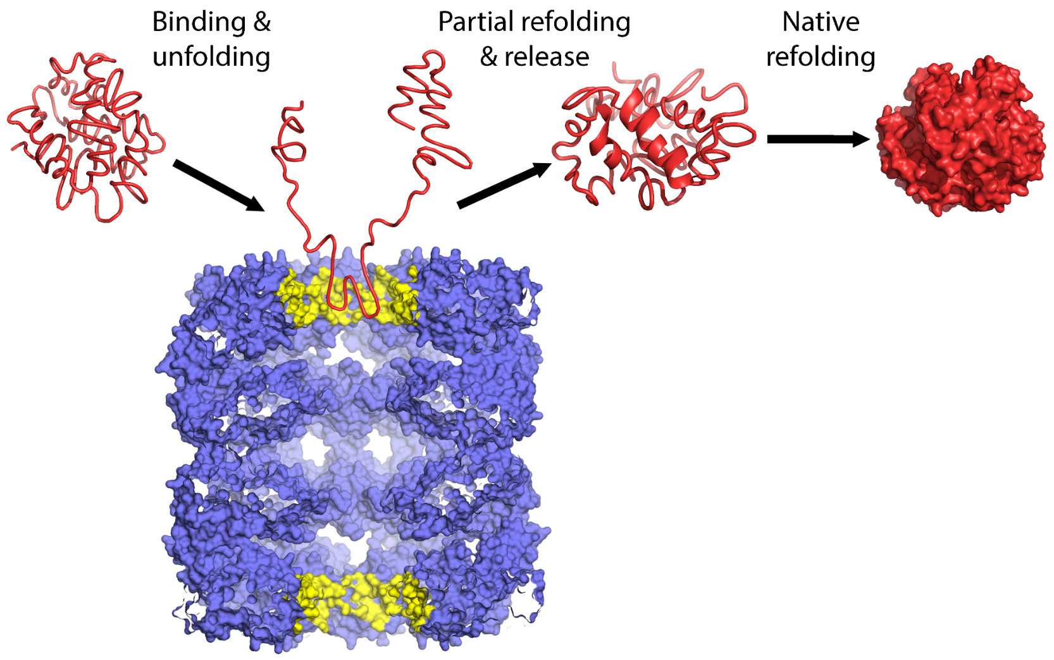
The GroEL-GroES system
Open questions:
How does GroEL induce unfolding of the protein?
Notes:
Figure 5.2.6. Scheme of apo GroEL acting as an unfolding facilitator. Apo-GroEL
(blue) mediates iterative cycles of binding to the upper cavity (yellow), unfolding, release, and out-of-cage refolding, thereby converting high-affinity misfolded polypeptide substrates (left) into partially-unfolded intermediates (center) that fold spontaneously in solution into low-affinity native products (right).

Slide 86
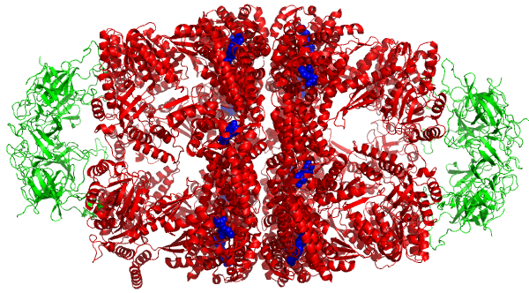
The GroEL-GroES system
Open questions:
How strong is the negative cooperativity? (football model)
HSP10
HSP60
HSP10
Nisemblat et al. (2015) PNAS 112: 6044-6049
Notes:
Some studies suggests that in the presence of a bound protein, a symmetric complex (‘football’) is possible despite the negative cooperativity, and may even be dominant. In such a structure, both rings of the chaperonin act simultaneously.
Figure 5.2.7. The structure of the human mitochondrial Hsp60-Hsp10-ADP complex, demonstrating a football shape (PDB entry 4pj1 ^{[155]}). Hsp60 is colored in red, Hsp10 in green, and ADP in blue (spheres).

Slide 87
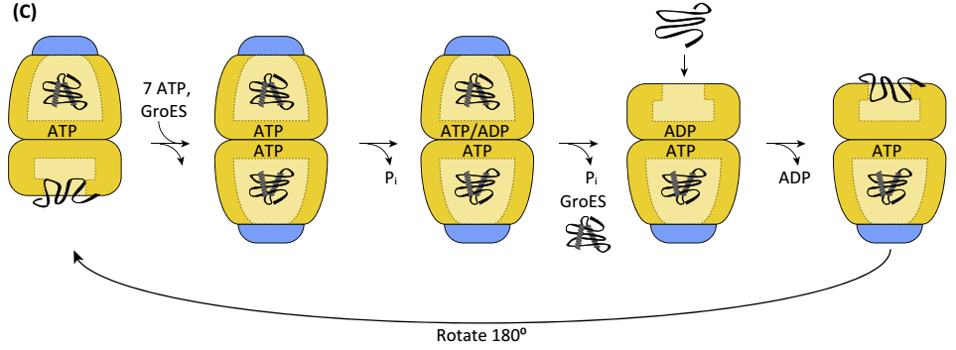
The GroEL-GroES system
The football model:
ATP + protein + GroES bind to the trans ring while the cis ring is already occupied → protein folding
ATP hydrolysis in the cis ring
1
2
3
4
Notes:
Figure 5.2.8. A symmetrical model for chaperonin-assisted folding. In this model, both rings are active in protein binding and refolding. See main text for details.

Slide 88
The GroEL-GroES system
The football model:
Release of GroES + folded protein from the cis ring
Binding of a new misfolded protein to the cis ring
1
2
3
4
Notes:
Figure 5.2.8. A symmetrical model for chaperonin-assisted folding. In this model, both rings are active in protein binding and refolding. See main text for details.

Slide 89
The GroEL-GroES system
Open questions:
Do chaperonins just provide an environment for misfolded proteins to fold, or do they actively accelerate the folding? – some studies suggest x10 acceleration

